Slide 1

Big Ideas for RE KS4 Curriculum
Islam
Beliefs (AQA A)
Created in 2019. Project funded by

Slide 2
AQA a: ISLAM, BELIEFS
Authority
• Prophethood (Risalah) including the role and importance of Adam, Ibrahim and Muhammad.
• The holy books:
• Qur’an: revelation and authority
• the Torah, the Psalms, the Gospel, the Scrolls of Abraham and their authority.
• The imamate in Shi’a Islam: its role and significance.
Key Beliefs
• The six articles of faith in Sunni Islam and five roots of Usul ad-Din in Shi’a Islam, including key similarities and differences.
• The Oneness of God (Tawhid), Qur’an Surah 112.
• The nature of God: omnipotence, beneficence, mercy, fairness and justice (Adalat in Shi’a Islam), including different ideas about God’s relationship with the world: immanence and transcendence.
• Angels, their nature and role, including Jibril and Mika’il.
• Predestination and human freedom and its relationship to the Day of Judgement.
• Life after death (Akhirah), human responsibility and accountability, resurrection, heaven and hell.

Slide 3
1: Before Islam (a) prophets
BIG IDEAS LEARNING
CONTEXT: Islam as an Abrahamic faith
CONTEXT: timeline: Jewish prophets, Jesus, Muhammad
BELIEFS: nature of prophet hood
BELIEFS: information about each prophet
From the spec→ authority; prophethood (risalah), including the role and importance of Ibrahim, Adam and Muhammad
Learning outcomes:
Who are Ibrahim and Adam
What is the role of a prophet in Islam?
Connection between prophets
RESOURCES
1 Ibrahim Adam
1 Prophets

Slide 4
Lesson 1
Show picture of the ka’aba. Built by Ibrahim, so the legend goes. Read info on Ibrahim on ‘1 Ibrahim Adam’ sheet
Mix and match ‘historical’ and ‘mythical’ knowledge –[slide x 2]. Write notes on the two types of knowledge. Is all the info about Ibrahim mythical? Is there any historical? Find examples of historical and mythical thinking- two given on slide
Define prophet [slide]. Discuss what gives prophets authority
Cut up and hand out prophets cards using ‘1 Prophets’, complete the table (slide)
Learn about Adam, info sheet ‘1 Ibrahim Adam’.
Discuss where Hawa fits in- is she a prophet? Do they have to be men?
Consolidate how Ibrahim and Adam met the role of a prophet- their authority in islam.

Slide 5
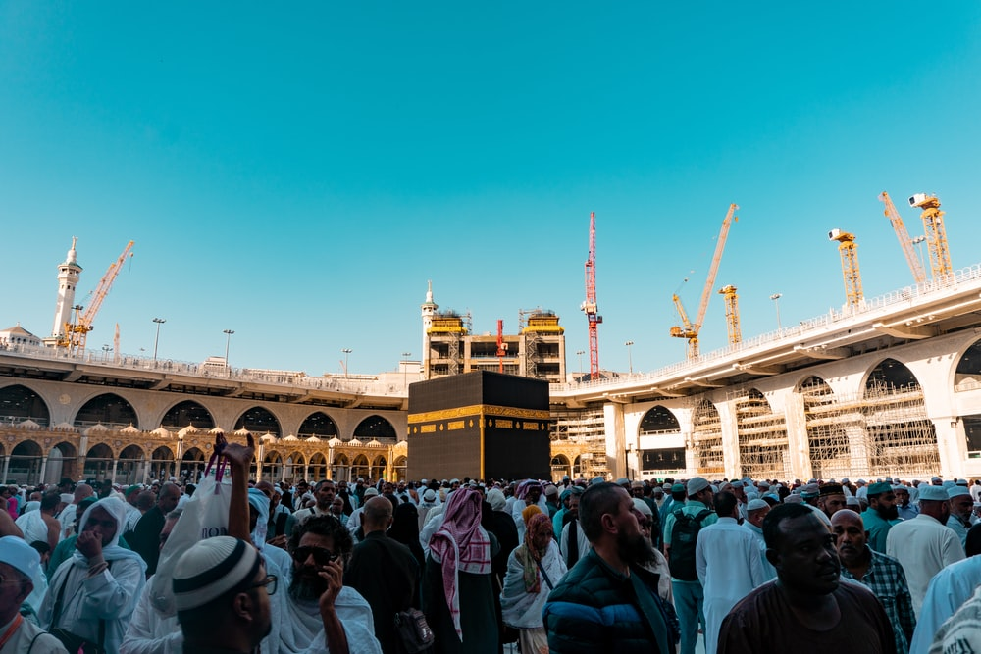
Who, Where, When ,Why, What?
Photo by Sulthan Auliya on Unsplash

Slide 6
Also known as ‘mystical’ knowledge
Looking for evidence of bias
Stories about gods and heroes which inspire courage
WE: Match the types of knowledge
Meaning; belonging; hope that things can be better
Assessing the validity of conflicting accounts
Comparing different evidence to build up understanding
Stories which contain a moral lesson
Historical | Mythical
Records of the past which shed light on the present
Stories which explain suffering and evil
Eyewitness accounts and physical evidence

Slide 7
Historical Knowledge
EXAMPLES…
Samuel Pepys’ diary describes the Great Fire of London in 1666 | God chose Moses to free the Hebrews from slavery in Egypt
Mythical
Knowledge
What happened, why did things happen, dates, people, events, causes.
Based on archaeological and written sources.
Stories of gods and heroes, accounts of incredible events which give meaning, hope and a sense of belonging. Explanations for suffering and evil.

Slide 8
Risalah (prophethood)
Prophets have been sent by God since beginning of creation; ‘every community is sent a messenger’ (Q. 10: 47)
Legend has it that 124,000 prophets have been sent.
25 are mentioned by name in the Qur’an (21 of whom are in the Bible)
Considered of equal importance: ‘We make no distinction between any of them’ (Q. 2: 136).
Some produce divinely inspired books (kutub)
In the Qur’an, a prophet:
Conveys God’s messages to humanity
Does not adapt or alter God’s message in transmission
Lives a perfect life to provide a living role model
Receives guidance from God in meeting this standard
Leads and guides the community so they can live according to God’s wishes
TASK: What does it mean to be a Prophet?

Slide 9
Prophets of Islam
BIBLICAL NAME | ISLAMIC NAME | WHAT THEY DID
YOU TASK: Explain How Adam and Ibrahim meet the role of a prophet? What is their authority in Islam?
12 mark Q: ‘For Muslims, Adam is a more important Prophet than Ibrahim.’
Notes:
Prophets card
Ibrahim Adam
Discuss where Hawa fits in –is she a prophet?

