Slide 1

Big Ideas for RE
KS4 Curriculum
Islam
Practices (AQA a)
Created in 2019. Project funded by

Slide 2
1: How Islamic is the Hajj?
From the spec→ Hajj: role and significance including origins, actions performed at sites including the Ka’aba at Makkah, Mina, Arafat, Muzdalifah and their significance.
Learning outcomes:
Explain Muhammad’s connection to the Hajj
Explain at least two pre-Islamic elements of Hajj from the legend of Ibrahim
Express a justified view as to how Islamic the Hajj is
BIG IDEAS LEARNING
CONTEXT: historical context of the Hajj
PHILOSOPHY: discussion of what makes Hajj Islamic
Resources
1 Ibrahim Adam (Islam beliefs lesson 1)
1 Hajj before Islam
1 Hajj: a history

Slide 3
Lesson 1
Starter: show a Christmas tree- discuss if it is religious? what makes it religious? (Christianity Practices lesson 9). Show religious ethical teachings (SLIDE). Are these passages religious? What makes them religious?
Brainstorm information about Ibrahim. Recap Ibrahim (using Islam Beliefs ‘1 Ibrahim Adam’).
Cut up ‘1 Hajj before Islam’ into a card sort. Students connect elements of the Ibrahim legend with modern Hajj (answers on slide).
Define the phrase ‘pre-Islamic’. These are pre-Islamic elements of Hajj, meaning their origin lies before the life of Muhammad and the Muslim community.
Read the paragraph ‘Guardians of the Hajj’ on resource ‘1 Hajj: a History’ to find out about Muhammad’s connection to the Hajj. Highlight lines describing the placing of stones. Discuss whether, because this is a Semitic (Middle-Eastern, including Jews) practice, rather than a strictly Arabic practice, it is pre-Islamic or even ‘non-Islamic’? Collect arguments on the board as students discuss.
Focus on Muhammad’s connection to the Hajj. Ask students to underline what they think is the most important element that links Muhammad to the Hajj. Listen to answers. Discuss what makes Hajj religious, and what makes it Islamic. Collect arguments.
Read the ‘Hajj traditions’ and ‘hajj logistics’ paragraphs. Discuss if this information makes the Hajj Islamic. Collect arguments.
Debate and answer the question: how Islamic is the Hajj? Groups must use at least two arguments already articulated (or new arguments).
Answer the question in notes in no more than 20 words.

Slide 4
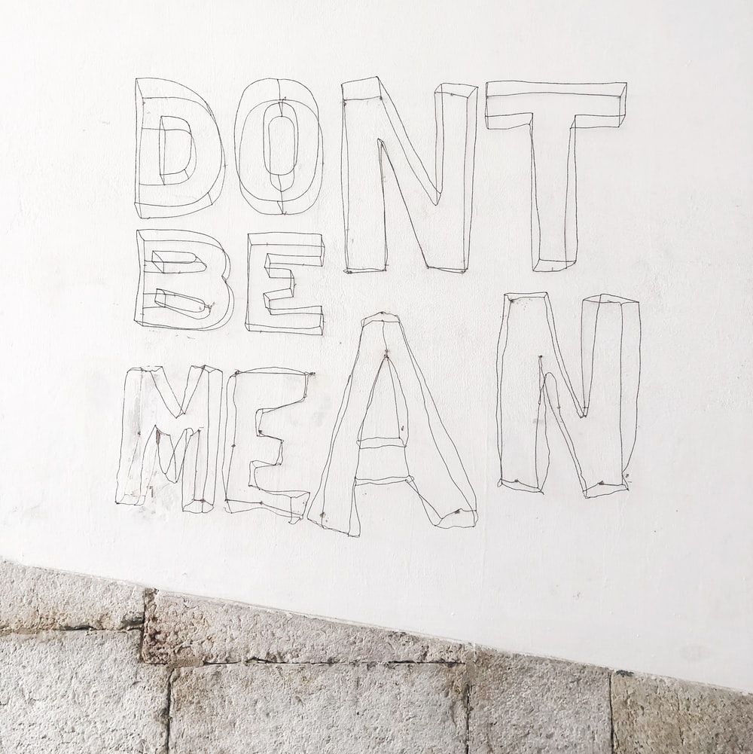
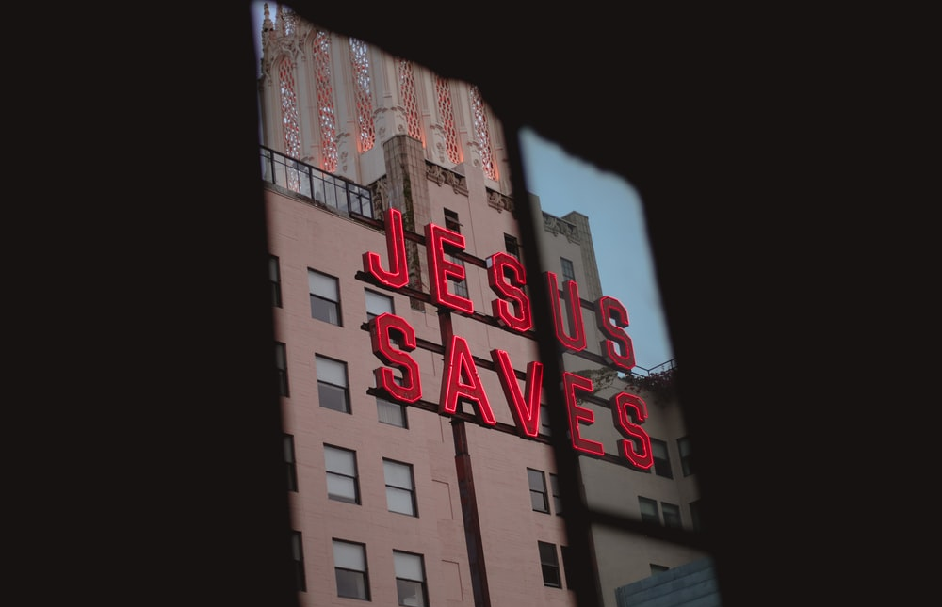
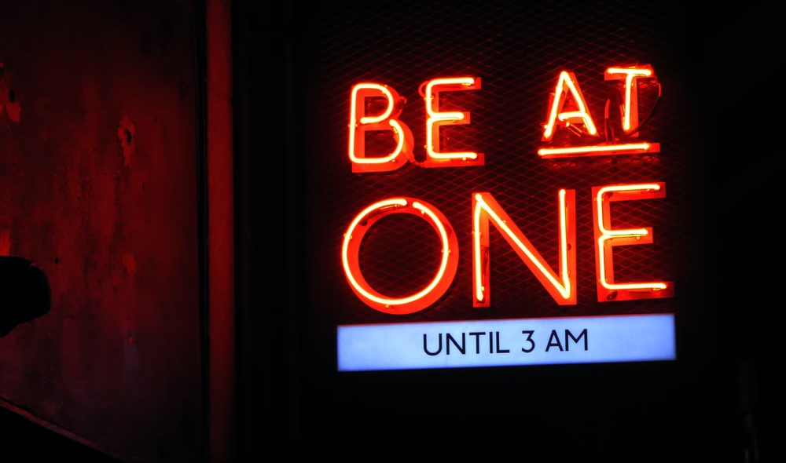

Notes:
Don’t be mean: Photo by Ashley Whitlatch on Unsplash
Jesus saves: Photo by Jason Betz on Unsplash
Live well: Photo by Brett Jordan on Unsplash
Be at one: Photo by Nick Fewings on Unsplash

Slide 5
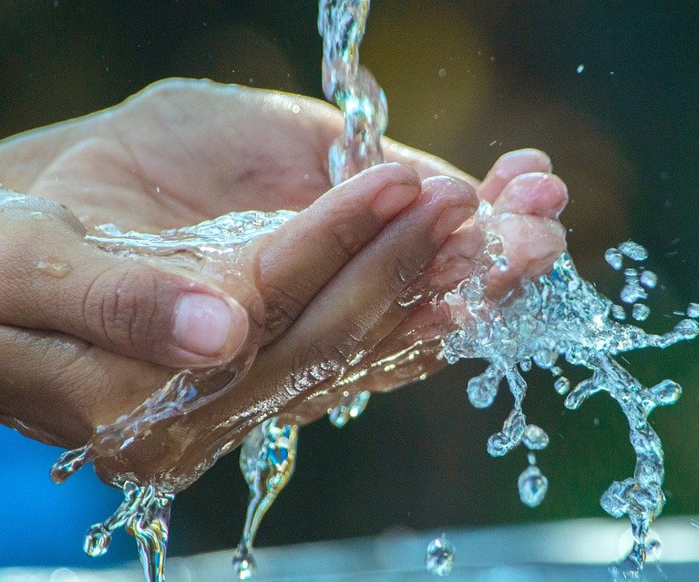
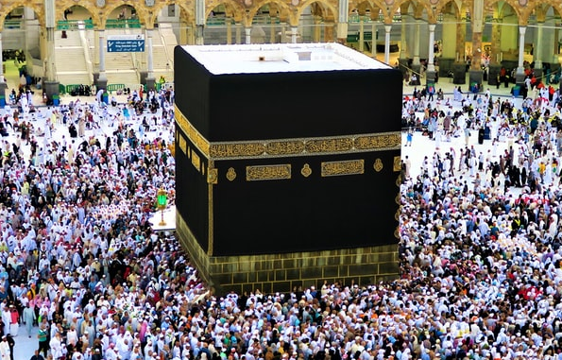
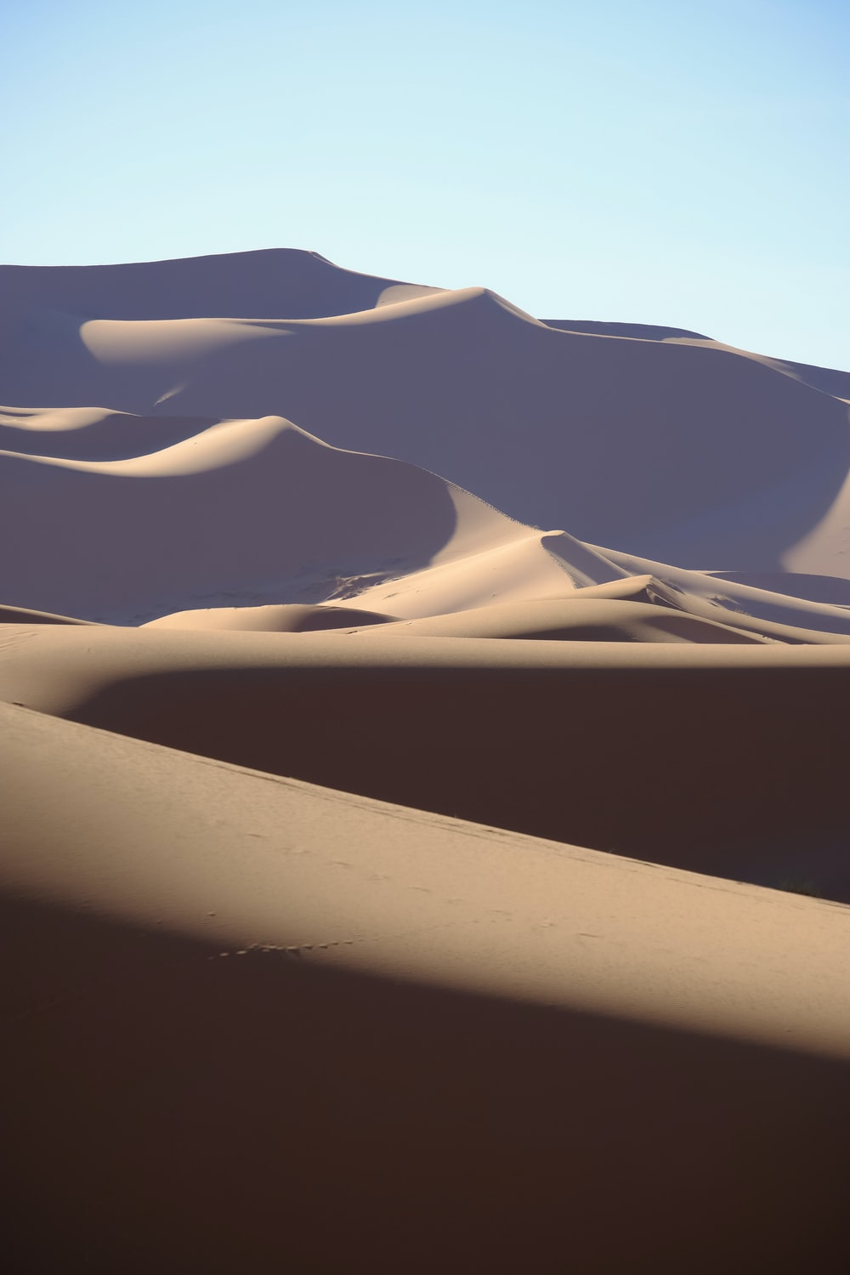
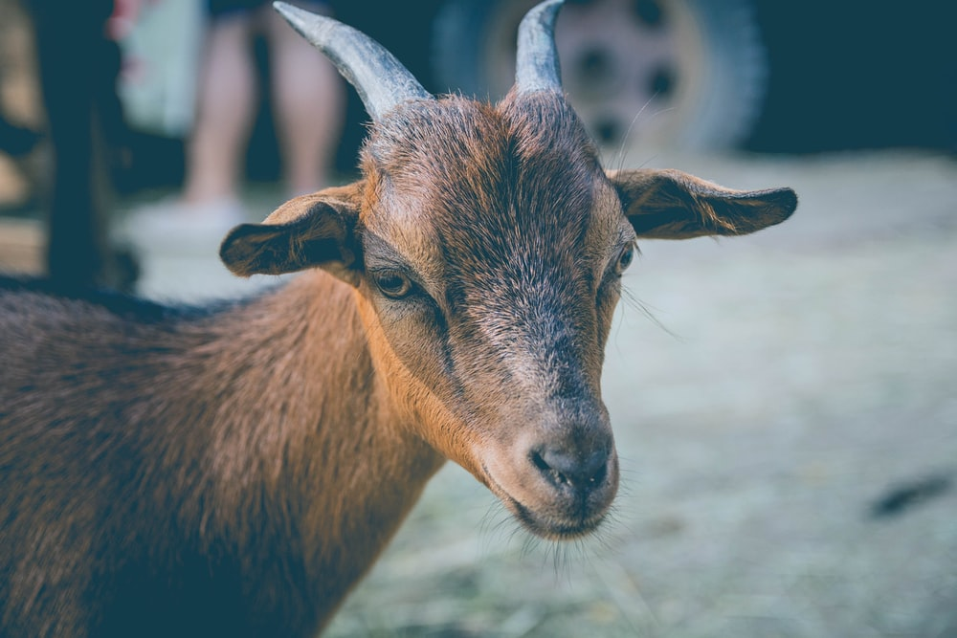
Hajj before Islam
As she ran between the stones of Safa and Marwa, Hajar noticed Ismail poking at the ground. This was the spot where the angel Jibril’s wing had touched. There the spring of Zam Zam appeared and saved them.
Jibril revealed a black stone to Ibrahim. Ibrahim asked his son Ismail to lay the stone as a sign of devotion to God. This is the black stone of the Ka’aba.
‘Feast of sacrifice’
Muslims remember Ibrahim’s willingness to sacrifice his son Ismail on God’s command. He showed perfect obedience to God
Ibrahim’s wife and son, Hajar and Ismail, were alone in the desert. Desperate for water, Hajar ran seven times between the stones of Safa and Marwa.
Notes:
Ka’ba: Photo by ekrem osmanoglu on Unsplash
Ram: Photo by Alvaro Reyes on Unsplash
Desert hils: Photo by Zack Woolwine on Unsplash
Water: https://pixabay.com/photos/hands-water-wash-color-source-4903050/

