Slide 1
Big Ideas for RE KS4 Curriculum
Islam
Beliefs (AQA A)
Created in 2019. Project funded by

Slide 2
3: The Seal of the Prophets
BIG IDEAS LEARNING
CONTEXT: recap (from KS3) Muhammad’s time and place
BELIEFS: about the prophet
BELIEFS: recap beliefs about prophethood
From the spec→ prophethood, Muhammad (authority)
Learning outcomes:
Muhammad’s time and place
Muhammad’s journey to becoming a prophet
Why Muhammad is called the ‘seal of the prophets’
RESOURCES
1 Ibrahim Adam
2 Kutub
3 A man called Muhammad

Slide 3
Lesson 3
Return to info on Adam and Ibrahim. Teach that prophets cannot commit sins because they are guided by God. Do students think either did commit sins? Discuss. Through discussion recap basis of prophet’s authority and beliefs about prophets in Islam.
Learn about Muhammad, using ‘3 A man called Muhammad’.
Find Arabic names online, display a list. Ask groups to create a tribe and give it a name. After reading the information (3 A man called Muhammad), write notes on what your tribe is worried about and what it needs. Write notes on what attracts your tribe to a man called Muhammad.
Recap mythical and historical thinking- how much of the Muhamad info is mythical and how much historical?
Using info on prophets and kutub- ask groups to explain the title ‘seal of the prophets’ in 25 words (use word grid on slide). Listen to answers.

Slide 4
Do Now:
HAP/MAP
Write 3 reasons why Adam is important in Islam
Write 3 reasons why Ibrahim is important in Islam
Father of mankind
Built the Ka’aba (1st place of worship)
Passed knowledge onto the rest of human race (e.g. how to plant seeds/harvest crops but also to worship Allah)
Caretaker of the Earth
Teaches Muslims about finding salvation since Adam disobeyed Allah but repented
Do now
He declared and shared his belief in one God (Allah)
Stopped idol worship
Rebuilt the Ka’aba
His obedience to Allah by being prepared to sacrifice his son
Id-ul-adha and Hajj remembers the actions of Ibrahim

Slide 5
Do Now: Think back to Adam and Ibrahim…
LAP
Which phrases best describes each prophet?
Put the phrases below in the correct column
Adam | Ibrahim
Do now
Id-ul-adha obedience (since prepared to sacrifice his son)
Stopped idol worship Hajj
Father of mankind Built the Ka’aba
Caretaker Found salvation since he disobeyed Allah but repented
declared and shared his belief in one God (Allah)
Rebuilt the Ka’aba

Slide 6
Prophets cannot commit sin!
It is argued that prophets cannot commit sins because they are guided by God.
Think, pair, share
“Did Adam and Ibrahim commit sins?”
We

Slide 7
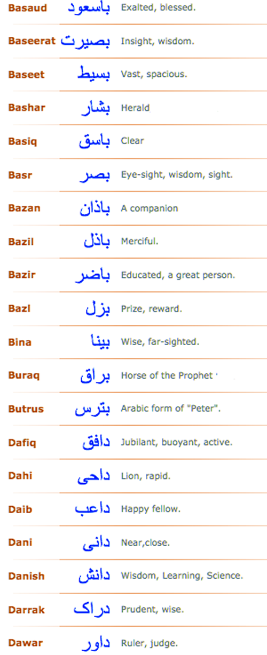
Understanding the context of Muhammad: THE TRIBE IN 7TH CENTURY ARABIA
Get into groups of 4
This is your tribe!
Choose a name using the Arabic names on the left
Read the fact file
Write notes on what your tribe is worried about and what it needs.
Write notes on what attracts your tribe to a man called Muhammad.
Be prepared to feedback!
10 minutes, go!
We

Slide 8
Mythical or historical?
How much of the Muhammad information is mythical?
How much is historical?
You

Slide 9
25 WORDS: WHY IS MUHAMMAD CALLED THE ‘SEAL OF THE PROPHETS’?
The ‘seal of the prophets’: understanding
Because…
We

Slide 10
Exit ticket
Explain two reasons why Muhammad is considered to be the most important prophet in Islam [5 marks]
One reason why Muhammad is the most significant prophet in Islam
is……
This is because it highlights…
Another reason why Muhammad is thought of as so important to
Muslims is …..
This indicates….
You

