Slide 1

Big Ideas for RE KS4 Curriculum
Islam
Beliefs (AQA A)
Created in 2019. Project funded by

Slide 2
4: Submission
BIG IDEAS LEARNING
BELIEFS: beliefs about God in Islam
CONTEXT: beliefs about God found in the Qur’an (Surah 112)
CONTEXT: rejection of monotheism in early Islam
Learning outcomes:
Link idea of submission to Ibrahim and Muhammad
Roots of Islamic monotheism
Explain why the religion is called ‘submission’
From the spec→ Tawhid, the nature of God, Surah 112; omnipotent, benevolent, merciful, just, immanent, transcendent
RESOURCES
3 A man called Muhammad
4 Tawhid
4 What does the Qur’an say about God?

Slide 3
Lesson 4
Now do: Display an image of Eid ul-Adha. Do the class know what this Eid commemorates? Ibrahim’s willingness to sacrifice his son Ismail. Ask groups to explain why at that moment Ibrahim showed perfect submission to God. Recall (from lesson 3) what the words ‘Islam’ and ‘Muslim’ mean. How did Ibrahim and Muhammad submit to God?
Hook: Read section 1 of ‘4 Tawhid’, ‘Muruwah’. Discuss what spiritual and political crisis the Arabs faced. Return to the tribal record established last lesson, add notes.
How did Muhammad ring the tribes together? Write notes in tribal record.
I (teacher exposition): Read to or read with the class the remainder of ‘Tawhid’ sheet, 2: Islam. Ensure understanding. Define ‘monotheism’.
We (paired/ group activity): discuss- Why did Muhammad insist upon absolute monotheism? Listen to answers.
We: hand out sections of ‘what does the Question say about God?’ worksheet- for 4 or 8 groups (double up if using 8 groups). Students use an online Qur’an such as http://al-quran.info/#home or physical copies if you have them. Students record how God is described in their 3 or 2 passages. Lay on tabletops, students walk around the room looking at passages they did not research.
Discuss questions on board
We: Read Surah 112. What could this passage be a reaction to? (it is a rejection of the Christian trinity).
You: Return to the tribal record. Explain why your new way of life is called ‘submission’.
Exit ticket: make a connection between Muhammad and Ibrahim

Slide 4
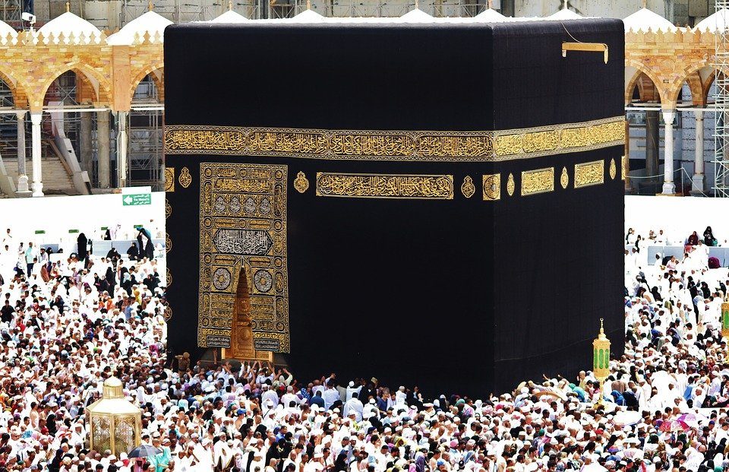
What does Eid ul Adha commemorate?
Image: https://pixabay.com/photos/religious-muhammad-religion-islam-2262799/

Slide 5
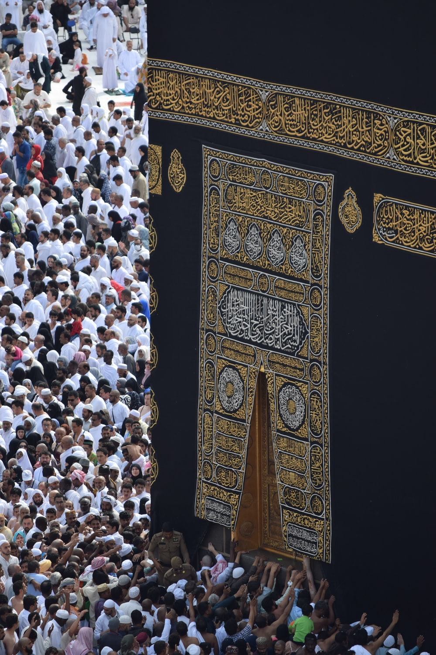
What did God ask Ibrahim to sacrifice?
How did Ibrahim respond?
Why do Muslims remember Ibrahim’s actions?
What do the words ‘Islam’ and ‘Muslim’ mean?
Image: Photo by Haidan on Unsplash

Slide 6
Hook Read section 1, Muruwah
1: Discuss in groups:
What crisis did the Arab tribes face?
2: Turn to ‘Tribal Record’ (last lesson)
Add notes. Finish this sentence starter:
‘the Arab tribes are in crisis because…’
3: Discuss in groups:
What happened to Muhammad in 620 CE?
How did this bring the tribes together?
3: Write notes in tribal record. Finish sentence starters:
‘An amazing thing happened to Muhammad…’
‘This means for the tribes…’

Slide 7
We (paired/ group activity)
Discuss:
Why did Muhammad insist upon absolute monotheism?
Was this a good or bad idea?
Complete ‘What does the Qur’an say about God?’ worksheet (groups)
Definition: monotheism
Belief in one God
Loyalty to one God
‘mono’= one, ‘theos’ = God (Greek)

Slide 8
We (paired/ group activity)
Definition: immanent
Close to humans, interested in humans
Definition: transcendent
Beyond the earth and the material/ physical world
After you have read all the passages describing God, find one that reflects God as:
Omnipotent
Benevolent
Merciful and fair
Creator
Transcendent
Immanent
Discuss: which is the strongest argument for monotheism? Why?

Slide 9
We Discuss: what do you think this surah could be a reaction to? (clue: another religion)
Qur’an 112
‘Monotheism’
Say, ‘He is Allah, the One.
Allah is the All-embracing.
He neither begat, not was begotten,
Nor has He any equal.’

Slide 10
You (independent working)
Update your tribal record:
Explain what has changed in your tribe since Muhammad has his first revelation
Explain why the new way of life is called ‘submission’
Exit ticket:
Can you make a connection between Muhammad and Ibrahim?

