Slide 1

Big Ideas for RE KS4 Curriculum
Islam
Beliefs (AQA A)
Created in 2019. Project funded by

Slide 2
5: What is and isn’t a Qur’an?
From the spec→ The holy books: Qur’an: revelation and authority
Learning outcomes:
Explain what gives the Qur’an authority
Explain why a Qur’an is in Arabic only
BIG IDEAS LEARNING
BELIEFS: recap books as revealed
BELIEFS: the Qur’an as revelation, importance of Arabic
DIVERSITY: different ways of interpreting the Qur’an
RESOURCES
5 How is the Qur’an read

Slide 3
Lesson 5
Do now: brainstorm in pairs: how was the Qur’an revealed? Give points for any of: revealed to Muhammad over 23 years, cave hira, previous revealed books (kutub), Qur’an means ‘recitations’
Hook: is information about the Qur’an mythical or historical? Discuss, share answers.
I (teacher exposition): what is a ‘true’ is a Qur’an? Image of Qur’an on screen→ ask if a Qur’an in translation is a ‘true’ Qur’an? It is not- it has to be in Arabic to be a Qur’an
We: Give different types of writing, such as a poem, a newspaper article, private correspondence between friends and a post on social media. Lastly- a holy book. Discuss questions on screen.
We: Read Daniel Brown in the first section of ‘5 How is the Qur’an read?’ Ask pairs to underline or highlight three ways in which the Qur’an can be read.
You: identify as a class the three purposes for reading, or three ways of reading. Which way of reading do students think they might be most inclined to employ?
We: read the second section of ‘5 How is the Qur’an read?’- Karen Armstrong. Pairs underline or highlight any information that tells them how the Qur’an should be read.
You: share and discuss as a class. Discuss the question: how is the Qur’an read? Why?
Exit ticket: give an answer using the information form today’s lesson to the question: what is the Qur’an?

Slide 4
Do Now
Brainstorm in pairs
How was the Qur’an revealed?
Is information about the revelation of the Qur’an historical or mythical information?

Slide 5
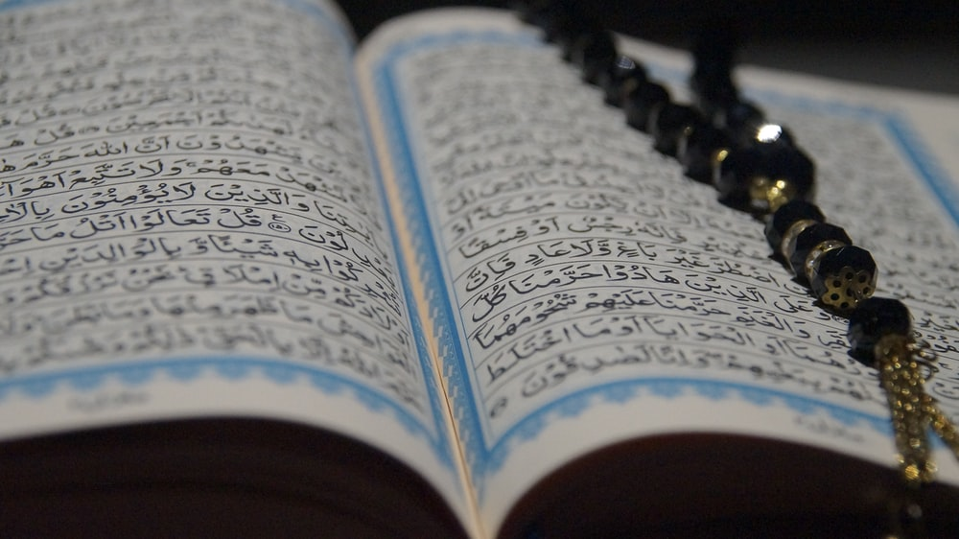
What is a ‘true’ Qur’an?
Photo by Ayesha Firdaus on Unsplash

Slide 6
poem
Newspaper article
Private letters between friends
Post on social media
WE: Discuss:
Would you read a newspaper in the same way you read a personal letter?
How is a personal letter different to a post on social media?
Which one do you read for information?
Which one do you read for reflection and insight?
Image: Qur’an
How are holy books read?

Slide 7
We (1) Read Daniel Brown info (2) Underline or highlight three ways in which the Qur’an can be read. (3) What three ways of reading the Qur’an can you identify? (4) Which way of reading do you think you might be most inclined to employ?
(5) Read Karen Armstrong info
(6) Underline or highlight any information detailing how the Qur’an should be read.
(7) How is the Qur’an read? Why?
What is the Qur’an?
Use at least one piece of info from today’s lesson

