Slide 1

Big Ideas for RE
KS4 Curriculum
Christianity
Practices (AQA a)
Created in 2019. Project funded by

Slide 2
9-10: Easter and Christmas: is there a ‘true meaning’?
BIG IDEAS LEARNING
CONTEXT: Christian settlers added Easter and Christmas to already existing midwinter and spring festivals.
BELIEFS: recap significance of evangelism, link to spread of Christianity
BELIEFS: purpose, events and symbolism of Christmas and Easter festivals
From the spec→ Christmas & Easter; importance for UK Christians
Learning outcomes:
Connect belief in Incarnation to three Christmas symbols
Connect belief in salvation to three Easter symbols
Explain the Christian meaning of both these festivals
Resources
9 Christmas symbols
10 Easter Symbols
To recap: 1 passion timeline (from Christianity beliefs unit)

Slide 3
Lesson 9
Show images of Christmas (next slide). Ask the class to discuss in groups which are Christian and which are not Christian symbols. Listen to answers.
Cut up ‘9 Christmas symbols’ into cards, hand out. Groups move into ‘Christian’ and ‘pre-Christian’ piles. Share and discuss.
Give out highlighters. Ask groups to highlight all Midwinter or Yule traditions that have become part of Christmas. Recap evangelism (lesson 1). Is this a brilliant example of Christian evangelism?
Look at the ‘Incarnation beliefs’ (subsequent slide). Define ‘Incarnation’. Can students find symbolism for this key Christian concept in any of the Christmas symbols? Discuss.
EXTENSION: read Luke 2: 1-21 for more detailed information.
Pairs or groups make a ‘non-Christian’ AND a ‘Christian’ Christmas card. The Christian card must show three symbols denoting Incarnation beliefs. The non-Christian Christmas card can show any outlooks on the planet, people or the time of year. Display in class.
Briefly discuss question: is there a ‘true’ meaning of Christmas?

Slide 4
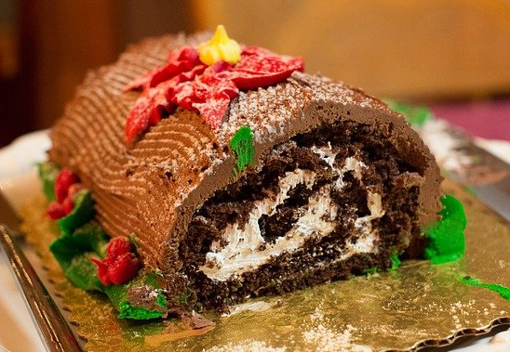
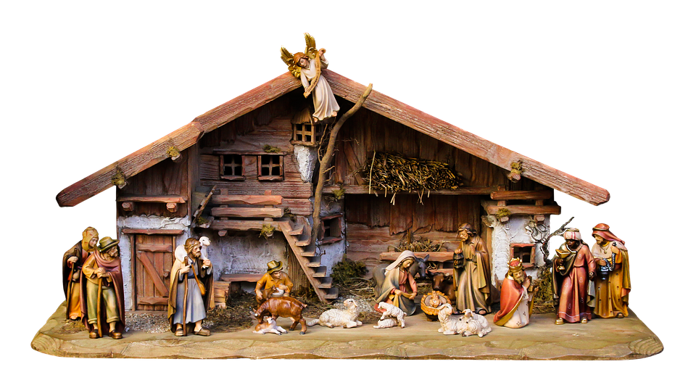
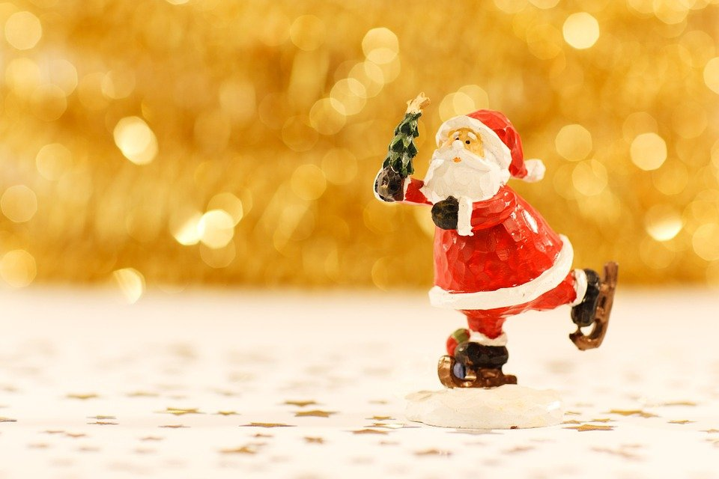

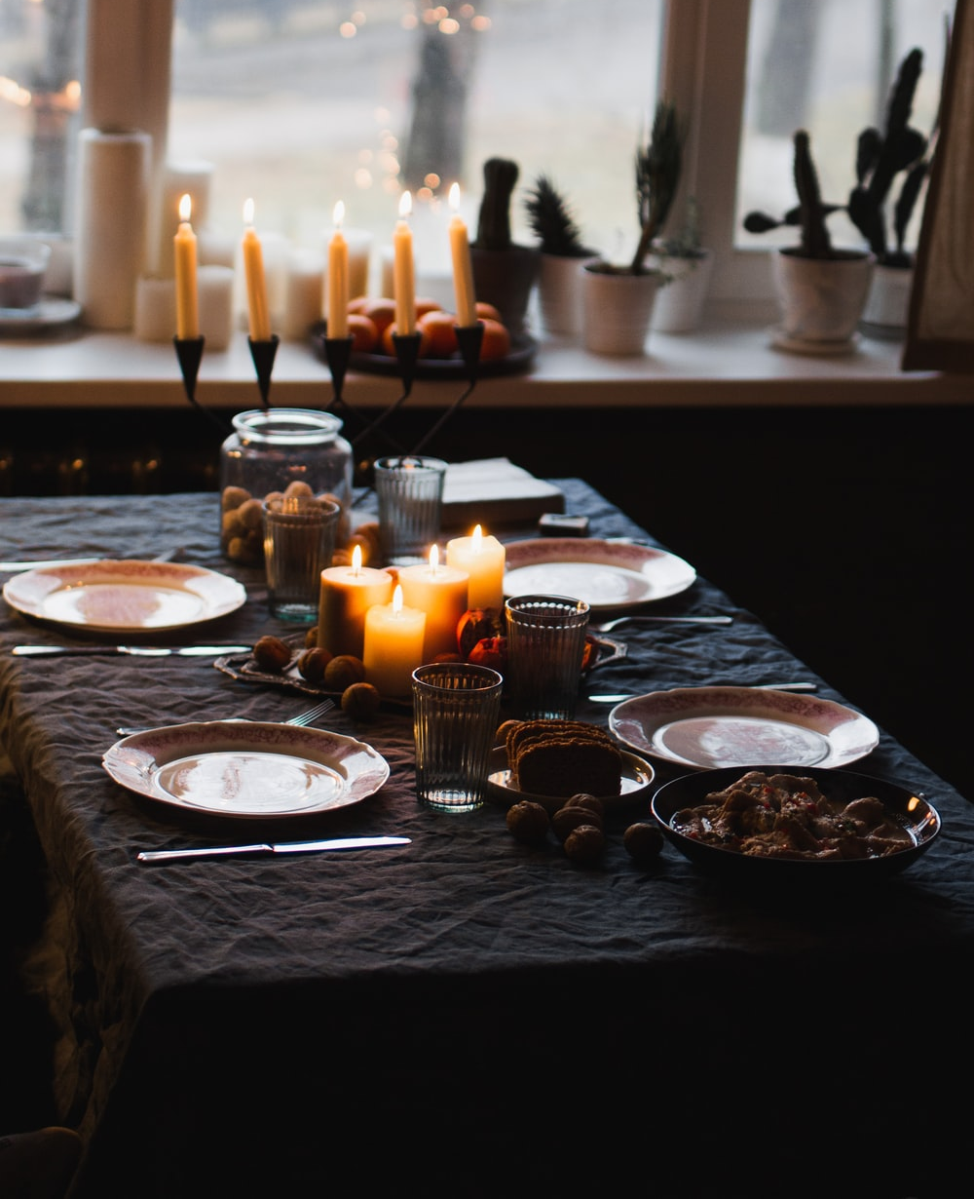
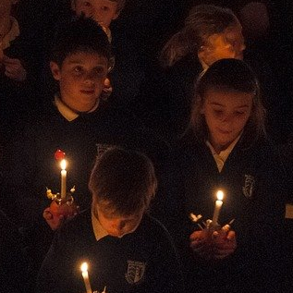
Father Christmas | Yule log | Baby Jesus/ Nativity
Presents | Feasting & Lights | Christingle
Notes:
Father Christmas: https://pixabay.com/photos/christmas-santa-claus-figurine-xmas-2918/
Yule log: https://pixabay.com/photos/christmas-dinner-dessert-christmas-3881666/
Nativity: https://pixabay.com/photos/christmas-nativity-scene-crib-1875885/
Presents: Photo by Mel Poole on Unsplash
Feasting: Photo by Vladimir Gladkov on Unsplash
Christingle: https://pixabay.com/photos/christdingle-xmas-candle-religion-1260406/

Slide 5
Incarnation Beliefs
The angel came to her and said, “Peace be with you! The Lord is with you and has greatly blessed you!”
Mary was deeply troubled by the angel’s message, and she wondered what his words meant. The angel said to her, “Don’t be afraid, Mary; God has been gracious to you. You will become pregnant and give birth to a son, and you will name him Jesus. He will be great and will be called the Son of the Most High God. The Lord God will make him a king, as his ancestor David was, and he will be the king of the descendants of Jacob for ever; his kingdom will never end!”
Mary said to the angel, “I am a virgin. How, then, can this be?” The angel answered, “The Holy Spirit will come on you, and God’s power will rest upon you. For this reason the holy child will be called the Son of God.”
(Luke 1: 28-35)
So Joseph also went up from the town of Nazareth in Galilee to Judea, to Bethlehem the town of David, because he belonged to the house and line of David. He went there to register with Mary, who was pledged to be married to him and was expecting a child. While they were there, the time came for the baby to be born, and she gave birth to her firstborn, a son. She wrapped him in cloths and placed him in a manger, because there was no guest room available for them. (Luke 2: 4-7)
For God loved the world so much that he gave his only Son, so that everyone who believes in him may not die but have eternal life. For God did not send his Son into the world to be its judge, but to be its saviour. (John 3: 16-17)
Jesus answered him, “I am the way, the truth, and the life; no one goes to the Father except by me. “
(John 14:6)

Slide 6
Lesson 10
Recap last lesson’s question: is there a true meaning of Christmas? Look at the Christian and non-Christian Christmas cards the class created last lesson.
Repeat process with Easter symbols. Show images of (next slide): Which are Christian and which are not Christian symbols?
Hand out ‘10 Easter Symbols’ as cards. Groups spilt into ‘Christian’ and ‘not Christian’ (or ‘pre-Christian’) piles.
Groups highlight all pre-Christian traditions that have become part of Easter.
Hand out ‘1 passion timeline’ (from Christianity beliefs unit). Ask groups to match up events of the beliefs around the Passion with symbols of Easter.
As last lesson, groups create a Christian or non-Christian Easter card. The Christian card must show three symbols denoting Passion events or beliefs about the passion. The non-Christian card can show any outlooks on the planet, people or the time of year. Display
Recap last week’s question: this a brilliant example of Christian evangelism?
Answer the question- is there a ‘true’ meaning of Easter and Christmas?

Slide 7
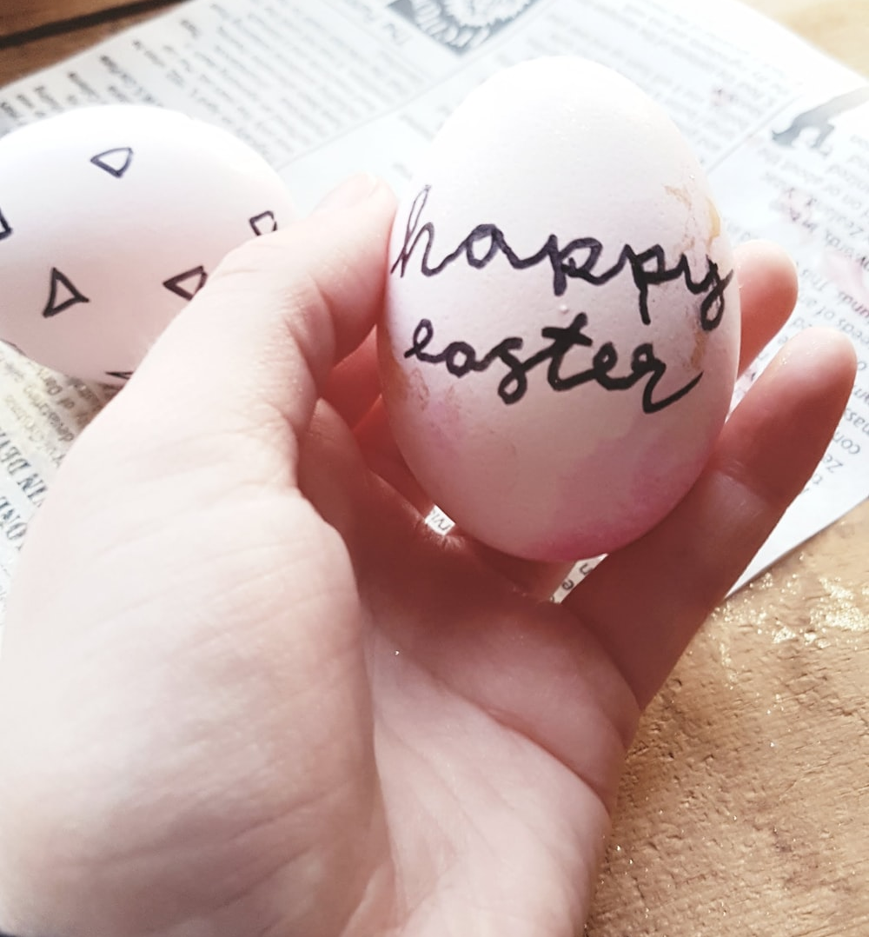
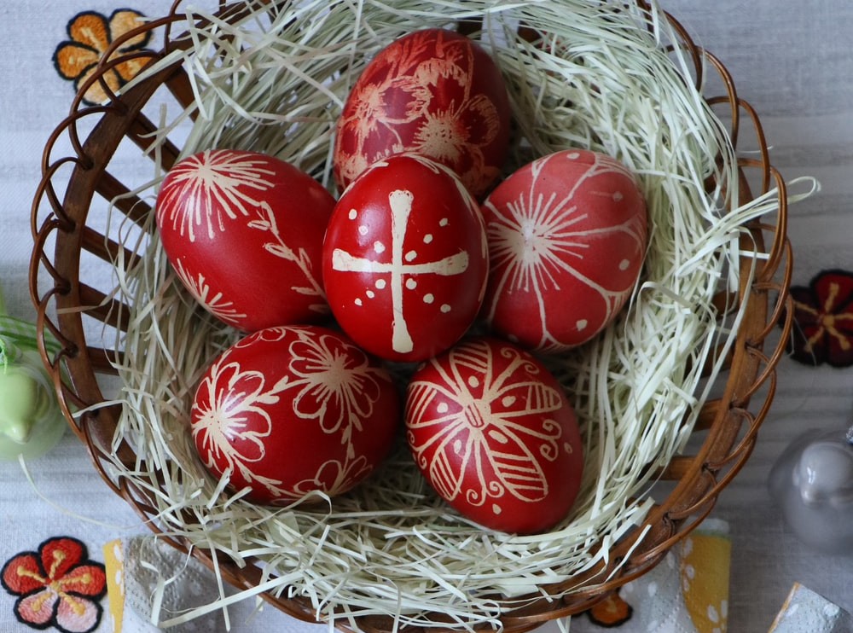
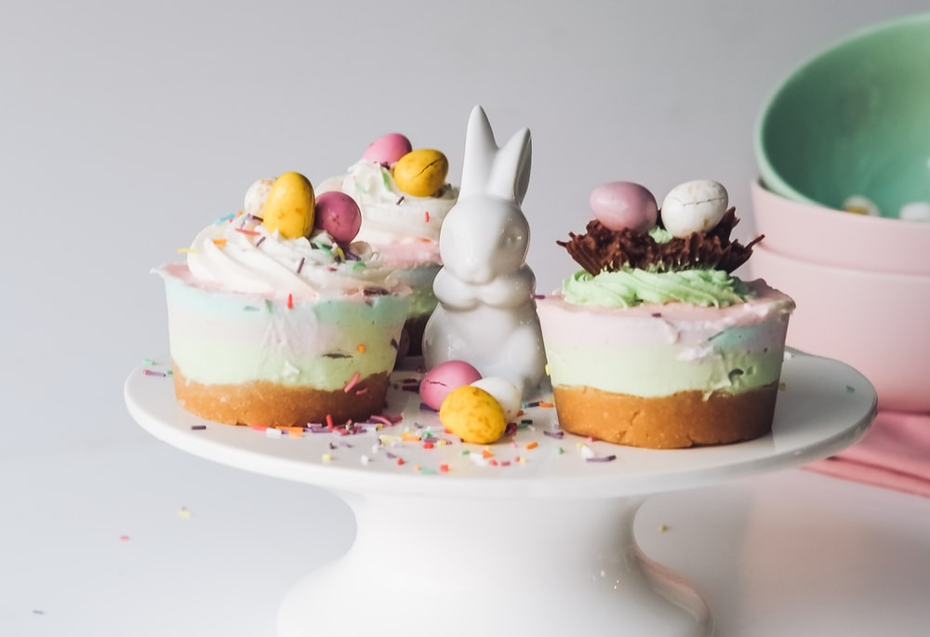
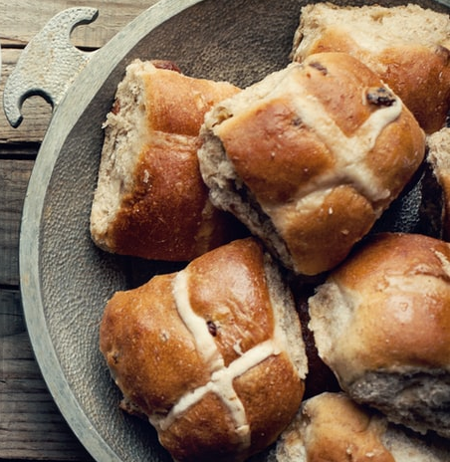
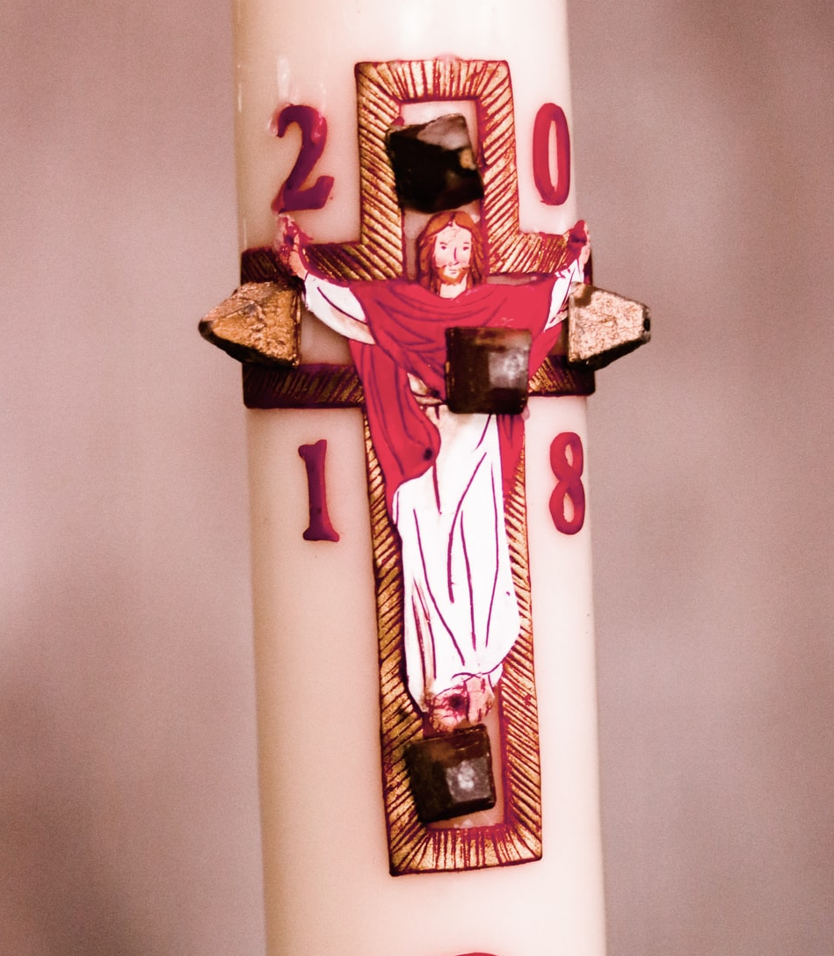
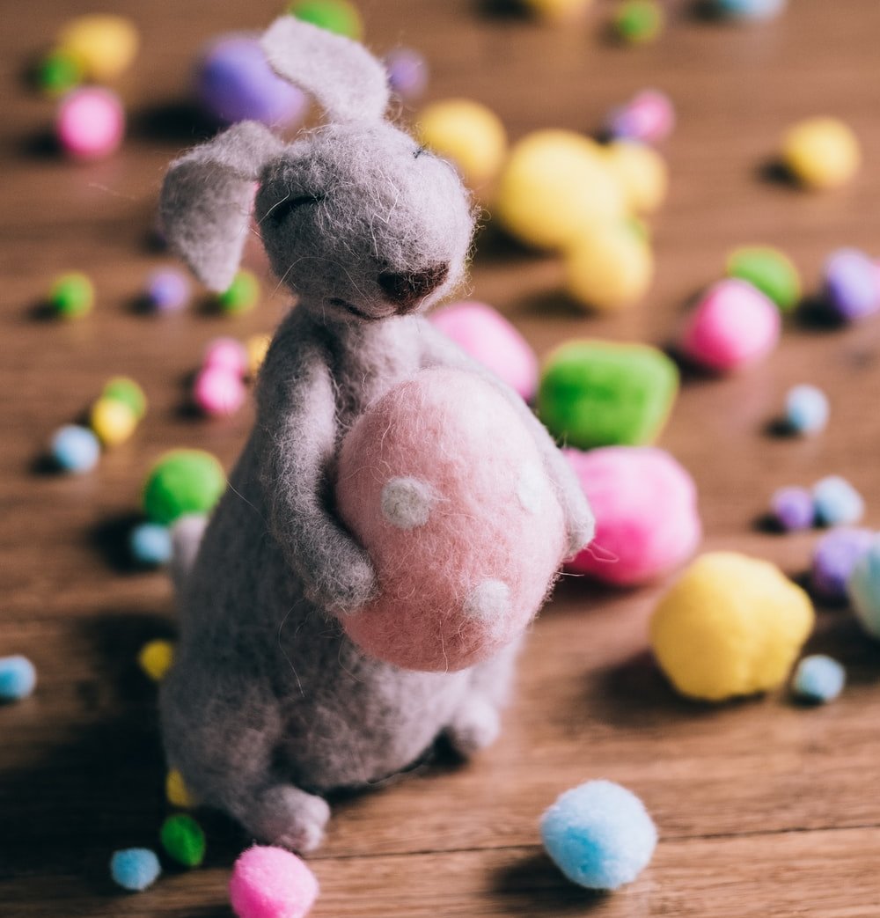
Easter/ Pascha | Chocolate Eggs | Decorated Eggs
Hot Cross Buns | Paschal Candle | Easter Bunny
Notes:
Easter: Photo by Sweet Amaryllis on Unsplash
Chocolate eggs: Photo by Melissa Walker Horn on Unsplash
Decorated eggs: Photo by Σελήνη on Unsplash
Hot cross buns: Photo by Jasmine Waheed on Unsplash
Paschal candle: Photo by DDP on Unsplash
Easter bunny: Photo by freestocks on Unsplash

