Slide 1
Big Ideas for RE KS4 Curriculum
Islam
Beliefs (AQA A)
Created in 2019. Project funded by

Slide 2
9-10: Do all Muslims believe the same thing?
BIG IDEAS LEARNING
CONTEXT: roots of Sunni/ Shi’a split
PHILOSOPHY: how significant are differences in S&S
BELIEFS: identifying Shi’a/ Sunni- specific beliefs
From the spec→ five roots of Usul ad-Din in Shi’a Islam, including key similarities and differences, Adalat in Shi’a Islam, The imamate in Shi’a Islam: its role and significance.
The six articles of faith in Sunni Islam
Learning outcomes:
Understand 5 roots of faith (Shi’a) and 6 articles of faith (sunni)
Shi’a or Sunni- specific beliefs about angels, life after death, predestination, Adalat, imamate
Answer key question: core beliefs the same? Or different?
RESOURCES
9 Do all Muslims believe the same thing?
10 Faith mix and match
10 Faith similarities differences
10 Imamah

Slide 3
Lesson 9
Do now: brainstorm Muslim beliefs. Discuss: do all Muslims adhere to these?
Hook: find images online showing mosques around the world in different regions, such as India, Arab countries, Egypt, Russia, Nigeria, Ethiopia and Central Asia. Discuss variations and similarities. Return to initial question: do students think Muslims believe the same thing or are there variations?
I: Recap free will continuum from last lesson; which are Shi’a views (Adl and Mu’tazilite view), how are they different from Sunni views (al-Qadr, Asharite)? Discuss if this is a core difference, or a variation on a core belief.
Show a map of the Middle East and Asia, pinpoint Iran (formerly known as Persia); the centre of the Shi’a world. Look at images of Iran- Persian style architecture, holy city of Qom.
We/ You: Handout ‘9 Do all Muslims believe the same thing? Sheet. Support students in the second task- they will go through their notes collecting information on the Sunni articles of faith. Give groups time, and check all have the correct information before summarising into 10-word sentences.
Exit ticket: what beliefs are shared by Sunni and Shi’a?

Slide 4
Do now
What are Muslim beliefs?
Brainstorm with a partner all Muslim beliefs you have learned
Discuss: do ALL Muslims follow these beliefs?

Slide 5
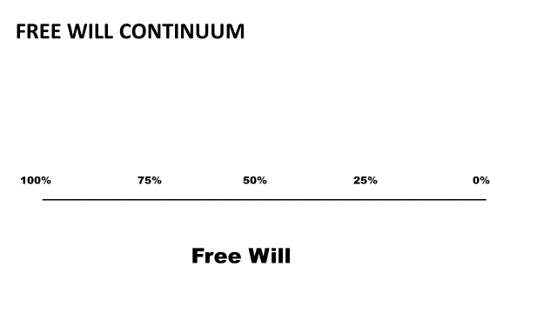
humans must have total free will as God, who is perfectly good, cannot cause evil
All human lives are predestined before the individual is born
Humans have some freedom of action, and total freedom of thought
God is just and cannot will evil.
Are these core differences? Or variations on a core belief?
Which two views are Sunni views?
Which two views are Shi’a views?

Slide 6
Iran, formerly Persia,
an ancient civilization
Image: https://pixabay.com/photos/world-globe-day-night-sun-stars-1582347/

Slide 7
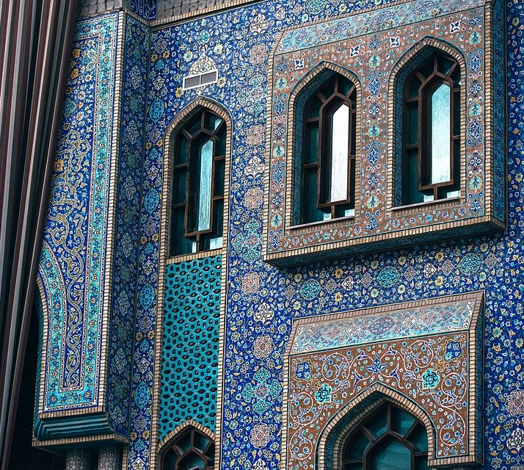
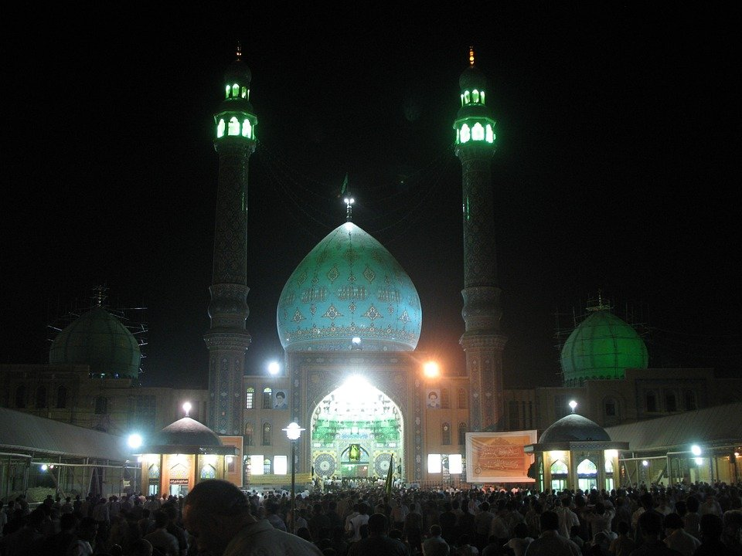
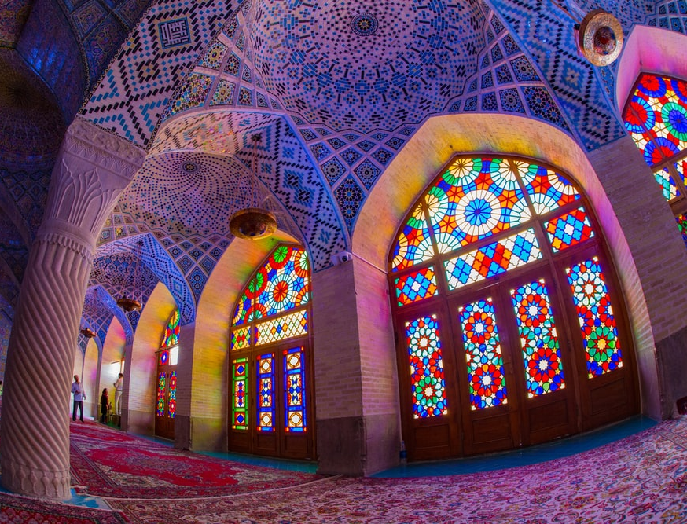
A
B
C
A = Persian architecture
B= Jamkaran Mosque in Qom, a holy city
C= mosque in Shiraz
Notes:
Jamkaran mosque: https://pixabay.com/photos/mosque-jamkaran-spiritual-night-380810/
Persian architecture: https://pixabay.com/photos/arabian-architecture-asian-2713819/
Shiraz mosque: Photo by Steven Su on Unsplash

Slide 8
Exit ticket
What beliefs are shared by Sunni and Shi’a?

