Slide 1
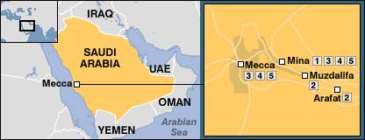
Hajj
The fifth pillar of Islam, Hajj is mandatory once in a life-time for all Muslim adults if they are financially and physically able to do so.
It takes place every year during Dhul Hijjah – the 12th month of the Islamic calendar.
The Hajj journey

Slide 2
The origins of Hajj
Hajj literally means “to set out to a place”.
The Qur’an tells us Ibrahim was first commanded by God to call upon the people for Hajj:
And proclaim to the people the Hajj; they will come to you on foot and on every lean camel; they will come from every distinct pass. [Quran 22:27]
The rites of Hajj are rooted in Ibrahim’s story:
The Ka’abah, built by Ibrahim with his son Isma’il
The search for water between Mounts Safa and Marwa by Ibrahim’s wife, Hajar
Ibrahim’s animal sacrifice in place of his son Isma’il

Slide 3
Hajj over the years
In August 2018, 2.4 million people performed the Hajj.²
Since 1920, the number of foreign pilgrims have grown by 2,824%.³
The Hajj is Saudi Arabia’s highest source of revenue after oil & gas; more recent stats show earnings of $9 billion.⁴ By 2022, revenue is expected to exceed $150 billion.⁵
In efforts to control crowds, Mecca and its surrounding areas have undergone (and continue to go through) substantial change.

Slide 4
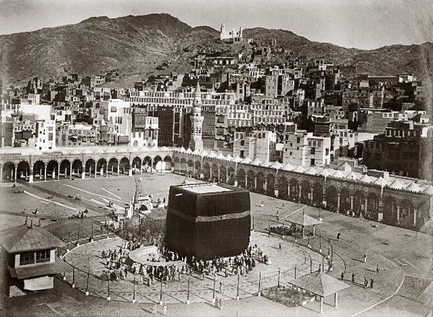
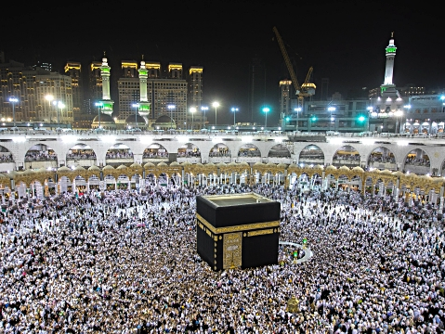
Hajj over the years
The Ka’aba, then and now

Slide 5
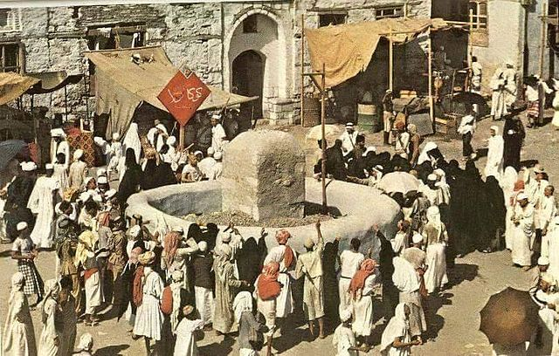
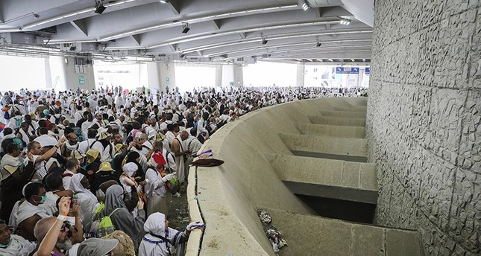
Hajj over the years
Stoning of the devils, then and now

Slide 6
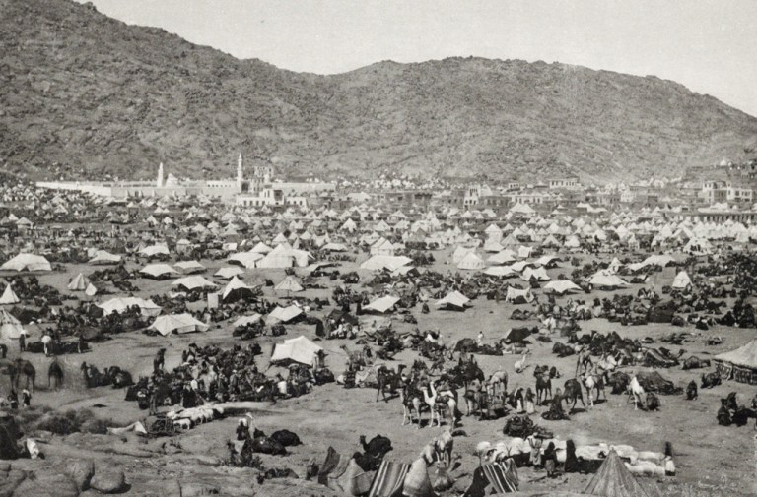
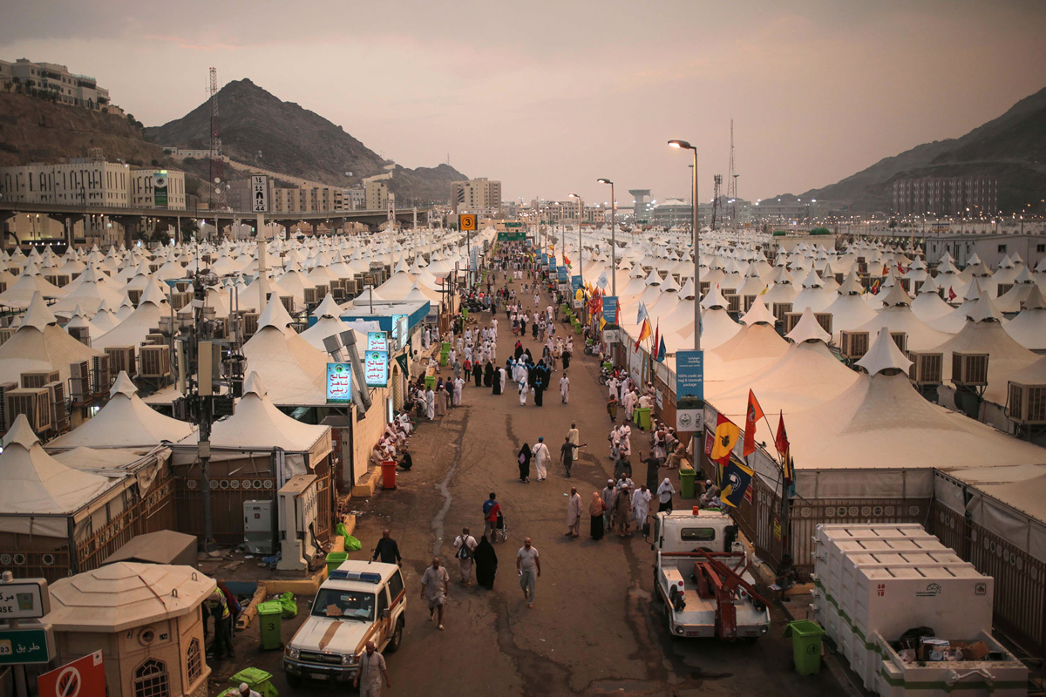
Hajj over the years
Camping at Mina, then and now

Slide 7
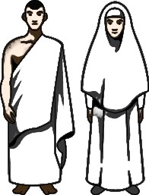
The state of Ihram
Pilgrims begin by announcing their intent (niyya) to perform hajj, upon which they enter into the state of ihram.
The state of ihram calls for certain conditions that need to be maintained throughout the duration of hajj.
Engaging in arguments/ quarrels
Looking in the mirror
Dissolute behaviour (lying, swearing or boasting)
Killing insects/other living creatures
… are some examples of behaviour that nullify the state of ihram.
Men wear two pieces of unstitched cloth, signifying simplicity (typically white)
Women wear clothing covering everything other than the face and hands.

Slide 8
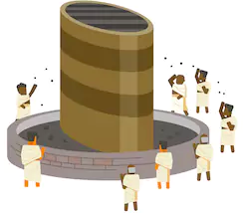
The stages of Hajj
1. Intention & Talbiya
Pilgrims announce their intent to perform the Hajj at a designated prayer point (miqat) and enter the state of ihram.
Pilgrims then utter the following prayer (talbiya) and typically repeat it until they arrive at Mecca.
“Here I am, at your service O Lord. Here I am at your service, you who have no partners. All praise, all bounty, all sovereignty is Yours alone, you have no partners.”
Entering the state of ihram is an important step: one writer described it as signifying a transfer from the self to Allah, from slavery to freedom, from racial discrimination to equality, from aimlessness to responsibility.¹

Slide 9
The stages of Hajj
2. Tawaf (Circumambulation)
Once in Mecca, pilgrims go around the Ka’abah 7 times, counter-clockwise.
The Tawaf symbolises the Oneness of Allah and His centricity of existence.
On every round, pilgrims point towards the Black Stone located in the Eastern corner and remember the pledge to faith, asking the Black Stone to testify that they upheld their pledge.
The Tawaf ends with 2 units of prayer behind Maqam Ibrahim (Ibrahim’s position).

Slide 10
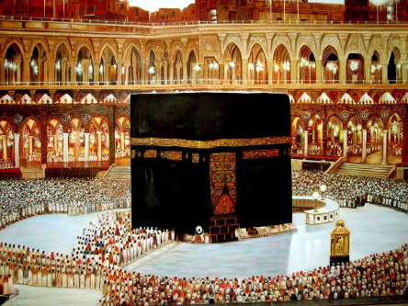
Indeed, the first house of worship established for mankind was that at Mecca, blessed and a guidance for the worlds. [3:96]
In it are clear signs, such as the standing place of Abraham. And whoever enters it shall be safe. And due to Allah from the people is a pilgrimage to the house – for whoever can find a way. [3:97]
Isma’il’s resting place
The black stone
The station of Ibrahim

Slide 11
The stages of Hajj
3. Sa’ i (the Walk)
Pilgrims then walk between the two mountains of Safa and Marwa a total of 7 times.
During Sa’i, pilgrims retrace Hajar’s steps and are reminded of the rewards that await those who make an effort.
4. Taqseer (Cutting hair)
At the end of the Sa’i, pilgrims cut some of their hair or clip their nails, upon which they exit the state of ihram.

Slide 12
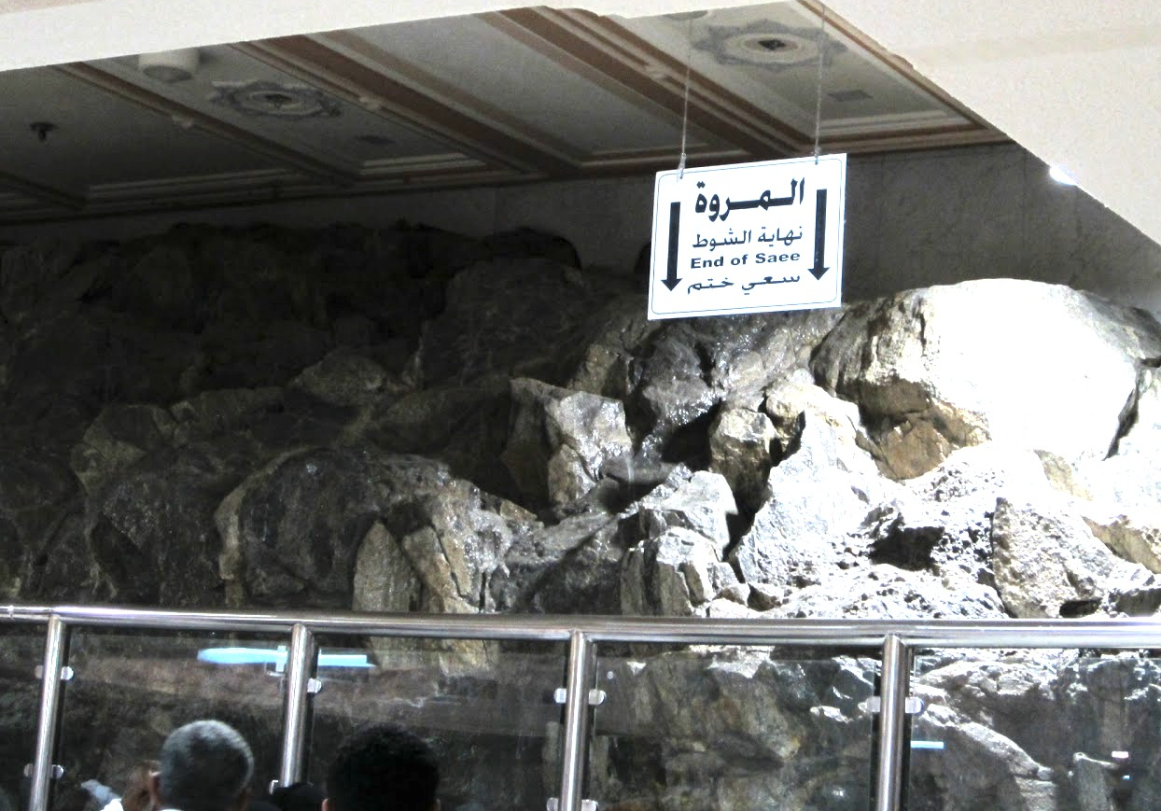
Indeed, the Safa and Marwa are among the symbols of Allah. So whoever makes hajj to the house or performs ‘umrah, there is no blame upon him for walking between them. And whoever volunteers good – indeed, Allah is appreciative and knowing. [2:158]

Slide 13
The stages of Hajj
Between the 8th and 10th of Dhul hijjah
5. Arafat
Pilgrims enter into the state of ihram again and head towards Arafat, a dry and plain desert land.
They must remain in Arafat between noon and sunset.
Pilgrims camping in Arafat tend to spend their time seeking forgiveness (although there is requirement for prayer).
Some pilgrims climb Jabal al Rahma (the mountain of mercy) seeking forgiveness.

Slide 14
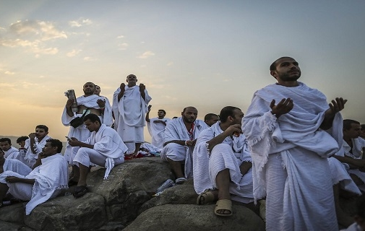
“Only You do I beseech, so do not disappoint me. Only for Your favours do I desire, so do not deprive me. Only to Your side do I resort, so do not set me aside.”
Extract from Dua Hussain - a prayer recited on Arafa day

Slide 15
The stages of Hajj
6. Muzdalifa
After sunset, pilgrims leave Arafat and travel to Muzdalifa, a desert plain land.
From the grounds of Muzdalifa, they collect stones. This signifies a gathering of arms to be used against the devils for the next 3 days.

Slide 16
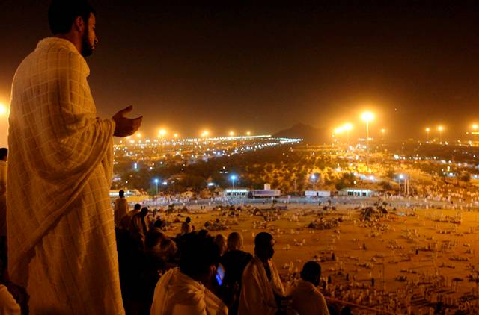
There is no blame upon you for seeking bounty from your Lord [during Hajj]. But when you depart from 'Arafat, remember Allah at the sacred place [Muzdalifa]. And remember Him, as He has guided you, for indeed, you were before that among those astray. [2:198]

Slide 17
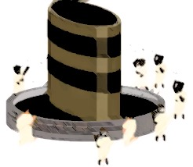
The stages of Hajj
7. Mina
At dawn on Eid day, the pilgrims arrive at Mina where they throw 7 stones at 1 of 3 boulders symbolising Satan.
Pilgrims then offer a sacrifice after which they can cut their hair or trim nails and in so doing, exit the state of ihram.
Pilgrims camp in Mina that night and the next.
During the day, pilgrims repeat the pelting of 7 stones at each boulder for 2 days. In throwing the stones, they confront their inner demons.

Slide 18
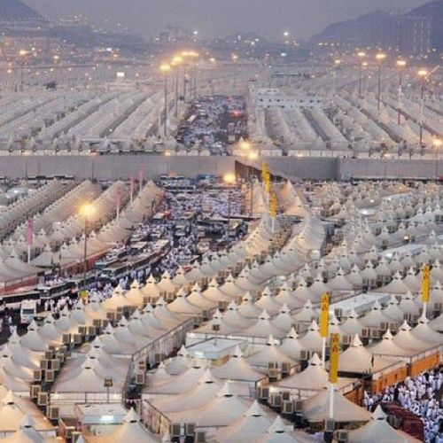
“The animal offerings are among the rites decreed by God; for you therein is good. So mention the name of Allah upon them when lined up; and when they are on their sides, then eat from them and feed the needy and the beggar. Thus have We subjected them to you that you may be grateful.” Quran 22:36

Slide 19
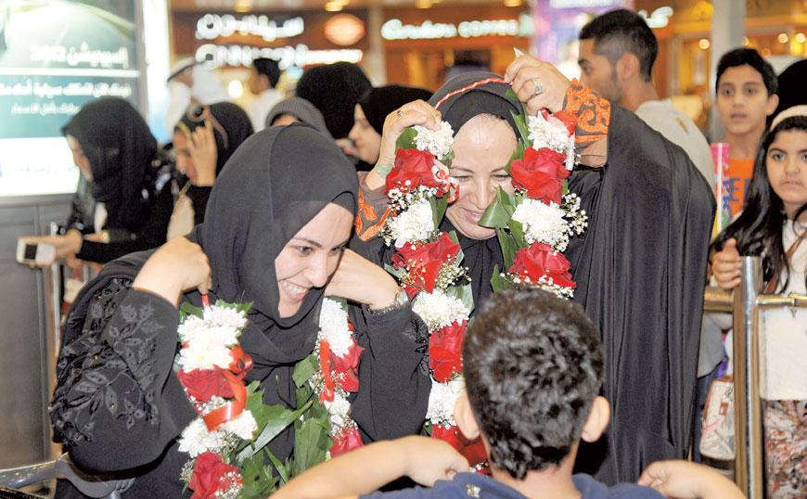
The stages of Hajj
8. Tawaf
Pilgrims end their Hajj where they began, with circumambulating the Ka’bah 7 times.
Pilgrims who have just completed their Hajj hold a special status and earn the title “Hajji”. The Hajj absolves pilgrims of all past sins. Families and friends traditionally greet pilgrims returning home with gifts.

Slide 20
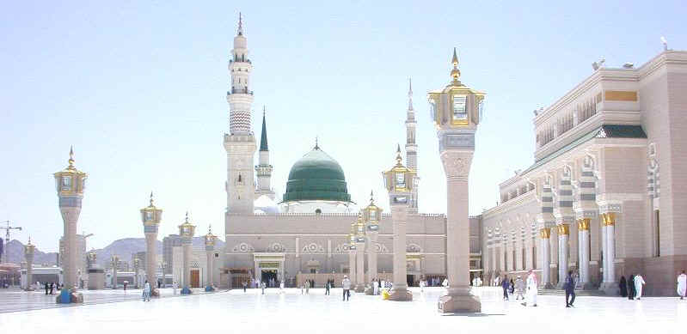
Visiting the Prophet
Although not part of the Hajj, pilgrims almost always visit the Prophet’s mosque and other sites in Medina, either before or after completing their Hajj.
A hadith of the Prophet says “Whoever performed Hajj and did not visit me, has deserted me.”

Slide 21
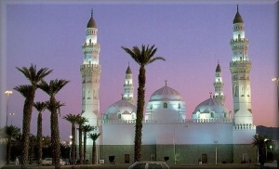
Sites in Medina
Masjid Qibba
This is said to be the oldest mosque in Islam.
“A mosque founded on righteousness from the first day is more worthy for you to stand in. Within it are men who love to purify themselves; and Allah loves those who purify themselves.” Quran 9:108

Slide 22
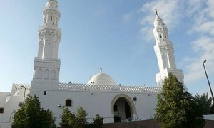
Sites in Medina
Masjid Al-Qiblateyn (Mosque of the Two Qiblas)
This is where Prophet Muhammad received the command to change the direction of prayer from Jerusalem to Mecca.
“The foolish among the people will say, "What has turned them away from their qiblah, which they used to face?" Say, "To Allah belongs the east and the west. He guides whom He wills to a straight path.” Quran 2:142

Slide 23
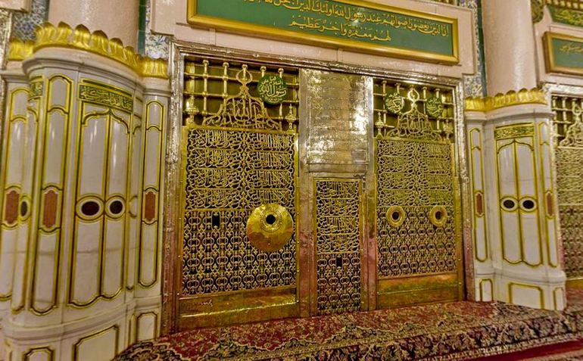
Sites in Medina
Masjid Al-Nabawi (The Prophet’s Mosque)
The resting place of Prophet Muhammad is under the green dome in the Rawdah.

Slide 24
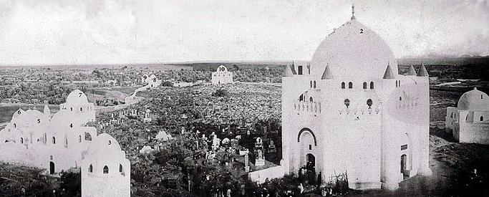
Sites in Medina
Jannat al-Baqi
A cemetery located to the south-east corner of the Prophet's mosque. It is the resting place of many of Prophet Muhammad’s close family and companions.
The mosques and shrines of al-Baqi were demolished by the Wahhabis in the 1920’s.
Jannat al-Baqi before demolition

Slide 25
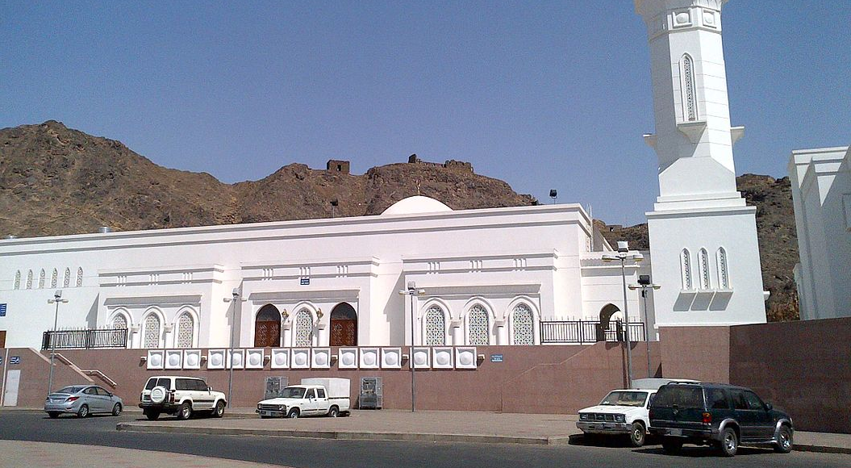
Sites in Medina
The Seven Mosques
A complex of seven small historic mosques located on the scene of a historic battle (the Battle of the Trench).
Al Fath Mosque
Ali ibn abi Talib’s Mosque
Fatima al Zahra’s Mosque
Salman al Farsi’s Mosque
Abu Bakr al Siddique’s Mosque
Umar ibn al Khattab’s Mosque
Sa’ad ibn Ma’az’s Mosque

Slide 26
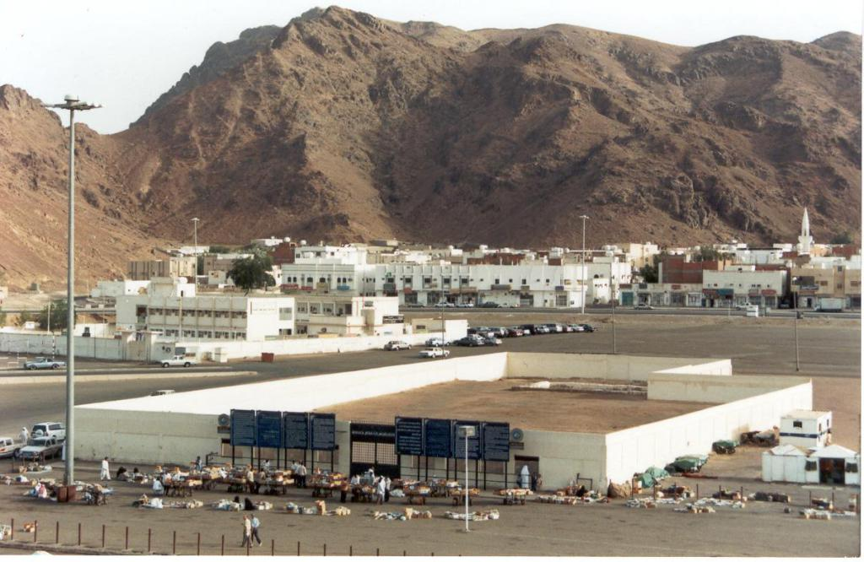
Sites in Medina
Site of the Battle of Uhud
The Battle of Uhud (625 AD) was fought between a group of Muslims and Meccan forces, where the Muslims were defeated after almost reaching victory. It contains an important lesson for Muslims.

Slide 27
Fun facts
A study conducted in 2008 by Harvard University’s John F. Kennedy School of Government found that the Hajj "increases belief in equality and harmony, leads to more favorable attitudes toward women" and that "Hajjis show increased belief in peace, and in equality and harmony among adherents of different religions.”⁶
During medieval times, pilgrims would gather in big cities of Syria, Egypt, and Iraq to go to Mecca in caravans comprising tens of thousands of pilgrims, escorted by a military force and physicians.⁷
Kiswa is the name of the cloth that covers the Ka’abah. It is renewed annually on the day pilgrims leave Mecca for Arafat. The old Kiswa is cut into small pieces and distributed.
In the 1850’s, English explorer Richard Francis Burton went on the Hajj as an undercover and published his travel chronicles. His journey was financed by the Royal Geographical Society.⁸
The Qur’an makes reference to the Bayt al Ma’mur, a prototype of the Ka’bah in the seventh heavens (outside of the human realm). In the Prophet’s ascension to the heavens, he saw the Bayt al Ma’mur being circulated by angels.

Slide 28
References
“Hajj, The Pilgrimage”, Dr Ali Shariati, 1993, Kazi Publications
General Authority of Statistics, Kingdom of Saudi Arabia, 22 August 2018. https://www.stats.gov.sa/en/28
“Number of foreign Hajis grows by 2,824 percent in 92 years”, The News International, 2 November 2012.
Al Arabiya, August 2014. http://english.alarabiya.net/en/business/economy/2014/08/26/-9-billion-income-from-hajj-expected.html
Arab News, August 2017. http://www.arabnews.com/node/1151751/saudi-arabia
"Estimating the Impact of the Hajj: Religion and Tolerance in Islam's Global Gathering”, 2008. Papers.ssrn.com
Philipp, Thomas (1998), The Mamluks in Egyptian Politics and Society, Cambridge University Press
Personal Narrative of a Pilgrimage to Al Madinah and Meccah, Richard Francis Burton, 1855
Slide cover:
https://i.pinimg.com/236x/d4/e6/7ad4e67ab7d68b4aa5ca17179096ebb0cc.jpg
Icons:
https://lh3.googleusercontent.com/jnVq15cShLyKMQFwQjbcll98oKu3uzE2dEkNkWj_XLM0LjbR6fDNfkfRcbt7fVaK5F634Q=s162
https://lh3.googleusercontent.com/R9iR011y43VnlODnFl9N-uH27GvH-07aptGYF5VCfADrtqcyVgDn8FxfvCVzNKAJIBl0G34=s85
https://lh3.googleusercontent.com/_RHxSfYDkypS_QBppEzpq0QypejbmnI1-Qh3gUd14NW3VSbZB6gRqkJ97GyuZHkJNpv_Rfk=s123
https://lh3.googleusercontent.com/scW4sVN7PX92X_G0BdCFn-hqtq9nu4hmnzY3RIk2ytL7pwewQypTkPnLi4-9wHo-KRUceg=s85
https://lh3.googleusercontent.com/wdWHvydouMw7twCU1N2mr4h4a4jgbC3HLdYkiY_uq5NGgTKDOrXfInIyhX-ZfT6L6LibqQ=s85
https://lh3.googleusercontent.com/IuWXVNAx63nnh_NmIIv13ZcAtilEtBhi8o1pViwvaYdaTq3QWsk9JBRdryf1je13lIkXFQ=s85
https://lh3.googleusercontent.com/8QVLvU12KD5A22J9mE5rWIkxcOEgLxEVhuShzgDXXZHulbAU3dmLiizyEAoNpzggAJNr=s98
https://lh3.googleusercontent.com/aRacpvM7H3eFPGNrIoSKxGTXcRRKNVe5jvLmfiQX-Ouh1D-PNq-_Nfn6k3Ab9EZH6r1M1jQ=s85

Slide 29
References
Images
Slide 1:
http://static1.mbtfiles.co.uk/media/docs/newdocs/gcse/religious_studies_philosophy_and_ethics/religions/islam/hajj/850592/html/images/image01.png
Slide 4:
https://i1.wp.com/www.futurenotez.com/wp-content/uploads/2017/10/22.jpg?w=600&ssl=1
https://www.istockphoto.com/gb/video/muslim-pilgrims-touring-the-holy-kaaba-in-mecca-in-saudi-arabia-gm985523246-267357974
Slide 5:
https://iadsb.tmgrup.com.tr/b19cfd/645/344/0/33/800/460?u=https://idsb.tmgrup.com.tr/2017/09/01/millions-of-muslim-pilgrims-reach-mina-perform-devil-stoning-hajj-rite-1504273141574.jpg
https://i1.wp.com/www.futurenotez.com/wp-content/uploads/2017/10/1965.jpg?w=640&ssl=1
Slide 6:
https://i1.wp.com/www.futurenotez.com/wp-content/uploads/2017/10/12.jpg?resize=768%2C505&ssl=1
https://cdn.theatlantic.com/assets/media/img/photo/2015/09/mecca-then-and-now-126-years-of-gro/m09_986303405504/main_1200.jpg?1443547392
Slide 7:
https://lh3.googleusercontent.com/FzmiUDLndNd9rbNTHJx9kkOUwWkqWflv70gpEhicv0zCTeVi6-Gd1ne09TJu_KPxPXmqww=s85
Slide 10:
https://marhabayamustafa.files.wordpress.com/2014/02/makkah-2012-07.jpg?w=444
Slide 12:
http://2.bp.blogspot.com/-ioGKkVx2StU/TsafyAkHTEI/AAAAAAAABgQ/1_HfH0fYfBw/s1600/Pilgrims+making+dua+at+Safa+facing+the+holy+Kabah.JPG
http://3.bp.blogspot.com/-ZK59_8ZvMwE/Tsafio_JLkI/AAAAAAAABgA/qpIXiSPHYVg/s1600/Photograph+of+Mountain+Marwah.JPG
Slide 14:
http://www.shiitenews.org/media/k2/items/cache/over-two-million-pilgrims-scale-mount-arafat-for-peak-of-hajj30329_L.jpg
Slide 16:
https://umrahinfolinks.files.wordpress.com/2017/01/the-importance-of-arafat-and-muzdalifah.jpg
Slide 18:
https://i.pinimg.com/originals/1f/99/f7/1f99f7fd4c5d1d7806dc0487341a2607.jpg
Slide 19:
http://storage.googleapis.com/jarida-cdn/images/1462166163333167900/1462166163000/1280x960.jpg
http://www.alriyadh.com/media/article/2009/10/31/img/570446878736.jpg
Slide 20:
http://www.hayrat.net/html/apo/m15.jpg
Slide 21:
https://abdurrahmanorg.files.wordpress.com/2014/01/masjid-quba-3.jpg
Slide 22:
https://i1.wp.com/www.amuslima.com/wp-content/uploads/2014/09/masjid_al_qiblatain_madina-300x180.jpg?resize=300%2C180
Slide 23:
https://upload.wikimedia.org/wikipedia/commons/thumb/1/1f/Madina_Haram_at_evening.jpg/790px-Madina_Haram_at_evening.jpg
Slide 24:
https://upload.wikimedia.org/wikipedia/commons/thumb/3/34/Jannatul-Baqi_before_Demolition.jpg/800px-Jannatul-Baqi_before_Demolition.jpg
Slide 25:
https://upload.wikimedia.org/wikipedia/commons/thumb/e/ec/Sab%27u_Masajid.jpg/1200px-Sab%27u_Masajid.jpg
Slide 26:
https://bestislamicimages.files.wordpress.com/2012/11/martyrs-of-uhud1.jpg?w=1024

