Slide 1
KNOWLEDGE AND CERTAINTY (Part 2)
RELIGION AND BELIEF – KS4
Notes:
The study of knowledge, or epistemology, is a key concept in Philosophy of Religion.
This starter is aimed at KS4 but could be easily adapted for younger or older students.
It follows on from ‘Knowledge and Certainty (Part I)’ and provides further exploration of two forms of knowledge, a priori and a posteriori.

Slide 2

How can we be ‘certain’ of anything?
An Introduction to Philosophy of Religion
Getting the tools for the job
Notes:
You should have taught the lesson ‘what do we mean by knowledge’: an introduction to philosophy of religion- starter 1, first.
Before you begin the lesson, get students to jot down an example of something they know a posteriori and an example of something they know a priori. Check understanding and get them to re-read the definitions to remind themselves.
The study of knowledge- or epistemology, is a key concept in Philosophy of Religion. This starter is aimed at KS3 but could be easily adapted for KS4. Before you introduce any arguments for the existence of God such as the Teleological, Cosmological and Ontological arguments, it is important to offer students a ‘toolkit’ for examining the different types of knowledge which underpin these arguments. By introducing them to two broad types, a posteriori and a priori, they will be able to critically analyse the strength and weaknesses of such arguments in a sophisticated way which goes beyond the stock answers of “There’s just no proof, Miss” or “Yeah, but science proves there is no God”.

Slide 3
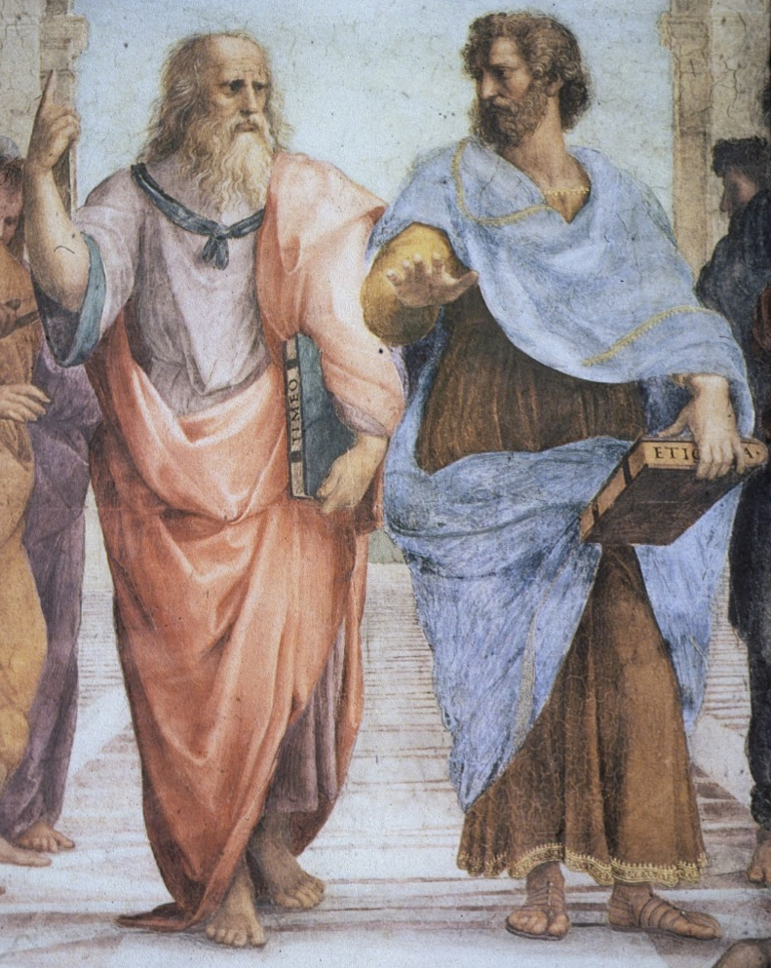
Notes:
This activity is a good way of revising the two new concepts of knowledge ‘a priori’ and ‘ a posteriori’ as learnt in their last lesson, and developing students thinking about the concept of ‘certainty’.
Show the students this slide ask them such questions as:
What do you see? What is going on in the picture? Who do you think these men are?
After sharing ideas, introduce these two famous philosophers of Ancient Greece, Plato (left) and Aristotle (right), and explain that Raphael, the artist, was showing them discussing knowledge. Ask them to note the position of their hands. Plato points upwards, perhaps towards the ‘eternal forms’ of his philosophy, while Aristotle gestures towards the earth, perhaps towards worldly experience.
Some commentators believe that the colours of their clothes are significant also. Plato’s two colours may stand for two of the four elements in Greek thought of fire and air, while Aristotle’s may represent the other elements of water and earth.
Ask students to vote on which philosopher they think supports a priori knowledge, and which supports a posteriori knowledge.
Then ask them to justify their views.
You could label and write around the picture on a Smartboard and get the students to label their own copy too with the following key words: Plato, rationalist, pointing up, walking along, not interested in this world, a priori knowledge, knowledge through reason, knowledge before experience; Aristotle, empiricist, hand palm down, feet firmly planted, interested in empirical evidence and science, a posteriori knowledge, knowledge through senses, knowledge after experience.
Information for Teachers:
This detail from the fresco School of Athens (1510) by Raphael contains the ancient Greek philosophers Plato (a rationalist) on the left and his pupil Aristotle (an empiricist) on the right. Their poses symbolise their view on knowledge. Plato felt that the world around us which we came to know a posteriori was merely an illusion. He is painted walking along in bare feet, pointing up to the sky, representing his argument that true knowledge cannot be found through our deceptive senses, but is to be known through reason, a priori, alone. In contrast, Aristotle stands with his feet in sandals firmly planted, and the palm of his hand reaching out into the world of experience. For Aristotle it is through empirical evidence gained a posteriori that true knowledge can be acquired.

Slide 4
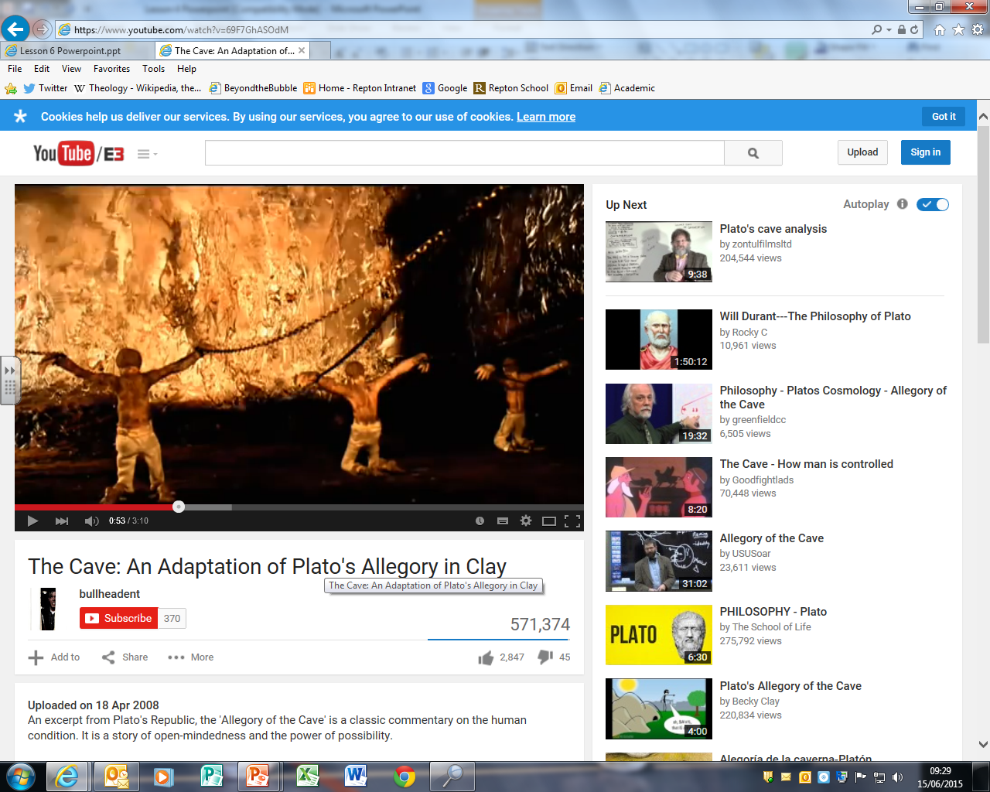
How secure is our a posteriori knowledge?
Watch the clip on Plato’s cave and think about these questions:
What do the prisoners ‘know’?
How reliable is their knowledge?
Think of an example in your life when you might have been like one of the prisoners.
Notes:
You can research and give a bit of background to the allegory of the cave from Plato’s book The Republic if you wish to, but it is best to keep details to a minimum in order to encourage the students to enquire for themselves.
Show students a short film about Plato’s cave: http://www.youtube.com/watch?v=69F7GhASOdM and ask them to talk in pairs or threes about possible answers to the questions on this slide.
Get some feedback from the class as a whole and ask the students to note down key points, e.g., on mini-whiteboards.
Point out that Plato’s cave allegory attempts to show how unreliable our sense experience of the world can be: we cannot use it to be CERTAIN of anything. For Plato, our experience of the world is essentially an illusion based on false beliefs. It was much better, he argued, to rely on knowledge gained through reason (a priori).
Ask the students to comment on how successful they think Plato’s allegory is: to what extent is our experience of the world illusory? Are we completely deceived by our senses? Are we like the prisoners who cannot accept that there is a more real world outside of what we experience in the cave?

Slide 5
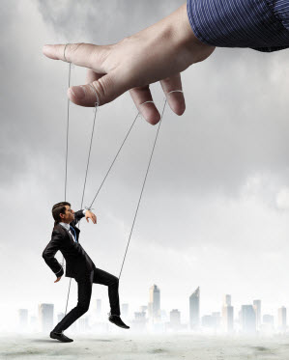
How secure is our a priori knowledge?
Imagine you are having a dream about maths….
Is it possible in your dream for you to be convinced that you KNOW that 2+3=6?
Notes:
1a) Ask students to imagine they are dreaming about maths (an exciting dream!!)
1b) In their dream, is it possible that they are convinced that they KNOW that 2+3=6?
1c) How secure is their a priori knowledge in a dream? – what about in real life?
2a) Ask students what the image is showing.
2b) Ask them how it might link to our A PRIORI knowledge.
Lead students towards to idea of mind control, or being tricked into believing something is true through misrepresentation of facts, manipulation.
Encourage them to consider the nature of dreams: when you dream, you only ever know that something was amiss when you wake up. The mind can create an elaborate world in which all appears real, and it is only when you wake up that you realise how strange of unbelievable it was. Sometimes, when dreaming, the mind can play tricks that even change the way in which maths works. In a dream, you could be convinced that 2+3=6, rather than 5 and be perfectly sure of the answer – it being self evident to you. Only when you wake up do you realise that this knowledge is actually false.
Explain that the philosopher Rene Descartes in his ‘Meditations’ argued that we should doubt all our knowledge, including mathematics and other a priori ideas because they could, conceivably, be a trick of an evil demon corrupting our thoughts and making us believe that 2+3= 5, when really, it is = 6! For Descartes, we should be careful of treating knowledge as ‘fact’ as it is difficult to be certain of anything, a posteriori or a priori.
If time allows, show a clip from the BBC ‘History of Ideas’ series to introduce them to Descartes’ ideas: https://www.youtube.com/watch?v=0A6UKoMcE10
Some students may engage in further investigation of the idea that ‘Cogito ergo sum’ or on ‘Cartesian Doubt’.

Slide 6
Evaluating a posteriori knowledge
Strengths | Weaknesses
Notes:
Provide with copies of this and the next slide and encourage them to work in small groups on the strengths and weaknesses of the two forms of knowledge being studied.
Points on a posteriori knowledge could include:
Strengths: convincing evidence which appeals to human beings who are sensory creatures. Aristotle would argue that empirical evidence is all that is available to us and we must accept this is the only ‘true’ knowledge we can have. Science uses this type of knowledge all the time and it can lead to great benefits to mankind e.g. medicine.
Weaknesses: The senses can be unreliable. Plato would argue that we can never be certain that our senses are telling the truth. There are many times when we might make an error and think we ‘know’ something because we have observed it happening when, in fact, we were wrong. The Philosopher Descartes gave the example of a stick appearing bent in water; our senses can play tricks on us and therefore they do not always lead to ‘sound’ knowledge. (You can also give the example of dreaming and thinking it is real; films such as The Matrix and Inception are useful stimulus here too). Kant argued that the human mind had a tendency to see order and regularity in places where none existed, we think that what we observe is the ‘truth’ because we simply function that way.

Slide 7
Evaluating a priori knowledge
Strengths | Weaknesses
Notes:
Points on a priori knowledge could include:
Strengths: A priori knowledge is more reliable than a posteriori because we avoid the problems of sensory evidence which might deceive us. We can be more certain of its truth because it is based in definition and ‘fact’. It is convincing because we can use our reason to verify it without relying on any experience, it is self-evidently true.
Weaknesses: Descartes doubts all knowledge, including mathematics, something we feel we know a priori. We could be being tricked by an evil demon, we cannot be certain of any knowledge and we should be careful to accept things as ‘true’ without questioning them first. In addition, a priori often just gives us a definition of a word and, as such it is not a very useful form of knowledge because we do not learn anything new about the world.
When students have completed their charts, encourage them to display them and to compare with other answers.

Slide 8
How can we be certain of anything?
Prepare a 90 second speech which begins
‘We can be certain of some things because…’
OR
‘We can be certain of nothing because…’
State your opinion firmly. You must be able to concisely state your opinion, giving reasons to back it up.
Speak to persuade. You should attempt to convince the rest of the class of your perspective. You can use props, pictures, well placed humour or anything else that you can think of to bring people round to your view.
Organise your speech and write it down ahead of time.
Present your speech as clearly and as fluently as you can!
Use scholars and key words, e.g., ‘a priori’ and ‘a posteriori’!
Notes:
Set this homework task for students to consolidate all they have learnt as well as to encourage them to develop confidence in front of their peers.
Provide a mark scheme, or a checklist of things for students to include in their speech. Depending on ability you might want to provide a writing frame to boost confidence in terms of structure, or ask students to work in pairs.
It is important to give them adequate time to prepare for their speech and then offer extra incentives such as a bonus prize for the person who can end bang on 90 seconds!
Encourage all students to listen respectfully to each others’ presentations and to give their classmates a cheer and a clap when they have finished!
Evaluate the presentations during the lesson by jotting down comments and reporting back to students at the end.

