Slide 1
Amazing Grace the life and work of John Newton
The Slave Triangle
E

Slide 2
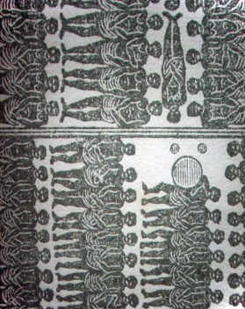
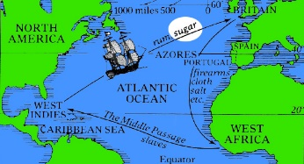
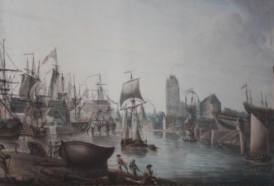
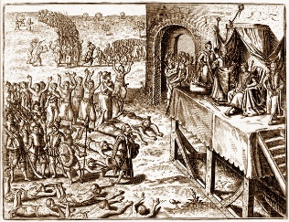
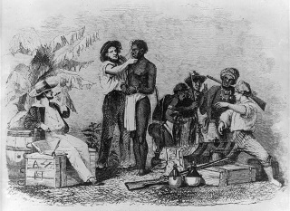
The Slave Triangle
Using the information:
Create a story board on the Slave Triangle. Here is an example:
The Slave Triangle | In England, Bristol and Liverpool were the main ports for the slave ships | Some African chiefs sold other Africans to the slave traders | Slaves were packed into the holds of the ships | Slaves were sent to market in America
E

