Slide 1
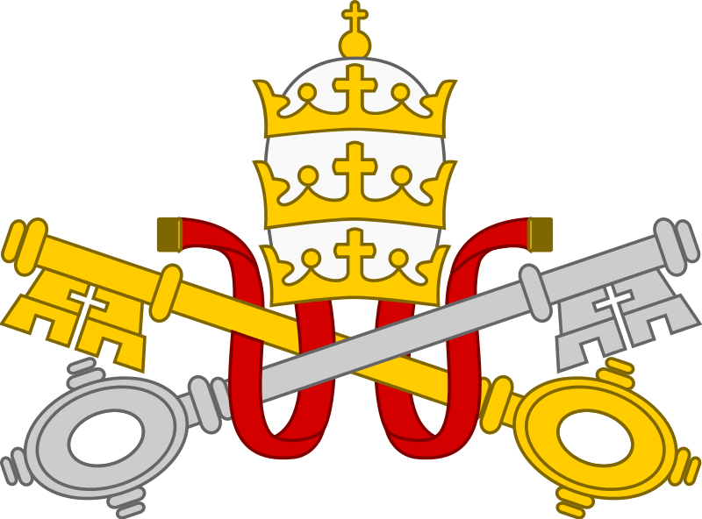
Catholics ~ Priests
Beliefs about the Eucharist

Slide 2
Beliefs about the Eucharist
Beliefs about what happens at the Eucharist are concerned with the way in which the communicant’s relationship with God is fed through this mystical meal.
Transubstantiation
The Catholic Church teaches a belief in Transubstantiation (see p.69). A very similar position is held by the Orthodox Church which refers to the Eucharist as the ‘Divine Liturgy’.
The real difference between the Eastern and Western Churches is that the Orthodox Church does not state when the actual change takes place whilst the Catholic Church does.

Slide 3
Beliefs about the Eucharist
Consubstantiation
“The bread retains its substance and … Christ’s glorified body comes down into the bread through the consecration and is found there together with the natural substance of the bread, without quantity but whole and complete in every part of the sacramental bread.” (This belief was held by the English Lollards q.v.)
Sacramental union
In the “use” of the sacrament, according to the words of Jesus Christ and by the power of his speaking of them once for all, the consecrated bread is united with his body and the consecrated wine with his blood for all communicants, whether believing or unbelieving, to eat and drink. This is the theology of the Lutheran Church.

Slide 4
Beliefs about the Eucharist
Objective reality
“Objective reality, but pious silence about technicalities” (“divine [or holy] mystery”) is the view of many Anglicans (including Anglo-Catholics) and Methodists. While they agree that in the sacrament the bread and the wine are really and truly changed into the body and the blood of Christ they do not attempt to explain this further.
Pneumatic presence (Receptionism)
“Real Spiritual presence”, also called “pneumatic presence” or “Receptionism” says that not only the Spirit of Christ, but also the true body and blood of Jesus Christ are received by the power of the Holy Spirit but only by those with faith.
This view is held by some Anglicans, and other Reformed Christians.

Slide 5
Beliefs about the Eucharist
Memorialism
The bread and wine symbolise the body and blood of Jesus Christ, and consuming them, the believer commemorates the death of Christ. Therefore Christ is not present in the sacrament, except in the minds and hearts of the communicants.
Suspension
This view of the events of the Last Supper is that the taking of bread and wine was not intended to be a perpetual instruction and was not to become a religious ceremony. This view is shared by the Religious Society of Friends (Quakers) and the Salvation Army.

Slide 6
Beliefs about the Eucharist
Task
1 Create a table showing what you believe to be the ‘pros’ and ‘cons’ of each of these theologies.
2 Write a short essay explaining which of the theologies you think might be considered to be the most convincing.

