Slide 1
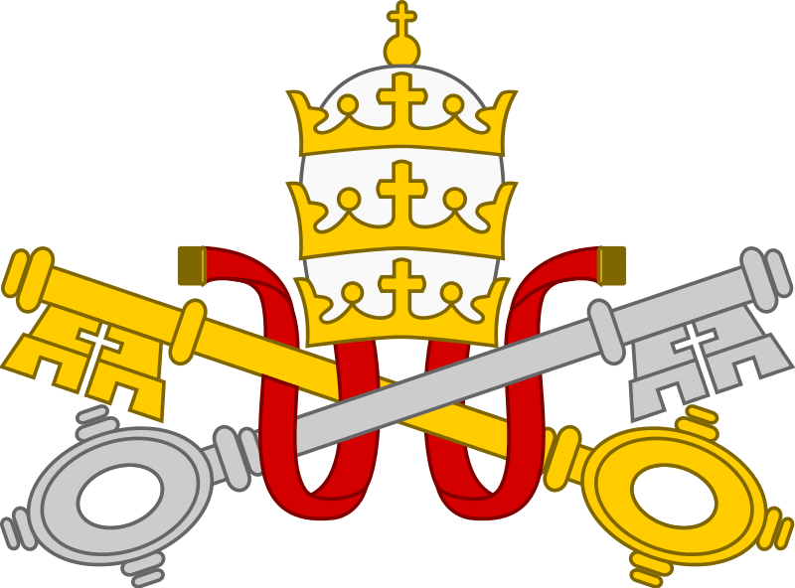
Catholics ~ Priests
Catholic Priests

Slide 2
Catholic Priests
Priest: One whose office is to perform public religious functions; an official minister of religious worship.
In specific Christian use, the officiant at the Eucharist and other sacerdotal (priestly) offices.
In hierarchical Christian churches: a clergyman in the second of the holy orders (above a deacon and below a bishop), having authority to administer the sacraments and pronounce absolution. (OED 1989 adapted)

Slide 3
Catholic Priests
A priest in the Catholic Church performs certain ceremonies and services which generally cannot be conducted by the lower orders of clergy or by lay people.
These include the administration of the Sacraments, including the Mass or Eucharist, the Sacrament of Reconciliation, Anointing of the Sick and Confirmation. However, Confirmation is usually performed by a Bishop.
Baptism can be celebrated by anyone (see p.00).

Slide 4
Catholic Priests
Marriage:
‘In the Latin (Catholic) Church, it is ordinarily understood that the spouses, as ministers of Christ’s grace, mutually confer upon each other the sacrament of Matrimony by expressing their consent before the Church.
In the Eastern liturgies the minister of this sacrament (which is called “Crowning”) is the priest or bishop who, after receiving the mutual consent of the spouses, successively crowns the bridegroom and the bride as a sign of the marriage covenant.’ (Catechism of the Catholic Church §1623)
Because of this, the ceremony may be witnessed and blessed by a Deacon or Priest.

Slide 5
Catholic Priests
In the Catholic Church there are certain conditions which a person must meet before they can become a priest:
They must be male
They must be at least 25 although Bishops can agree to ordain men a year younger.
They must have a Bishop or leader of a religious order as their superior. Th is is called incardination.
They must be celibate. There are special rules for priests joining the Catholic Church from other Christian denominations who may already be married, but marriage cannot take place after ordination.
Bishops cannot be married.

Slide 6
Catholic Priests
In Western Christianity, most priests wear a stiff white clerical collar with a cassock or a clergy shirt. The collar is sometimes full or otherwise a tab which is seen through square cut-out in the shirt collar.
Pope John Paul II (1920-2005) instructed Catholic priests and the religious (monks and nuns) to always wear distinctive (clerical) clothing, unless this could result in persecution or severe verbal attacks.
Many Catholic priests wear a hat called a biretta when they are outside and during certain parts of church ceremonies.

