Slide 1
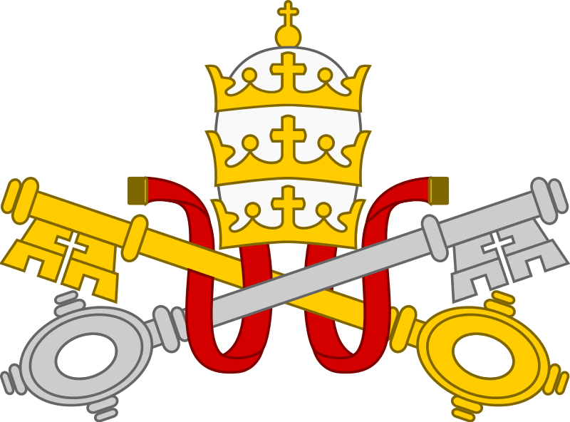
Catholics ~ Priests
The Catholic Church

Slide 2
Key words
Denomination
Catholic
Orthodox
Anglican
Non-conformist
Pentecostal
Copy these key words into your books

Slide 3
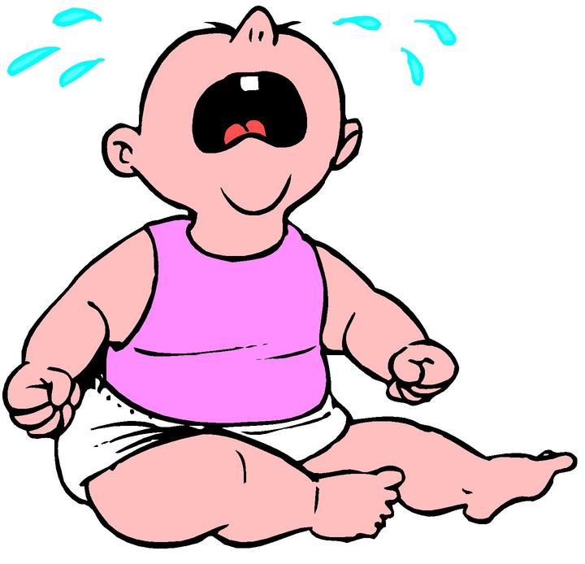
Starter
Create a timeline of your own life
Example:
Born 4th January 2001
Started at Primary School …
After you have completed your timeline compare it with a partner and highlight the key differences.

Slide 4
The Christian Church
Sometimes the different denominations (parts) of the Christian Church are represented as being parts of a tree.
After the Holy Spirit came to Jesus’ followers at Pentecost, they started to worship together in Jerusalem – this became the first Christian Church.
As the news about Christianity spread across the countries around the Mediterranean, more and more Churches were formed.
At first they looked to Jesus’ twelve disciples and St Paul for guidance.
Later the Church began to develop a structure of deacons, priests and bishops.
It was the bishops who made decisions for the local churches in their area.

Slide 5
Spread of Christianity in the 1st century ce
Jerusalem

Slide 6
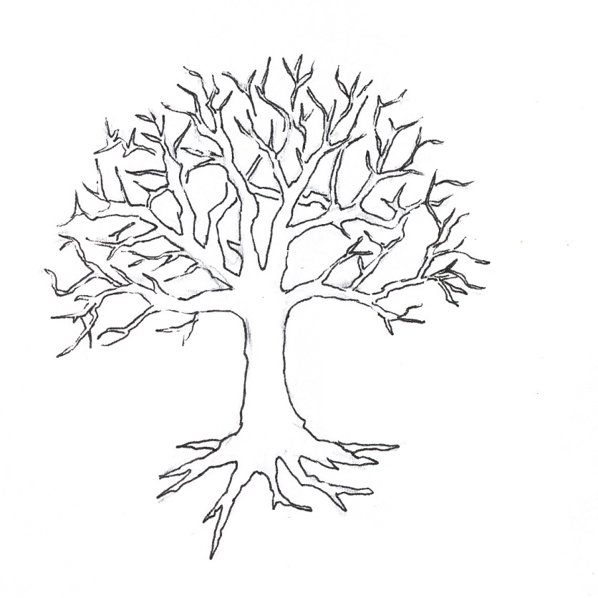
Task One
Looking at the arrows, write down the importance of each part
Leaf
Branch
Trunk
Root

Slide 7
Task One
Branch: represents the main denominations of the Christian Church today
Leaf: represents the smaller Christian Churches which have formed
Trunk: this represents Jesus, his disciples and the early Christian Church
Roots: the basis of the Christian Church is Judaism

Slide 8
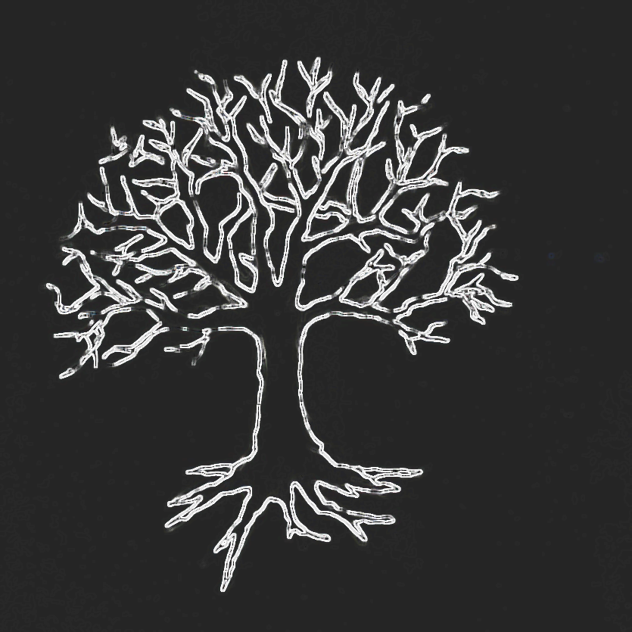
Task Two
In groups, list as many different Christian denominations and Churches as you can think of.

Slide 9
Task Three
Answer the following questions in your books:
Why do you think there are so many different denominations (parts) of Christianity?
Do you think that all the different denominations of Christianity have the same beliefs and / or practices?
Do you think that all the different denominations agree with one another? Why?
Do you think that Christianity, as a religion, should have so many different denominations? Why?

Slide 10
Recap
Write a paragraph explaining the example of a tree and how it can be used to represent Christian denominations.

Slide 11
Key words
Denomination
Catholic
Pope
Vatican
Priest
Copy these key words into your books

Slide 12
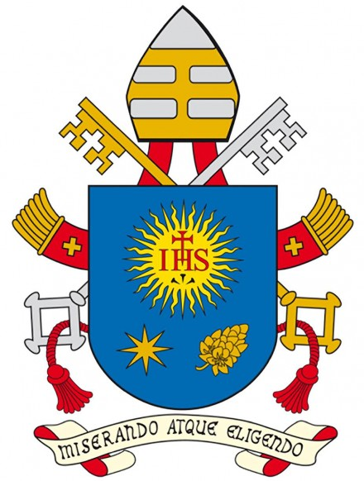
find someone who
You need to write the definitions for the keywords below.
Go around the class and find someone whose definition matches yours.
Church
Catholic
Roman
Notes:
'by having mercy, by choosing him'

Slide 13
Answers: find someone who
The ‘called-out ones’ means all Christians when it is being used to translate the Greek word ‘ekklesia’, this is the word used in the New Testament.
‘Catholic’ which comes from the Greek word ‘katholikos’ meaning ‘universal’.
‘Roman’ is sometimesused because the Vatican City in Rome in Italy is the centre and headquarters of the Catholic Church.
Copy these Key Words and their definitions into your books

Slide 14
The Origins of the Catholic Church
‘All roads led to Rome’ and all roads led from Rome so when the gospel reached the capital city it was the guarantee to the Christians that the promise of Jesus would be fulfilled and the message would reach the ends of the earth.
Copy this sentence into your books
Peter and Paul were martyred during the reign of Nero when the Christians were being persecuted after a fire broke out in Rome. According to tradition, Peter asked to be crucified upside down. He did not feel worthy to be crucified in the same way as his master.

Slide 15
The Origins of the Catholic Church
To Christians in Rome, Peter was their leader because Jesus had appointed him to look after the Church. Since that time, according to Christians, the touch of Jesus has been passed on through Peter and his successors when they lay their hands on others.
As the Roman Empire continued to grow it had capital cities in Rome and also in Constantinople (now Istanbul in Turkey).
There were divisions about particular beliefs between the two cities.

Slide 16
The Origins of the Catholic Church
In 1054, when the debaters could not agree, the leaders from Rome put a document on the altar saying that the Christians of Constantinople were no longer in union with Rome.
The Patriarch (leader of the Church) in Constantinople, Michael Cerularius, condemned the West.
After that there were two separate Churches.
Today, more than half of the world’s Christians are Catholics.

Slide 17
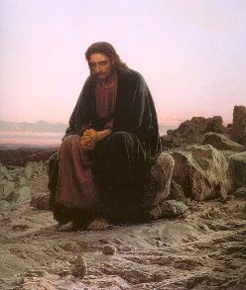
Task Four
How do you think Jesus would have responded to this separation of the Church if he had been alive?
Explain your answer.
Swap books with your partner and mark their answer.

Slide 18
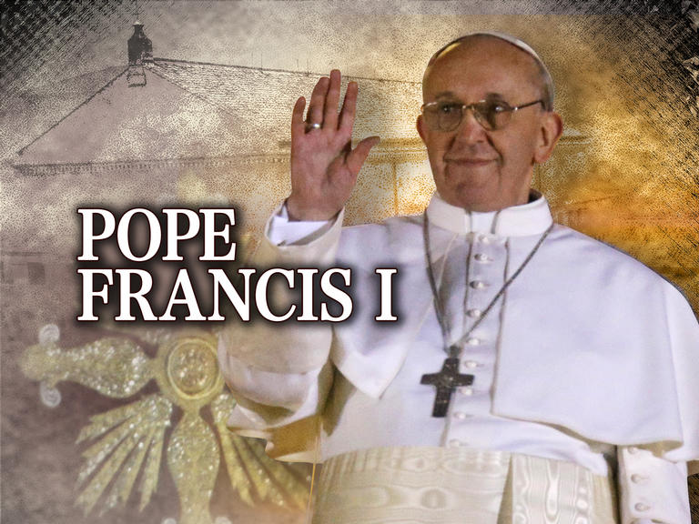
The Pope
The leader of the Catholic Church is called by many different names:
Vicar of Christ
Bishop of Rome
Pope – ‘father’
Servus servorum Dei – ‘Servant of the Servants of God’
Successor of St Peter.
The current Pope is Francis I.
Gregorian Chant is associated with the worship of the Catholic Church https://www.youtube.com/watch?v=JXByMD4XWso

Slide 19
Plenary
Write down three things that you learnt about the Catholic Church.

