Slide 1
Theologies of Reading Islamic approaches to the Qur’an
RESOURCES
Surah 1
Yusuf and Binyamin

Slide 2
Introduction: Recitation of the Qur’an
A Qur’an is in Arabic.
There is no silent reading of the Qur’an- it is auditory and revelatory through the act of hearing.
Audible, deliberate recital of the Qur’an is essential. Muhammad’s companions would read the words of the Qur’an back to him.
Arabic letters have symbolic meaning as well as literal meaning. Meaning is found as much by the sound of the words as by the content.
The musical and aesthetic quality of Qur’anic recitation helps to draw the meaning into the heart allowing a deep, reciprocal relationship between memorisation and understanding, to develop.

Slide 3
Qur’anic Recitation
Example 1:
The compassionate,
the merciful,
the master of the day of judgement.
(Qur’an 1: 3-4)
Recitation rules run ‘merciful’ and ‘compassionate’ together, showing God’s mercy encompasses God’s kingdom and judgement.
The objective of Qur’anic recitation is the presence of the heart during reading, leading to understanding and contemplation.
Recitation rules- the exact way to pronounce, elongate, shorten, emphasise, as learnt alongside the words- lead the reader towards this goal of discovering meaning.
The emotion of a text can be conveyed through the way that words run into each other as part of the prescribed recitation.
Example 2:
The final passage of the Qur’an has a verse ending with an ‘s’. These are considered ‘whispering letters’, indicating that the wisdom contained in this holy book is that of subtlety and secrecy.
Notes:
Resource: Surah 1 for recitation

Slide 4
Use https://www.quranexplorer.com/Quran/ to hear the Qur’an being recited. Compare Arabic text with English for pupils’ understanding…

Slide 5
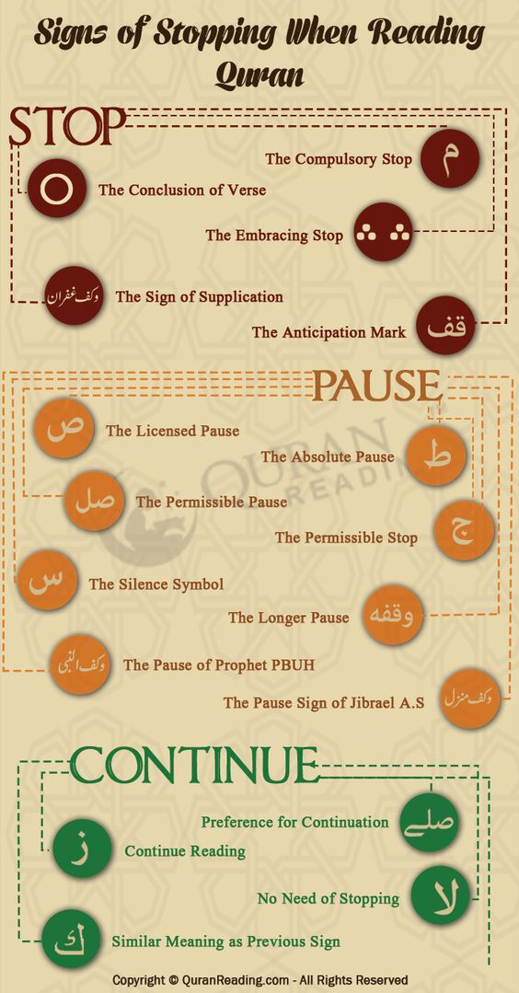
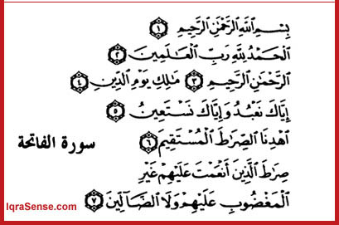
Qur’anic Notation How do readers of the Qur’an’ know the recitation rules? The Qur’an contains notation to guide readers…
Read from right to left
Notation
What do the notations mean?

Slide 6
Yusuf and Binyamin
Yusuf, when reconciling with his brother Binyamin says,
Lo! I, even I, am thy brother
[Qur’an 12:68]
Within the Qur’an both letters and punctuation convey meaning and Quranic recitation follows these rules so that both content and delivery contain the intended meaning to be conveyed.
The story of Yusuf (the Arabic version of Joseph) is told in the Qur’an as well as the Hebrew Bible(Quran 12).
At a crucial point in the story Yusuf is reunited with his brother Binyamin.
The vowel in the word ‘am’ in Arabic is elongated when recited, adding to the drama of the reconciliation between the brothers. The purpose is to prompt understanding and empathy in the hearer.
Muhammed liked to have the Quran recited back to him to fully appreciate the impact of its words when spoken.
Check out the Qur’an reference: http://corpus.quran.com/wordbyword.jsp?chapter=12&verse=69#(12:69:1)
Notes:
Resource: Yusuf and Binyamin

Slide 7
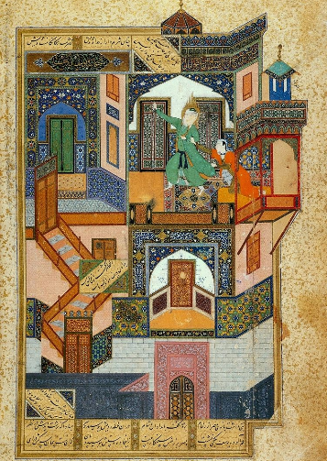
Yusuf and Binyamin Reading with pupils
Explore the impact this way of reciting has on a text.
Give out the verse and have pupils sit in groups, taking it in turns to recite the verse following their natural speech patterns.
Then repeat this process, playing with putting emphasis on different parts (words and vowels within words) of the line.
Can pupils settle on a recitation that conveys the full meaning of this reconciliation moment between brothers?
https://en.wikipedia.org/wiki/Yusuf_(surah)#/media/File:Yusef_Zuleykha.jpg

Slide 8
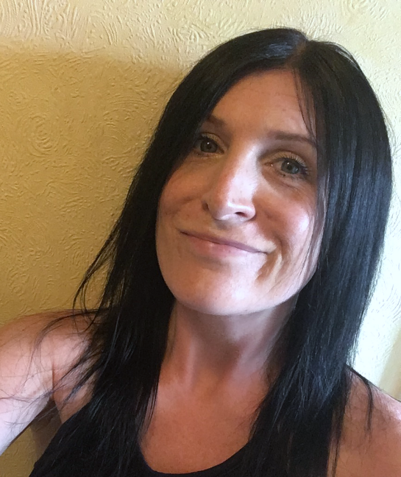
Jennifer Jenkins RE Facilitator for Coventry and Warwick
Former assistant head teacher at a large primary school in Nuneaton. Former English subject leader (13 years) and Lead Teacher for Royal Shakespeare Company (2 years), as well as RE subject leader for 15 years.
Currently working one day a week as RE Facilitator for Coventry and Warwickshire on behalf of both SACREs working jointly and some work for Coventry Diocesan Board of Education. ICON School Project Manager for Coventry Cathedral. ICONS are schools awarded a Cross of Nails (a symbol of peace and reconciliation following the Coventry Blitz in November 1940) for their commitment to teaching children and young people how to be peace-makers and reconcilers.
Lover of all things literary and text-based and super fan of lifelong learning.

