Slide 1

Catholics ~ Children
Challenge 15

Slide 2
Challenge 15
Poem
Choose some of the key terms which you defined in Challenge 14 and use them in writing a poem.
Make clear links to Lent and Easter and be very specific.
You could try writing a ‘shape poem’ like the one on the next slide.

Slide 3
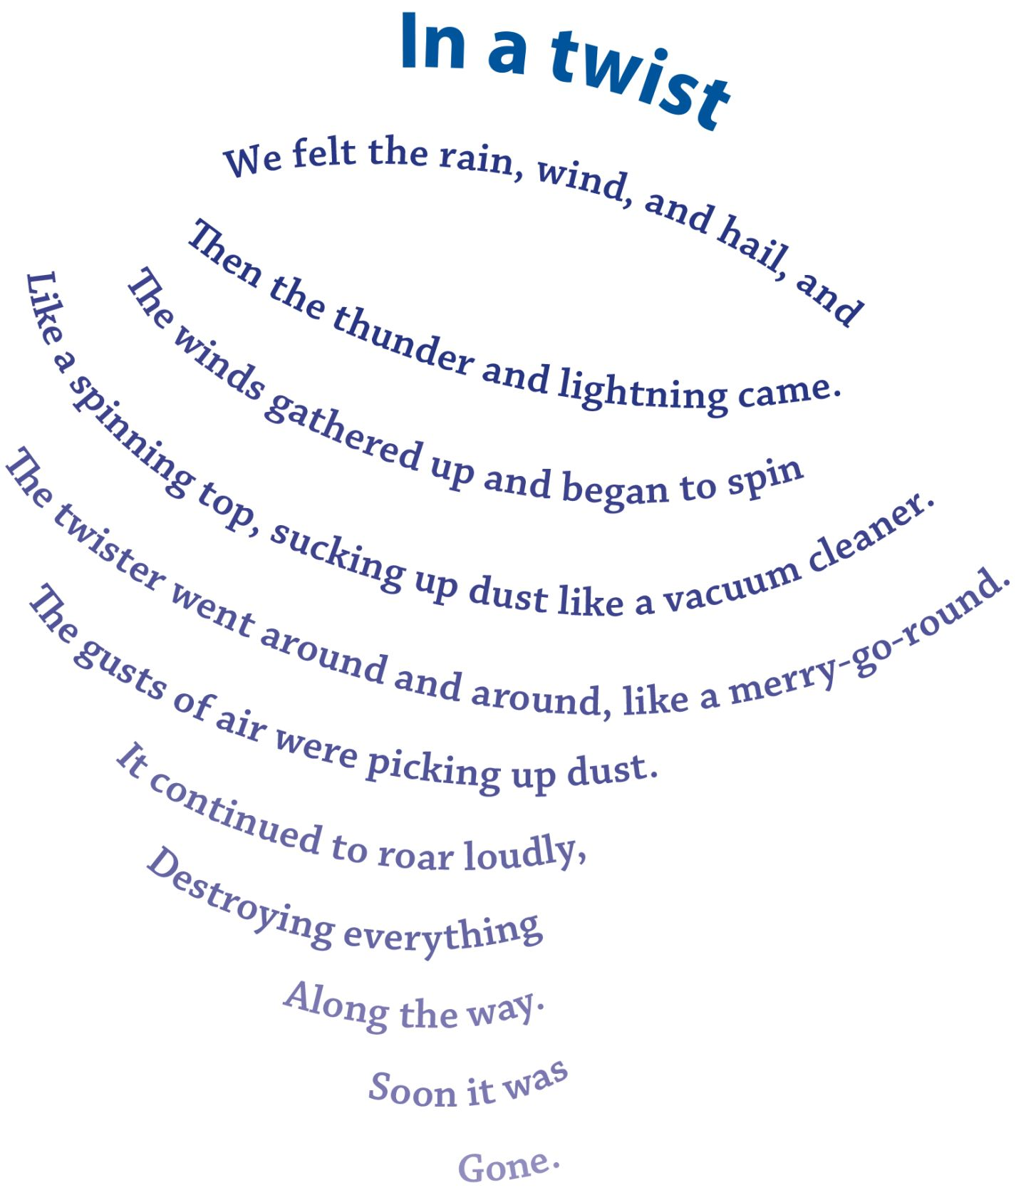
Challenge 15

