Slide 1

Catholics ~ Children
Challenge 16

Slide 2
Challenge 16
Crown of Thorns
Make a Crown of Thorns out of whatever materials you can find.
Write an explanation of your chosen design.
What does it represent?

Slide 3
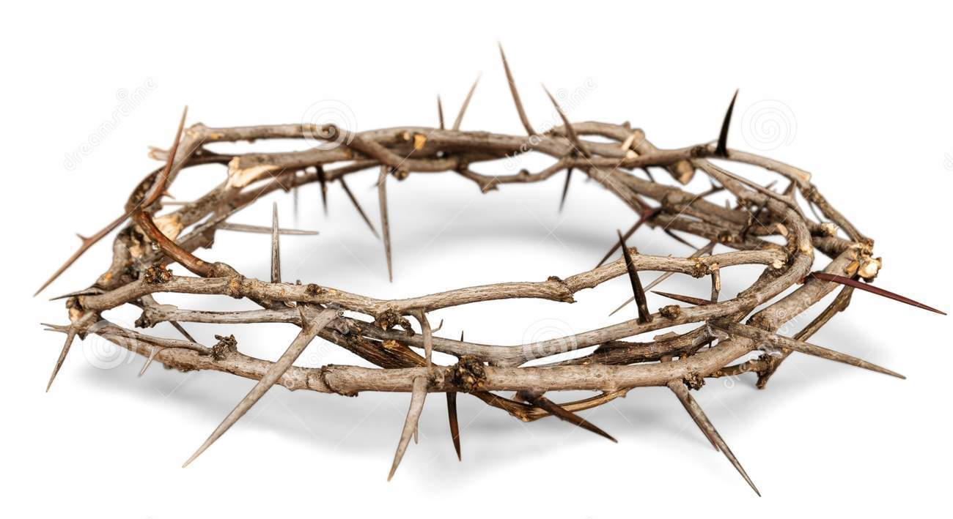
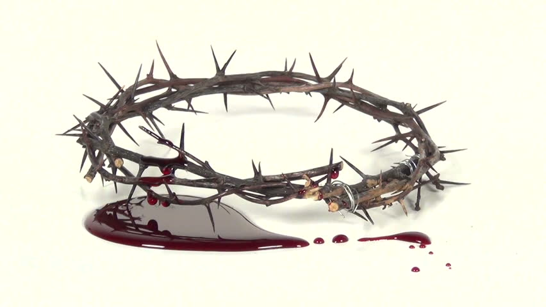
Challenge 16

