Slide 1

Catholics ~ Children
Challenge 22

Slide 2
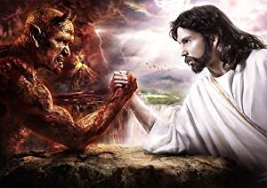
Challenge 22
Jesus and Satan
Create a poster which shows your understanding of Jesus and Satan.

