Slide 1
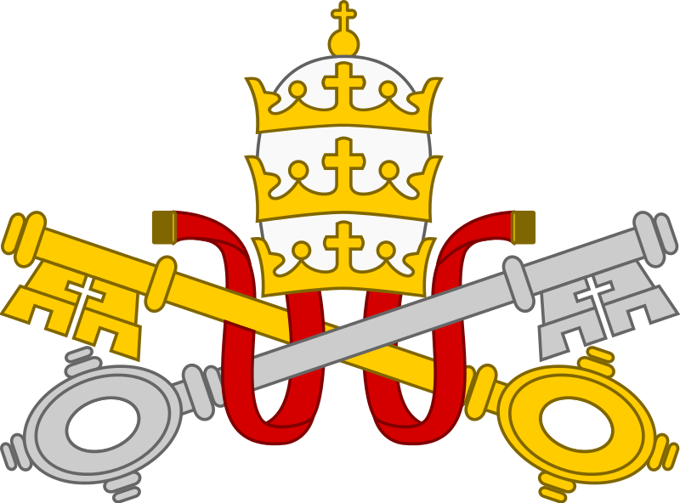
Catholics ~ Children
Challenge 5

Slide 2
Challenge 5
Article
Write an article about the role of a Catholic Priest in Church and the Community.

