Slide 1
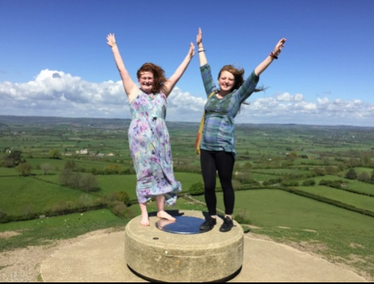
Championing the underdog: a positive pluralist approach to equality and diversity in religious education
Professor Denise Cush

Slide 2
Overview
Initial Reflections on the title
Positive Pluralism
Pluralism, Diversity and Equality : religions, worldviews, school subjects
Experience as a source of authority – a feminist approach
The Future of Religion and RE?

Slide 3
Initial Reflections
Title of my PhD 2012
Analysis of publications 1986-2011.
Buddhism, Hinduism, Paganism, Christianity, Pluralism, RE policy/pedagogy/curriculum, Humanism, Jainism, Theology/RS/RE, faith schools, newer religious movements, experiential learning through placements with religious communities…
Notes:
The title of this talk came from that of my PhD (Warwick 2012) which summarised my decades of work in Study of Religions and RE.
The topics upon which I have published look initially rather disparate and random, but…

Slide 4
Initial Reflections
Commitment to equality and diversity: whoever or whatever is being left out – Buddhists in the 80s, Humanists and Pagans in the 90s…
Focus on experience: religious experience as central (Smart 1971), experiencing religions, women’s experience, children’s experience, teachers’ experience, experience as a source of authority
Recognised as a feminist approach
Notes:
…they are all united by a concern for the ‘underdog’, a commitment to equally and diversity and not wanting anyone or any tradition to be left out. In the early 80s Buddhism was neglected in RE so a group of us who met at a Shap conference on Buddhism put together the ‘Buddhism resources project’ which helped publicise what was available and create further resources. In the 1990s, Humanism was left out of the 1994 SCAA ‘Model Syllabuses’, so I became interested in the inclusion of ‘non-religious worldviews’, and likewise Pagans were being discriminated against in the debates over Halloween/Samhain in schools. The other theme that runs through my work is a focus on experience – whether religious experience as an important element in the development of religious traditions (as emphasised by Ninian Smart), or experiencing religions at first hand through visits and visitors, and in the case pf Bath Spa students, spending a week with a community other than one’s own. Experience also features as a source of authority, particularly for women, as so many of the competing sources (texts, institutional authorities) are male. I learned that stress on experience is an aspect of feminism. It is also important to listen to the experience of our pupils and of teachers.

Slide 5
Positive Pluralism: a Manifesto
Skeie 1995 ‘plurality’ and ‘pluralism’
‘Positive pluralism’ 1991/1994/2001
(cf Hemming 2018)
Plurality and diversity between and within traditions is not a problem but a good thing
Can learn from others without losing your own tradition and worldview (or not)
A positive resource ‘spiritual biodiversity’ (cf King 2009 ‘pneumatophore’)
Notes:
My partner Dave Francis and myself have long advocated a ‘positive pluralist’ approach to RE – an overall approach rather than a detailed pedagogy, as we would advocate using a mixture of pedagogies and methods in practice. This can be done if you focus on the practical methods rather than the ideological theories behind them which can be incompatible philosophically. I coined the phrase ‘positive pluralism’ in 1991 when on a visit to universities in the USA, where the American approach of seeking human rights and equality in the area of religion and education was to leave it out of state education, which seemed to me to merit the label ‘negative pluralism’. The Norwegian scholar Geir Skeie helpfully distinguishes between ‘plurality’ which simply describes the situation as it is – there are many different religious and non-religious worldviews, and ‘pluralism’ which is a view or belief, usually considering it to be a good thing. Dave and I were pleased to see that ‘positive pluralism’ and our 2001 article was referenced approvingly by Hemming and the team from Cardiff in Religion and Belief: a Resource Pack for Primary Schools in England and Wales (2018).
The basic idea is that plurality and diversity within and between traditions should not be viewed as a problem, or something to gloss over in a universalistic claim that ‘religions are the same really’ but is a positive resources for humanity. There are many teachings and practices from traditions other than the one you belong to that can actually enhance your own faith. The fear that this means watering down or compromising a ‘pure’ tradition should be resisted (are there really any ‘pure’ traditions uninfluenced by culture and context?). What some would view as a ‘worst case scenario’ of deciding that another tradition is actually the one you’d prefer to be involved with, might also be positive. Freedom of religion/worldview and freedom to change religion/worldview are both important human rights.
The amazing diversity of religious and non-religious traditions can be viewed as a kind of ‘spiritual biodiversity’. Just as we should preserve a diversity of species, partly in case one of them turns out to have a crucial benefit to humanity/the planet, there may be elements of traditions that may turn out to hold a important spiritual truth or value. This idea is somewhat similar to Ursula King’s views of ‘pneumatophore’.

Slide 6
Positive Pluralism: a Manifesto 2
‘Epistemologically humble’ 1994
Neither an endorsement nor a refutation of the claims of religions (religious studies/study of religions approach) ‘non-confessional’
Keeps open both the question of the existence and/or possibility of discovering ultimate truth/reality (methodologically agnostic)
Takes non-religious worldviews seriously, and respects backgrounds of all pupils
Notes:
Accepting that there may be all sorts of value in traditions one currently does not follow or belong to requires an attitude which I termed being ‘epistemologically humble’ in 1994 – most of us are not omniscient and do not know the whole truth. This requires an approach to studying religions which neither endorses nor refutes the claims of the worldviews under consideration, sometime called a ‘non-confessional’ or ‘study of religions’ approach. It is ‘methodologically’ agnostic, keeping open both the ontological issue of ultimate reality and the epistemological issue of whether this can be known, for the purposes of study. It doesn’t mean that either teacher or pupil is agnostic in their own worldview and daily life. It does involve taking both religious and non-religious worldviews seriously and respecting the backgrounds of all pupils.

Slide 7
Positive Pluralism: a Manifesto 3
Accepts real diversity and disagreement between and within traditions and does not try to reconcile them prematurely
Differs from theological pluralism (eg John Hick)in not claiming a core of religious reality
Not universalist ‘different paths up the same mountain’
Not relativist in the negative sense of ‘all paths are equally valid’
Notes:
This slide distinguishes ‘positive pluralism’ from views that might sound similar. It differs somewhat from John Hick’s pluralism as that puts forward a religious reality that all the various traditions point to in their different ways. It is definitely not saying that all religions are the same really, or different paths up the same mountain. It is definitely not saying that any view/practice is as good as any other, in the sense in which the word relativism is sometimes used.

Slide 8
Positive Pluralism: a Manifesto 4
Relativist in a positive sense that there are relatively better and relatively worse elements of worldviews and lifestyles and judgments have to be made in practice – critical thinking, ethical engagement.
Fair, impartial, objective?
Feminist critique of ‘objectivity’ – perspectivism but also not all views ‘deserve to survive’ (Gross 1993)
Notes:
No-one really holds that opinion anyway. Positive pluralism is relativist in a different sense of seeing that there are elements of worldviews and lifestyles (rather than judging whole traditions) that are better or worse when looking at from the viewpoint of human flourishing. Judgments do have to be made in practice on critical and ethical grounds. One feminist view is that rejecting the possibility of total objectivity (for any but the omniscient) on the ground of perspectivism (ie we are all looking at things from our own particular context) is not to say that all views deserve to survive.

Slide 9
Positive Pluralism: a Manifesto 5
‘[o]ne should feel that sexist, racist, ethnocentric, and religious chauvinisms, if present, are being threatened by the academic study of religion’ (Gross 1996)
Avoid premature evaluation but not ethical critique
Notes:
An open, non-confessional approach to studying religions (including in the often misunderstood phenomenological approach of Ninian Smart) does not require that one never evaluates the material under consideration, especially on ethical grounds, rather that evaluation should not be undertaken prematurely in an an ignorant and prejudiced way.

Slide 10
Pluralism, Diversity and Equality
Positive Pluralism implies welcoming diversity and promoting equality
2010 UK Equality Act - protected characteristics include ‘religion and belief’, the people rather than the ‘isms’
Are religions and worldviews and their adherents treated equally in RE?
Not really –Christianity v the rest, the Big Six v smaller traditions, ‘religions’ v ‘non-religious worldviews…
Notes:
So diversity is welcomed and equality promoted. Since 2010 the Equality Act included ‘religion and belief’ as one of the protected characteristics. It is important to note that this is for the protection of people not of doctrinal systems. Criticising views, values or practices associated with religions/worldviews is not the same as stirring up hatred against or discriminating against people who identify with or are presumed to belong to a particular religion/belief group.
Does British RE treat worldviews and their adherents equally? Not really, there are some unintended (?) messages given by our curriculum choices.

Slide 11
Religionism in Religious Education
‘Religionism’ (Hull, 1992) ‘tribalistic’ identity involving rejection and exclusion
1988 Education Reform Act (England and Wales) and 1994 guidance
‘Fundamental distinction’ (Hull, 1993)
Christianity versus ‘other religions’
Issues of power, advocacy, funding…
Swedish RE as ‘marinated in Lutheran Protestantism’(Berglund, 2013)
Notes:
John Hull coined the term ‘religionism’ as a parallel with racism and sexism to mean the favouring of one ‘religion’ over the rest in a way which involves exclusion and prejudice. He claimed that British RE tends to make a ‘fundamental distinction’ between Christianity and ‘other religions’. In practice, there are issues of which traditions have access to power, advocacy and funding when it comes to RE. Something similar has been said of that other bastion of non-confessional, multi-faith RE, Sweden.

Slide 12
The Big Six
Buddhism, Christianity, Hinduism, Islam, Judaism, Sikhism – why?
An artefact of English RE in the 1980s
Cole, 1981 cf Cole, 1984
‘one religion after another, each in a watertight compartment’ (Hull, 1993)
Reification/construction of ‘religion’, ‘religions’ and‘world religions’- is religion a meaningful category? Are ‘religions’ monolithic or distinct?
Notes:
Where did the idea of six ‘major world religions” come from? Other countries have different lists eg rarely include Sikhism and often include Chinese/Japanese traditions. Important because of size? Worldwide importance? Presence in Britain? Legacy of imperial conquests/contacts?
This list evolved during the 1980s. In 1981 a popular textbook dealt with 5 religions and then added Buddhism in its 1984 new edition. Why was Buddhism the last to be added?
John Hull criticised the treatment of religions as hermetically sealed units, dealt with in series in RE.
The more scholars – or indeed anyone – think(s) about concepts such as ‘religion’ ‘a religion’ ‘world religions’ they are revealed as human constructs, not necessarily helpful. Is there really such a thing as ‘Hinduism’? Religious traditions and their non-religious equivalents are not monolithic and are very diverse, nor are they completely distinct from each other as they have complex inter-relationships (think of the term ‘Judeo-Christian’ or trying to distinguish ‘Buddhist’ from ‘Hindu’ components in many South and South-East Asian countries).

Slide 13
Including a wider range
Value the backgrounds of all pupils so include a wider range: do I count?
A limited range leads to an impoverished concept of religion – need Dharmic as well as Abrahamic, local/indigenous/newer as well as Big Six
‘Mixed faith families and the ‘existentially interfaith’ (Nesbitt, 2011)
Notes:
There are many arguments for drawing upon a wider range of traditions than the ‘Big Six’ apart from the somewhat arbitrariness of this list. All pupils should feel that their background is respected - if it never mentioned, does my faith count? A limited range of traditions leads to an impoverished or narrow concept of ‘religion’ – for example that it has to centre on belief in God. We need to include Dharmic as well as Abrahamic traditions, and smaller ‘indigenous’ or newer religions and new ways of being religious such as contemporary Paganism. We should also recognize the reality of children from mixed-faith families and the increasing number of people who draw upon a range of traditions in their personal worldview.

Slide 14
Including a wider range
‘Bahá’í Faith, Jainism and Zoroastrianism’ (QCA2004)
Other ancient traditions: Chinese and Japanese religions/philosophies (Daoism, Confucianism, Shinto…)
Newer religious movements eg Rastafari, Mormons, Jehovah’s Witnesses
Paganism (Druids, Wicca, Goddess spirituality)
'Indigenous' traditions and spiritualities native to America (N & S), Australia, New Zealand, Africa and their presence in diaspora.
‘
Notes:
The 2004 QCA non-statutory national framework for RE used these three traditions as examples of further traditions that might be included but this led some to talk of a new list of nine religions!
We could also draw upon other ancient traditions, newer religious movements (the three listed were chosen to appear on REONLINE), Paganism and so-called indigenous traditions and spiritualities.

Slide 15
Including non-religious worldviews
The Toledo Guiding Principles 2007 to include ‘religious and non-religious views in a way that is inclusive, fair and respectful’
1994 exclusion of Humanism
The largest minority/silent majority (Rudge, 1998)
Census data (2001: 16%, 2011: 25%)
Woodhead’s claim (2016 a and b) for December 2015 as the tipping point into a ‘non-religious’ majority in Britain
‘No religion is the new religion’
Notes:
There are many arguments for including the ‘non-religious’ in RE: on ground of inclusion and equality, sheer numbers, influence on European culture. Bath Agreed Syllabus suggested this in 1970 and Birmingham in 1975. Humanism is the most accessible organized non-religious worldview in the UK at present, and Humanists have long been supportive of RE. However, those who call themselves ‘non-religious’ are not necessarily Humanist. Which other organized non-religious worldviews could also be included is a matter for debate. I would argue that it is not any philosophy but those that play a similar role in the lives of adherents as religions do (what Ninian Smart termed ‘quasi-religions’). I might argue for Marxism/Maoism on grounds of impact, or Confucianism if it is considered non-religious. But the subject discipline is not politics, economics or even philosophy.

Slide 16
Including non-religious worldviews
Must include non-religious worldviews to reflect pupils’ backgrounds
18-24 year olds ‘no religion’ = 60%
And to question whether RE is just about ‘religions’
‘Religion has become something that other people do’ (Andrew Brown)
Notes:
One argument for including non-religious worldviews in RE is to avoid the impression that RE is only for ‘religious’ people, or a study that might be interesting but is about ‘them’ rather than ‘me’ or ‘us’.
Especially given the increasing majority of pupils who identify as ‘non-religious’ but still have their own worldviews.

Slide 17
Differential treatment of ‘major’ religions
Some are more equal than others
‘Mentions’ in REC 2013: Christianity 26, Islam 16, Judaism 15, Hinduism 13, Humanism 7, Buddhism 5, Sikhism 4, Jains/Zoroastrians/Bahá’í 2, Jehovah’s Witnesses and Latter Day Saints 1, Pagans 0.
‘Abrahamic’ more than ‘Dharmic’
Notes:
This rather superficial ‘count’ of ‘mentions’ in the 2013 REC document does serve to indicate an implicit hierarchy of importance, conscious or unconscious, although Humanism perhaps receives more attention in this document than it usually does in RE.

Slide 18
Differential treatment of ‘major’ religions
Islam – prioritised or neglected but why?
Neglect of Buddhism (Backus & Cush 2008), Sikhism
Hindu tradition: not so much neglected as distorted (Jackson, 1996)
Christianity: in one sense predominant (DfE,1994) but reified, distorted, unreal (Hayward, 2006) and badly taught (OFSTED, 2010 onwards)
Notes:
Even the so-called major religions (the big six) are treated rather differently in RE

Slide 19
Differential treatment of ‘major’ religions
Some traditions studied via theology and philosophy (Christianity, Buddhism, Humanism and Atheism?) – beliefs, teaching and ideas. A level.
Others studied via sociology and ethnography (Islam, Hinduism, Sikhism, Judaism?) – customs and practices. GCSE. (cf. Thomas and Rolin, 2019)
What is this implying?
Also when? KS1,KS2,KS3, KS4, post 16?
What is this implying?
Notes:
Am I reading too much into this? Perhaps an exaggeration, but some traditions seem to be studied more as the customs and practices of the ‘other’ and others as serious contenders in the realm of ideas.
And does a focus on some traditions with younger children and others with older imply that some traditions are more adult and serious than others?

Slide 20
Subjectism
RE suffers from unequal treatment
Stereotyped, neglected and discriminated against: a ‘minority’ experience
REmoaners?
A society with an instrumental view of education?
Not a priority so students are losing out – unequal access to high quality RE
(See CoRE, NATRE Report, APPG 2013 etc)
Notes:
RE itself as a subject in the curriculum does not seem to have equality with other subjects. Though important in theory and rhetoric, in practice often neglected. One doesn’t want to be classified as an ‘REmoaner’ but ’just because you’re paranoid…’ I do get fed up after more than 40 years of teaching, lecturing and writing about the most amazing and important school subject of it being treated as the least important, being stereotyped, neglected and discriminated against – the classic ‘minority’ experiences. The Ebacc has reinforced the idea that some subjects are more worthwhile than others. It is really sad to see the very recent decline at A level and University level after decades of improvement and success. We must turn this around. Occasionally it is an advantage to be considered unimportant – you get less interference and more scope to choose what you want to do – but not if you have no timetable time, teachers or resources.

Slide 21
Experience
The centrality of experience, religious experience and life experience
The importance of first hand experience of religious and belief communities
Listening to children’s and teachers’ experience
Experience as a source of authority, especially for women – otherwise from leaders, texts, philosophers, tradition : elite, male, white, Eurocentric, Colonial…
Notes:
Just a brief mention of this, but another theme that keeps cropping up over my career is the importance of experience. Whether talking about what could be labelled ‘religious experiences’, including those crucial for the ‘founders’ of religions (think of the revelation of the Qur’an to Muhammad, or the Enlightenment experience of the Buddha), or the everyday lived experience of ‘ordinary’ people, the things that happen in your life that make you ask ‘ultimate’ questions, experience is fundamental to religions/worldviews. In studying religions, from KS1 to university level, nothing beats actually meeting people from religious and belief communities. As in slide 4 above, the experience of both children and teachers is important in both learning and teaching about religions and worldviews. A feminist message is that ‘women’s experience is a source of authority’, especially when it seems to differ from what is found in other sources of authority such as leaders, texts, traditions, philosophers which do tend to foreground the perspectives of elite males (and often also white, Western, Colonial, heterosexual perspectives).

Slide 22
The future of Religion in the UK?
Changing religious landscape
Increased public visibility
Increasing diversity
Loss of Christian monopoly
Increase in the ‘nones’
Entrenched identities/fundamentalism
‘Patchwork religiosity’
‘Non-binary’ approach to religious/secular divide (Richard Holloway)
Notes:
Sociologists of religion, such as Linda Woodhead, point to the changing religious landscape in the UK and many other European countries. Religion seems to be both more in the news and more talked about yet less formally practised. There is increasing diversity, and Christianity, though still the tradition with the most influence on British society, can no longer be assumed. From 2015, Woodhead tells us that those who call themselves ‘non-religious’ have tipped over the 50% mark, referred to as the ‘nones’. Yet in contrast, some seem to be becoming more entrenched in their religious identities, and more conservative and even ‘fundamentalist’ forms of religion are attracting followers. Others feel free to construct their own ‘patchwork’ worldviews, drawing upon a number of different traditions. The sharp division between what is ‘religious’ and what is ‘secular’ is becoming harder to maintain, and Richard Holloway came up with an interesting answer to the question RE teachers often get asked ‘but are you religious or not yourself? It is possible to be ‘ ‘non-binary’ in this matter as in other aspects of identity, and one does not to have to accept either label.

Slide 23
‘Spiritual Revolution’?
Heelas and Woodhead (2002,2005)
Move from ‘religion’ to ‘spirituality’
‘subjective turn’, no external authority
Individual, personal, experiential, loose
Deity immanent if any
2005 Kendall – both active ‘religious’ and ‘spiritual’ a minority, but…2035?
‘Spiritual Care Centre’ Bath RUH
Notes:
Paul Heelas and Linda Woodhead observed a move from ‘religion’ to ‘spirituality’, where there is more stress on the individual and personal rather than external authorities. Where there is a Deity, he/she/it tends to be found ‘within’ rather than ‘out there’, immanent rather than transcendent. Fieldwork in the town of Kendal revealed that actually the majority of people are neither actively ‘religious’, for example attending church regularly, nor actively ‘spiritual’, for example attending an ‘alternative’ meditation group. However, there seems to be a decline in the former and an increase in the latter, and they suggest looking again in about 2035 to see what has happened. On a recent visit to our local hospital, I noticed that the former chapel and chaplaincy has become the ‘Spiritual Care Centre’, so Heelas and Woodhead’s ‘spiritual revolution’ may be slowly happening.

Slide 24
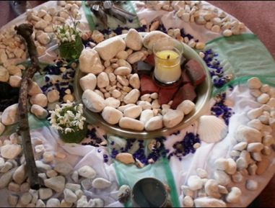
Pick and Mix?
Drawing upon multiple traditions for personal spiritual development ‘patchwork religiosity’ (Lähnemann, 2008); ‘existentially interfaith’ (Nesbitt, 2011); ‘whateverism’ (Plasterk in ter Avest, 2010) ‘religion a la carte’ (Franken, 2016)
Hybrids eg Forest Church
Reconnecting with nature
Christian based but open
Pagan-style rituals
LGBTQ+ relevance
Notes:
The ‘pick and mix’ or ‘bricolage’ approach to religions/worldviews is on the increase, with some interesting phrases suggested to describe this. The knowledge explosion and communications technology (and perhaps 50 years of multi-faith RE) has made this more practically possible. There are also hybrids – a label that would be rejected by many Forest Church practitioners themselves, but we see there an example of Pagan-style rituals used to reconnect with nature in a Christian milieu. People who in other aspects of their lives do not fit into the old boxes often find this flexibility more welcoming, such as the teacher I met recently who identified as Christian but married her female partner in a Pagan ceremony which was more celebratory of their sexuality than their own church was able to be.

Slide 25
Contemporary Paganism indicative of new paradigm religiosity
The individual, experience, as authority
Eclectic, drawing upon several traditions
Stress on ritual, story, myth not doctrines
Anti-dogmatic; liberal ethics ‘an it harm none, do what thou wilt’
Networks rather than organisations
Nature and Environment: immanent divine
Conscious human creation of religion (Nolava)
Notes:
I have been taking note of contemporary Paganism for some time, not only for its intrinsic interest, and because it tended to be discriminated against, but also because it is an example of a wider phenomenon of what could be called a new paradigm of religiosity. The individual and her experience is the main authority. Several traditions are drawn upon (many Pagans for example talk about karma, and may include deities from different pantheons in their practice). There is not so much stress on creeds, doctrines, beliefs or metaphysical truth claims, and more stress on rituals, stories and mythology. There is a tendency to be the opposite of dogmatic, including in the ethical realm – the Wiccan phrase quoted in the slide being a typical example. Groups tend to be more connected networks than institutions, and many stress the importance of the divine in nature, linking with concerns about the planet. The Sea of Faith network talks about religion as a human creation, which might offend more traditional religious adherents, but within the new religiosity that is not not necessarily so. People can create new forms of religion, such as the goddess Nolava (Avalon backwards) in Glastonbury (though of course it can be argued that this is just a new name for an ancient reality).

Slide 26
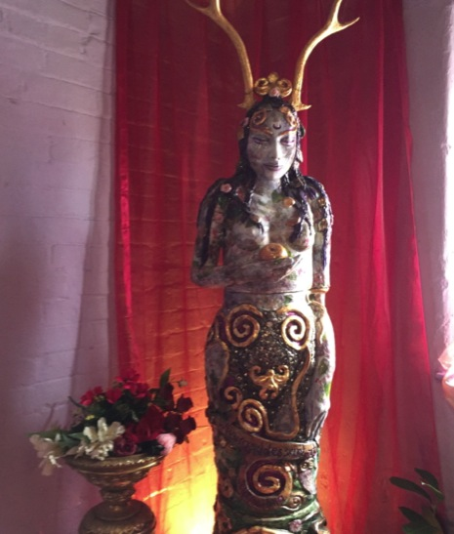
The Lady of Avalon – ‘Nolava’

Slide 27
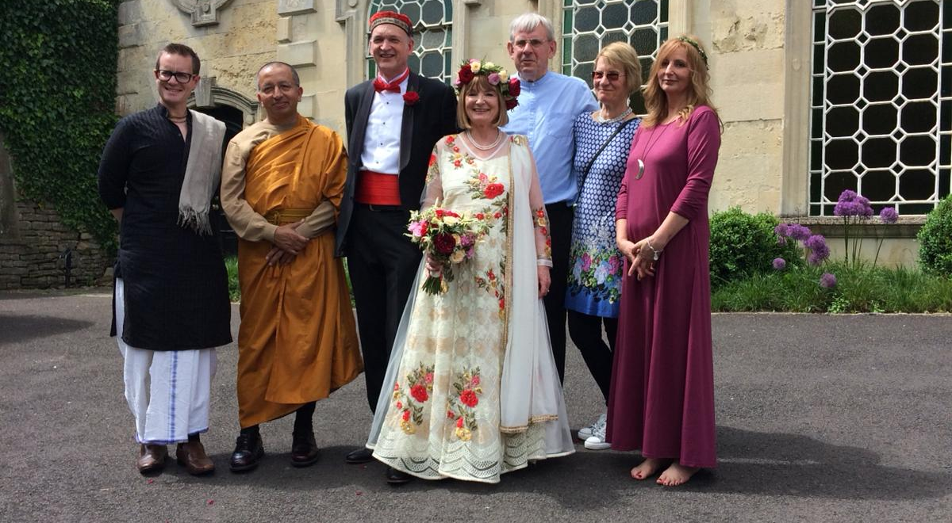
Walk the Talk: a non-religious and multi-faith wedding
Notes:
To illustrate the ‘positive pluralist’ and ‘non-binary’ approach in lives rather than RE lessons – Dave and I were married in 2018 in a ceremony which had both non-religious and multi-religious elements (Christian, Buddhist, Hindu and Pagan celebrants, but we included readings from the Hebrew scriptures and received a Muslim blessing later). The non-religious bit took place in a former chapel and, for legal reasons, the religious blessings took place in a marquee in the garden, which provided a case study of the complex relationship between the religious and secular.

Slide 28
The future of RE?
Need for a fairer RE equal access and equality for pupils and traditions
CoRE Interim Report RE for All
‘widening disparity of provision’
‘reinforces perceptions that religions and worldviews are only of interest to their adherents’
Reflect the changing religious landscape
a wider range of religions/worldviews
Include newer traditions, hybrids, new forms of religiosity, and recognise ‘personal religion’

Slide 29
Future of RE?
More Dharmic and nature religions – to avoid conflating ‘religion’ with belief/doctrines/metaphysical truth claims/God, authority/institutions.
Include non-religious worldviews
Recognise that many don’t have or want overarching ‘worldview’
Challenge the religious/secular divide and explore ‘non-binary’ approaches
Religious and non-religious worldviews as ‘treasure chests’ of useful wisdom?
Introduce idea of conscious creation of ‘religion’?

Slide 30
The future of RE?
Direct first hand experience
A new name?
Religious and Moral Education, Religion Education, Religious Citizenship, Religion(s) and Belief(s), Religion and Ethics, Philosophy and Ethics, RPE, Philosophy and Belief, Worldview Studies, Religion(s) and Worldviews, Sophology?

Slide 31
Future of RE? The Commission and Big Ideas for RE
National entitlement – statutory?
‘New Settlement’ – change to the law?
Change in role of SACREs
Accountability
Improved teacher training
Big Ideas as criteria for curriculum planning (see Wintersgill 2017 and 2019)
A fairer, plural, diverse and more equal RE?

Slide 32
Bibliography
Backus, J. & Cush, D. (2008) ‘Buddhism in the English State School System’ in M. Deegalle (ed.) Dharma to the UK: A Centennial Celebration of Buddhist Legacy. London: World Buddhist Foundation
Berglund, J. (2013). Swedish Religious Education: Objective but Marinated in Lutheran Protestantism? Temenos, 49, 165-184.
Cole, W.O. (1981) Five Religions in the 20th Century Cheltenham: Stanley Thornes
Cole, W.O. & Morgan, P.(1984) Six Religions in the 20th Century Cheltenham: Stanley Thornes
Cush, D. (1994) ‘A Suggested Typology of Positions on Religious Diversity’ Journal of Beliefs and Values 15.2
Cush, D. with Francis, D. (2001a) 'Positive Pluralism to Awareness, Mystery and Value: a Case Study in RE Curriculum Development' in British Journal of Religious Education 24.1

Slide 33
Bibliography 2
Gross, R. (1993) Buddhism After Patriarchy: A Feminist History, Analysis and Reconstruction of Buddhism. Albany: State University of New York Press.
Gross, R. (1996). Feminism and Religion: An Introduction. Boston: Beacon Press.
Hayward (2006) ‘Curriculum Christianity’ British Journal of Religious Education 26:2, pp. 153-171
Heelas, P. (2002). The Spiritual Revolution: from 'Religion' to 'Spirituality'. In L.Woodhead, P.Fletcher, H.Kawanami & D.Smith (Eds.), Religions in the Modern World (pp. 357-377). London: Routledge.
Heelas, P. and Woodhead, L. (2005) The Spiritual Revolution. Oxford: Blackwell.
Hemming,P., Harwood, E. & Stokes, C. (2018) Religion and Belief: a Resource Pack for Primary Schools in England and Wales. Cardiff University.

Slide 34
Bibliography 3
Hull, J. (1992) ‘The Transmission of Religious Prejudice’ (editorial) British Journal of Religious Education 14:2, pp.69-72
Hull, J. (1993) ‘The Fundamental Distinction: A Review of the DFE Draft Circular X/94’, unpublished paper
Jackson, R. (1996) ‘The Construction of “Hinduism” and Its Impact on Religious Education in England and Wales’, Panorama: International Journal of Comparative Religious Education and Values, 8(2), pp. 86-104.
King, U. (2009) The Search for Spirituality: our global quest for meaning and fulfilment. Norwich: Canterbury Press.
Nesbitt, E. (2011). Sikh Diversity in the UK: Contexts and Evolution. In K.A. Jacobsen & K. Myrvold (Eds.) Sikhs in Europe: Migrations, Identity and Representations (pp.225-252). Farnham: Ashgate.
QCA (2004) The non-statutory national framework for RE. London: QCA.
REC (2013) A Review of Religious Education in England. London: REC.

Slide 35
Bibliography 4
Rudge, L. (1998) ‘ “I am nothing” – does it matter? A critique of current educational policy and practice in England on behalf of the silent majority’. British Journal of Religious Education, 20(3), pp.155-165
Skeie G (1995) ‘Plurality and Pluralism : a Challenge for Religious Education’ British Journal of Religious Education 17.2
Smart, N. (1971) The Religious Experience of Mankind London: Fontana
Thomas, A. & Rolin, A. ‘Reading religion in Norwegian textbooks: are individual religions ideas or people?’ British Journal of Religious Education, 41(1).

Slide 36
Bibliography 5
Wintersgill, B. (ed.) (2017). Big Ideas for Religious Education. Exeter: University of Exeter. Also available from: https://socialsciences.exeter.ac.uk/media/universityofexeter/collegeofsocialsciencesandinternationalstudies/education/research/groupsandnetworks/reandspiritualitynetwork/Big_Ideas_for_RE_E-Book.pdf
Wintersgill, B., with Cush, D. and Francis, D. (2019) Putting Big Ideas into Practice in Religious Education. Available from: http://www.reonline.org.uk/knowing/big-ideas-into-practice/
Woodhead, L. (2016a) ‘Why no religion is the new religion’. Talk given at the British Academy, 19th January, 2016.
https://www.youtube.com/watch?v=hPLsuW-TCtA
Woodhead, L. (2016b) ‘Changing Religion, Changing RE’. REtoday 33.2.

