Slide 1
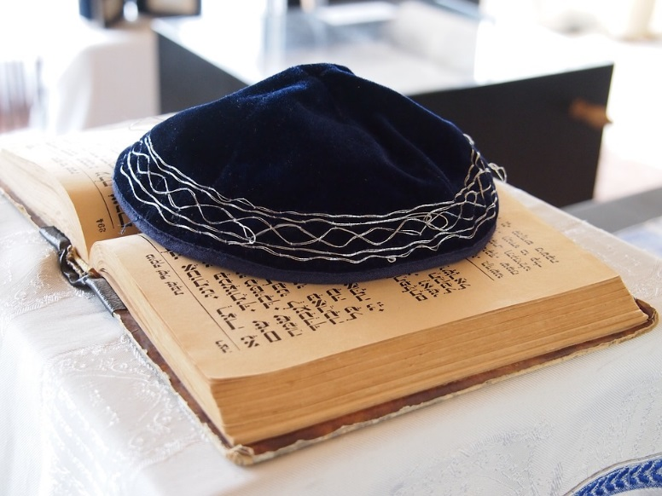
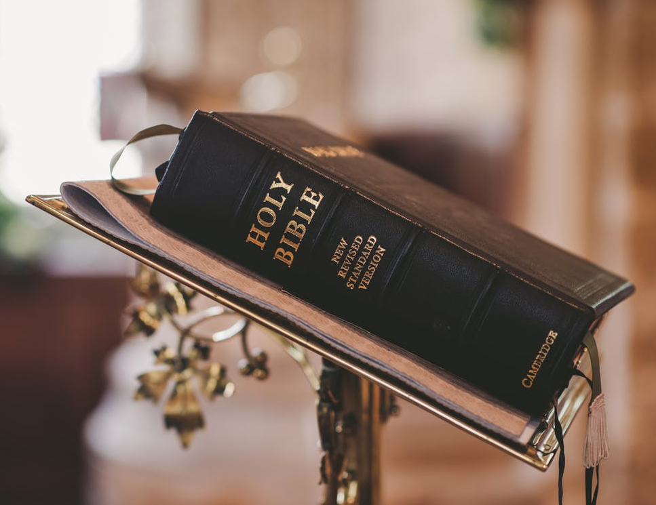
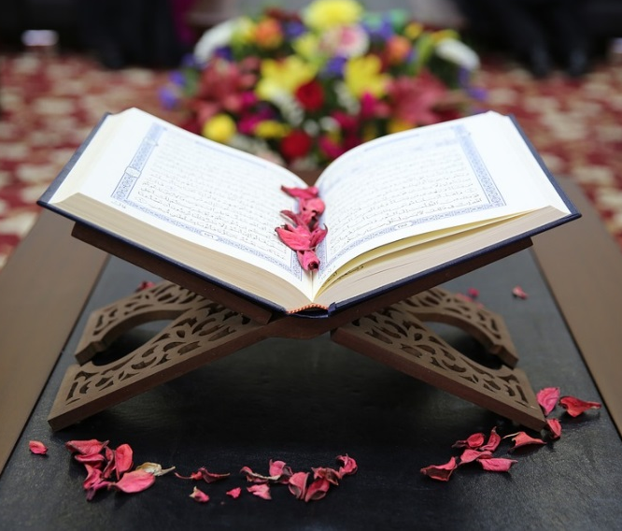
Narrative
Abrahamic faiths
Notes:
This session follows on from the session on Worldviews and focuses on a narrative approach to RE.
This approach may be employed for all religions but for this session, as a starting point, the focus is on the Abrahamic faiths – religions that have Abraham as a key figure: Judaism, Christianity and Islam.
The Bible image is from a free collection at https://www.pexels.com/photo/bible-blur-christ-christianity-372326/
The image of the Qur'an is from a free collection at https://pixabay.com/photos/quran-faith-islamic-muslim-2784477/
The image of the Tanach is from a free collection at

Slide 2
Narratives
Introduction
Worldviews review
How are worldviews formed
– the role of narrative
The role of Narrative –
Judaism
Christianity
Islam
Notes:
The session begins with a reminder of how worldviews are formed with a particular emphasis on the role of life narrative in impacting and forming individuals’ and community worldviews. This provides a bridge then to examine how life narratives have played a role in the formation of the three monotheistic faiths which hold Abraham as a key figure. In examining the narratives formation of these faiths we may learn more about these faiths.

Slide 3
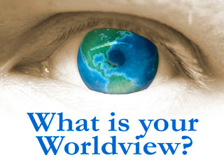
Notes:
A worldview is a system of presuppositions by which one witnesses world and culture. Chuck Colson defined worldview as “the sum total of our beliefs about the world.” It’s an ideology or philosophy of how the world works and how to engage the world. Sometimes we can identify aspects of our own worldviews when we come up against difference.
Christmas….eg. How did you spend Christmas day? We all have a worldview – a set of personal biases by which we engage context, culture, life, and politics. The direct question asks, “What is your worldview?” What set of biases or beliefs incorporate your established framework or worldview?
This will have been examined in previous sessions on worldviews but it would be good to revisits and see if teachers/student have experienced this since the previous session – perhaps in planning preparation or teaching of RE where the views of others have resonated with the student or stood in contrast to the student’s own views.
The worldview image is from
https://growinghostingartistry.files.wordpress.com/2014/01/world-view-eye.jpeg

Slide 4
How are worldviews formed?
refiguration
Text/experience
configuration
Time
prefiguration
The hermeneutic spiral
(Ricoeur, 1984)
Notes:
Recap – French Philosopher, Ricoeur, wrote about the hermeneutical spiral.
Individuals come to a text or life experience with preconceived ideas which can be examined at the prefiguration stage.
Then the individual interacts with the text/life experience in a configuration stage
Then the individual’s views are refigured – the amount or impact of refiguration varies.
This process take place over time.
For further reading read Ricoeur’s work on Time and narrative, (3 Volumes 1984,85 and 88)

Slide 5
The role of narrative
in worldview
formation
‘We tell about our lives in
story form.
Stories also form us.
They are important for the formation of our identity
and they help us know who
we are’
(Bruce, 2008:323).
Notes:
Writing from a theological perspective Bruce notes that ‘we tell about our lives in story form. Stories also form us. They are important for the formation of our identity and they help us know who we are’ (2008:323).
Thus the narrative of individuals’ lives impacts on their worldview. The life narrative that creates the worldview is not yet complete: the individual is still experiencing the world and thus they are still developing and transforming their views, values and beliefs. If the premise is accepted, that worldviews are created by the life narrative that the individual experiences, then as life has an organic nature so too the worldview that life narrative creates for an individual, in very nature, has to be organic too.

Slide 6
The role of narrative
in worldview
formation
‘
“But how could you live and have no story to tell?”
Fyodor Dostoevsky (1848)
“
Notes:
Dostoevsky’s novel (short story) ‘White Nights’ contains this short question.
A lonely man falls in love with a young girl who he meets on the street. She asks to hear his story but he states that he has no story (no history) to retell. Yet she points out that how can you live and have no story to tell.
A living being has a story to tell of their lives so far however unremarkable that may seem to the individual themselves.

Slide 7
What stories do we tell?
If someone asked you to introduce yourself what would you say?
What are the key aspects of your story?
What does that show is important to you?
Does the story change depending on who you talk to?
Notes:
It is worth discussing if we tell different stories depending on our audience – job interview, social occasion, introductions at a work event, when meeting new colleagues or neighbours etc..

Slide 8
Notes:
The process is cyclical but can be impacted by a change in community experiences. External pressure can then be placed on the community worldview and transform it. Just as it can for individuals
the second half of a man’s life is made up of nothing
but the habits he has acquired during the first half”
Fyodor Dostoevsky
Cited by Peter, L. Peter’s Quotations: Ideas for our time 1979, pg 299

Slide 9
Narrative
Notes:
This links clearly with literacy – remind the students of story maps or other narrative aids in their literacy training.
Possible activity - plot out a simple story that they know on this to remind them of the process.

Slide 10
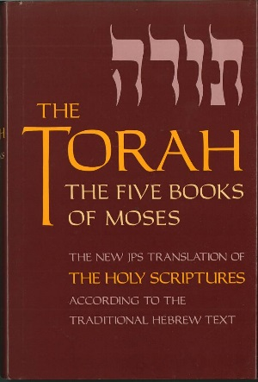
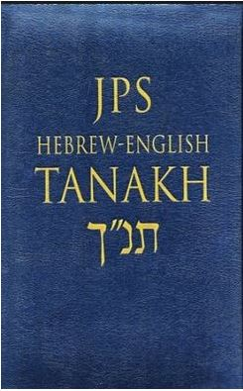
The Jewish Narrative
Tanakh
Jewish Scripture
T=Torah
Nevi'im=prophets
Ketuvim=the writings.
Notes:
Beginning chronologically, Judaism is the first faith to examine.
The Jewish Scriptures are called the Tanakh.
This includes
The Torah – the law
Nevi’im – the prophets
Ketuvim – the writings.
The image of the Tanach is from http://rockofisrael.org/wp-content/uploads/2017/11/tanach.jpg
The image of the Torah is from
https://d.gr-assets.com/books/1344673100l/821535.jpg

Slide 11
The Jewish Narrative
A series of narratives within a
meta-narrative of Yahweh’s
relationship with the people Israel.
Genesis:
Abraham
Flood
Covenant
Babel
Rising Action
Falling Action
Creation
Fall
Bless the nations Genesis 12
“A new world, ultimately a new creation,
begins in this text … God’s mission of
world redemption begins.”
(Wright, 2006:199)
Notes:
The first book of the Tanakh is Genesis (also the first book of the Christian Bible).
Within the first 12 chapters this simple narrative can be traced. The Jewish scriptures are written in narrative form, containing a series of narratives and retell the metanarrative of Yahweh’s (Hebrew God) relationship with the Jewish peple. Wright (a Christian theologian) writes that here is where God’s mission of world redemption begins. His Christian perspective sees the key narrative as how God redeemed, or saved, the world after the fall of mankind. Jewish scholars would see narrative as crucial but would focus more on the redemption of the Jewish people as God’s chosen people.
Yet Jewish prophet, Isaiah, describes Israel as a ‘light to the gentiles’. Isaiah 42:6, 49:6, 60:3. For Jewish scholars Israel as a light acts in a centripetal (drawing towards) rather than centrifugal sense. Indeed, some interpret the term nations as referring to tribes of Israel and not gentiles (or non-Jewish nations) (Rashi )Yet 49:6 and 60:3 are clear references to other nations. The context of these three references (ch. 41–42, 49, and 60) are a prophecy of comfort and a promise to the people of Israel, in which God will restore the people of Israel to their land, and this return will cause the rest of the nations to open their eyes, and look up to the people of Israel, as well as to walk in the way of the One God.
Rashi was Shlomo Yitzchaki (Hebrew: רבי שלמה יצחקי‎; Latin: Salomon Isaacides; French: Salomon de Troyes, 22 February 1040 – 13 July 1105), today generally known by the acronym Rashi (Hebrew: רש״י, RAbbi SHlomo Itzhaki), was a medieval French rabbi and author of a comprehensive commentary on the Talmud

Slide 12
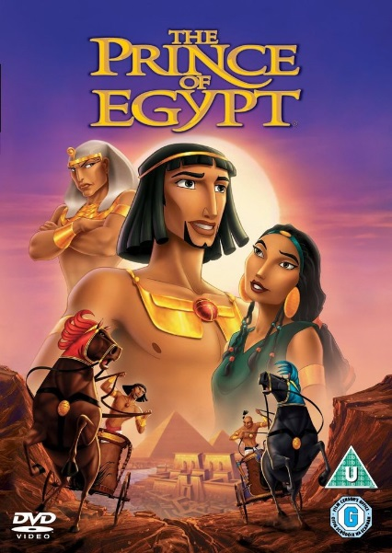
The Jewish Narrative
Exodus:
Watch the Youtube clip
and plot the story on the timeline
Rising Action
Falling Action
https://www.youtube.com/watch?v=N0Vh65UrBK4
Notes:
Activity – ask the students to draw 9 simple pictures of the story as you retell it and then discuss – the emphasis then is not on drawing beautiful pictures but on quickly recalling the actual plot.
The image is from:
http://i.ebayimg.com/images/i/262305446777-0-1/s-l1000.jpg

Slide 13
The Jewish Narrative
Exodus:
Set free
Passover
10 Plagues
Parting of the Red Sea
Moses’s call
Wander in the desert
Moses in the desert
Moses birth
Rising Action
Falling Action
Slaves
Israelis in Egypt
Reach the promised land
Notes:
Elie Wiesel, Messengers of God: Biblical Portraits and Legends (New York: Simon & Schuster, 2005).
‘Wiesel interprets the wellsprings of Jewish religious tradition as the many faces of man’s greatness facing the inexplicable. Relationship with God and his justice.’
· Elie Wiesel, Somewhere a Master: Hasidic Portraits and Legends (New York : Schocken Books, 2005).
‘For Jews who felt abandoned and forsaken by God, these Hasidic masters incarnated an irresistible call to help and salvation.’
· Howard Schwartz, Reimagining the Bible: The Storytelling of the Rabbis (New York: OUP, 1998).

Slide 14
The Jewish Narrative
The narrative begins in the Tanakh but continues throughout history.
Notes:
Many theological studies programmes halt their study of Judaism at the birth of Christ. However, Jewish narrative and scholarship has continued past that point. This slide is to illustrate that and not to be studied in detail.
Recently Universities such as Exeter have developed courses on contemporary Jewish studies.

Slide 15
The Christian Narrative
Jesus birth
God sends the prophets and promises a saviour
Jesus’s ministry – miracles, healings
Exile
Jesus warns them to repent
God sends prophets to warn them
Lack of justice, mercy
Jesus promotes justice (Luke Manifesto)
People ask for a King
Jesus as King
God gives the Law
Jesus fulfils law – sacrificial death
Exodus
Jesus resurrection
God chooses Abraham
Rising Action
God chooses Noah to start again
Falling Action
People respond - repent
Humans fall
God promises new earth
God Creates
Notes:
This is an overview of the Christian narrative.
It has a chiastic form – mirrors. The action is mirrored with counter action in a ABCCBA form.
The Bible image is from a free collection at https://www.pexels.com/photo/photo-of-child-reading-holy-bible-935944/

Slide 16
The Christian Narrative
Resources:
Plot https://www.youtube.com/watch?v=dLFCE8z__hw
Setting https://www.youtube.com/watch?v=7FuT8WtoAK0
Character https://www.youtube.com/watch?v=0EQDGax19xk
What are the strengths and weaknesses of these clips?
In what ways might you use these aids in reading narratives from other faiths?

Slide 17
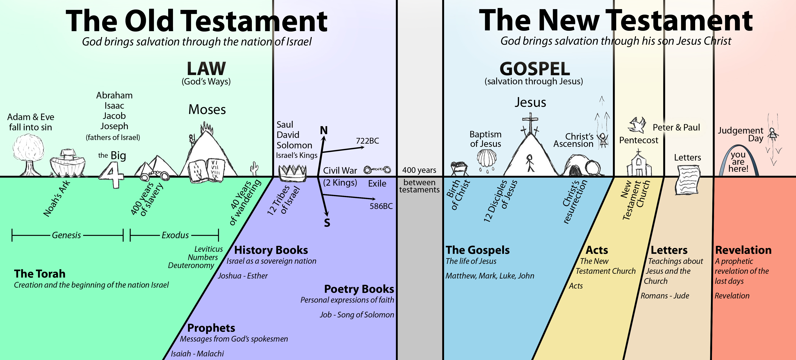
The Christian narrative
Notes:
The Christian Bible contains 66 books which are divided between the Old Testament and the New Testament. The Old Testament contains the Jewish Tanakh and therefore contains the stories of Israel .
The New Testament begins with the birth of Jesus and tells the story of the early church.
This time line is from
https://messiahnetwork.org/wp-content/uploads/2014/09/BIBLE-TIMELINE-NEW.jpg

Slide 18
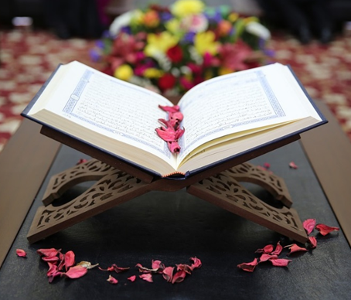
The Islamic Narrative
Qur'an
Notes:
The Islamic narrative is contained in the Qur’an.
From the timeline it is possible to see the overlap with Judaism and Christianity.
The Islamic timeline is from
https://i.pinimg.com/736x/0e/6f/c8/0e6fc81083fd6bffa4e76448575e93f6--the-prophet-prophet-muhammad.jpg

Slide 19
The Islamic Narrative
Mohammed – seal of the prophets
Messages corrupted
True message from God - Qur’an and Hadith
Jesus/Isa - gospel
People respond by submitting
to the will of God revealed by his
last prophet -Mohammed
Moses/Musa - Torah
God sends prophets
Rising Action
God chooses Ishmael
Falling Action
God judges -Day of judgement
God Creates
Paradise
Notes:
The Islamic narrative has some similarities to the previous narratives.
What similarities can you see?
What differences can you see?

Slide 20
What is the narrative for Jews, Christians and Muslims?
Similarities? Differences?
Creation
Noah
Abraham
Sodom and Gomorrah
David
Notes:
After the simple introduction to the meta narratives for each of these three faiths it is important to begin to compare them.

Slide 21
The Abrahamic religions
Parallels – all three founded
in the Middle East
Abraham – common patriarchal figure
Future hope – judgment day, heaven.
Messianic age (Judaism)
Jesus returns to judge (Christianity and Islam)
Notes:
There are key parallels between these three faiths.
All were founded in the Middle East. This may challenge certain preconceived ideas about faith/culture.
All have Abraham as a common patriarchal figure – father of the faith.
All have a future hope of a judgment day and heaven
Differences include
A Messianic age – Messiah is a saviour and Judaism and Christianity believe that there will be a Messianic age where the saviour will be in charge in some way.
Jesus returning on judgment day is common to both Christianity and Islam.
The image is from:
http://static.newworldencyclopedia.org/thumb/8/8f/ReligionSymbolAbr.PNG/250px-ReligionSymbolAbr.PNG
For further information you can examine :
https://slideplayer.com/slide/5195218/

Slide 22
The Abrahamic religions
Narrative differences?
Creation Noah Abraham Isaac Judaism
Ishmael Islam
Examine these 3 Creation narratives – what differences can you identify?
Judaism – https://www.youtube.com/watch?v=lre-LLz-UzE
Christianity - https://www.youtube.com/watch?v=9v1MMQUgNDo
Islam - https://www.youtube.com/watch?v=EP17iaAfQlg
Notes:
One of the key difference comes with the story of Abraham.
Abraham was promised a son by God but his wife was elderly so she suggested he had a child with her slave girl. She gave birth to his son, Ishmael. Ishmael became the father of the Arab people.
Then Sarah herself had a son, Isaac, and she sent Ishmael and his mother away. Isaac became the father of the Jewish people.
Activity – watch the three creation narratives – in groups perhaps pick out main themes.
Discuss any differences.

Slide 23
The Abrahamic religions
Examples of narrative differences?
Sacrifice Isaac (Judaism and Christianity) Genesis 22:1-19
Ishmael (Islam) Qur'ân verse 37:99- 109
Testing soldiers – Gideon(Judaism and Christianity) Judges 7
Saul (Ṭālūt,Islam) Surat al-Baqara 2:246 – 252
Examine each text – what impact does this narrative difference have?
Notes:
Print resources – the key passages. Allow students to read and compare the accounts.
What similarities and differences occur?
How do these change the stories? Or the role of each figure?

Slide 24
References
Dostoevsky, F. (1848) White nights and other stories. New York: Macmillan,
1918 translation.
Reed, E., Freathy, R., Cornwall, S. & Davis, A. (2013) Narrative Theology in
Religious Education, British Journal of Religious Education, 35 (3), 297- 312.
Ricoeur, P. (1983, 1984, 1987) Time and Narrative (Temps et Récit), 3 vols.
trans. McLaughlin, K. and Pellauer, D. (1984, 1985, 1988) Chicago: University of Chicago Press.
Teece, G (2001) Pocket Guides to the Primary Curriculum. Leamington Spa:
Scholastic.
Wright, C.J.H. (2006) The Mission of God: Unlocking the Bible’s Grand Narrative
Nottingham: Inter-Varsity Press.

Slide 25
Further resources:
RE Definitions http://www.re-definitions.org.uk
RE On line http://www.reonline.org.uk/learning/
Zakat http://www.zpub.com/aaa/zakat.html
Islamic narrative https://www.patheos.com/library/islam/beliefs/sacred-narratives
Judaism 101 http://www.jewfaq.org/

