Slide 1
Lessons that make a difference
Pupil Competition 2022

Slide 2
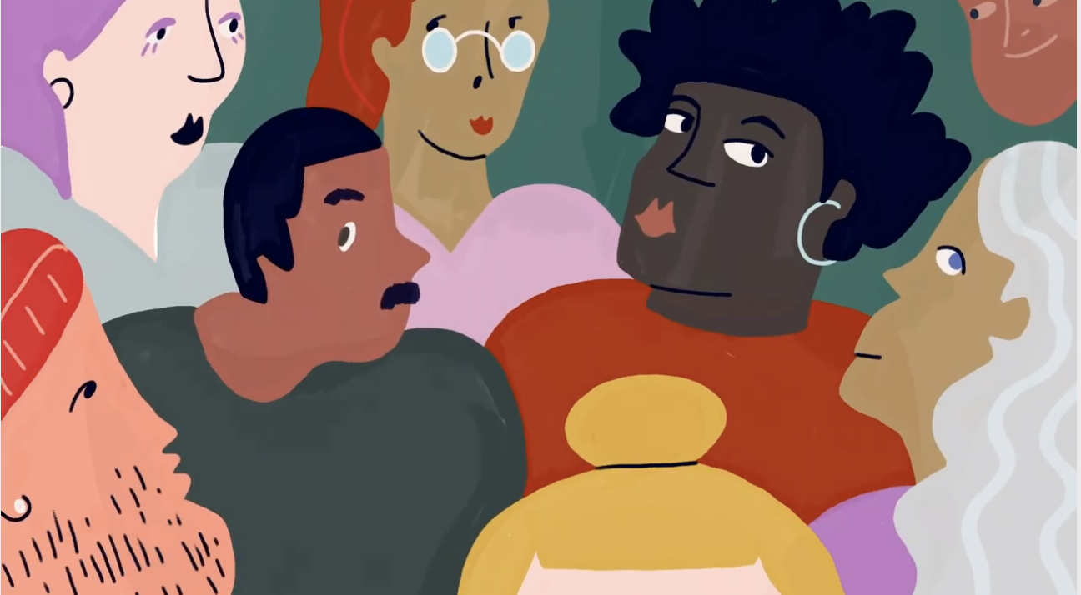
Think about your best RE lesson ever!
Was it one where you had to think really hard?
Was it one that made you change your mind about something?
Was it one where your brain got so full of new ideas?
Was it one where you did something different to a normal lesson?
We want to hear from you!

Slide 3
We are looking for your stories!
Stories of RE/Religion and Worldviews lessons that have made a difference to you!
Could you write a short blog, or create a picture with some writing?
Or
Could you ask your teacher to record you speaking?

Slide 4
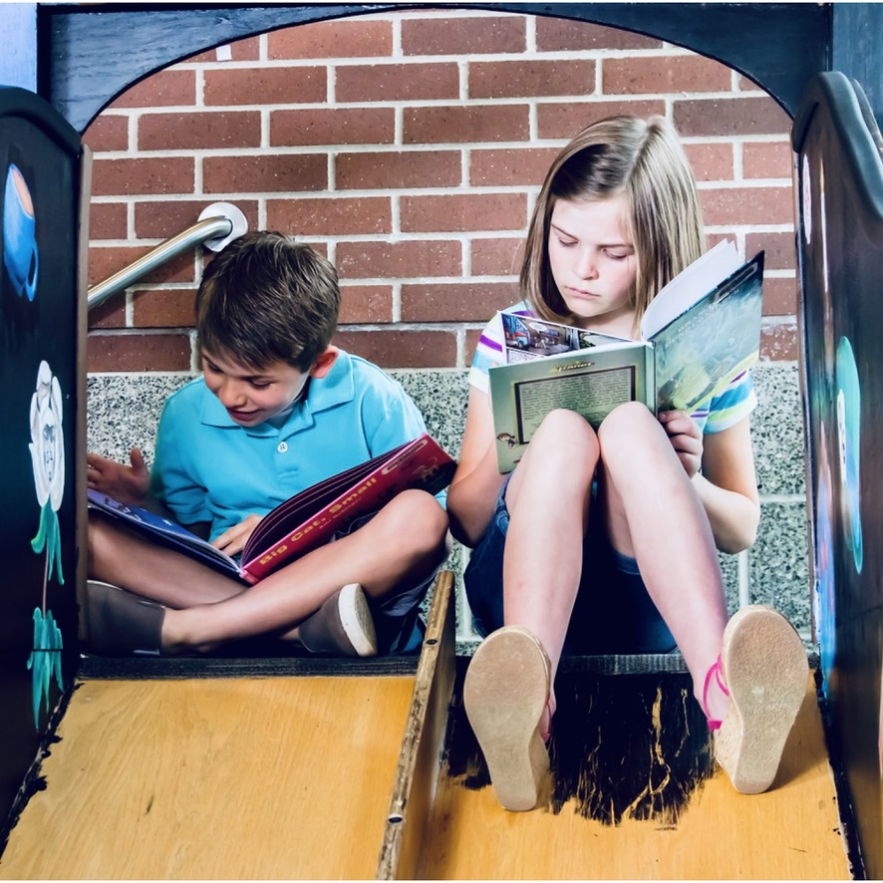
What are judges looking for?
How the lesson made a difference to you
An original or fresh learning experience
A unique, creative writing or speaking style
Supporting arguments with examples
Keeping your listener or reader excited!

Slide 5
Are there any prizes if I win?
Yes- £30 Book Token if you enter as by yourself, or £15 Book Token each if you enter in a pair.
Your school will also receive a voucher to spend on RE Resources.

Slide 6
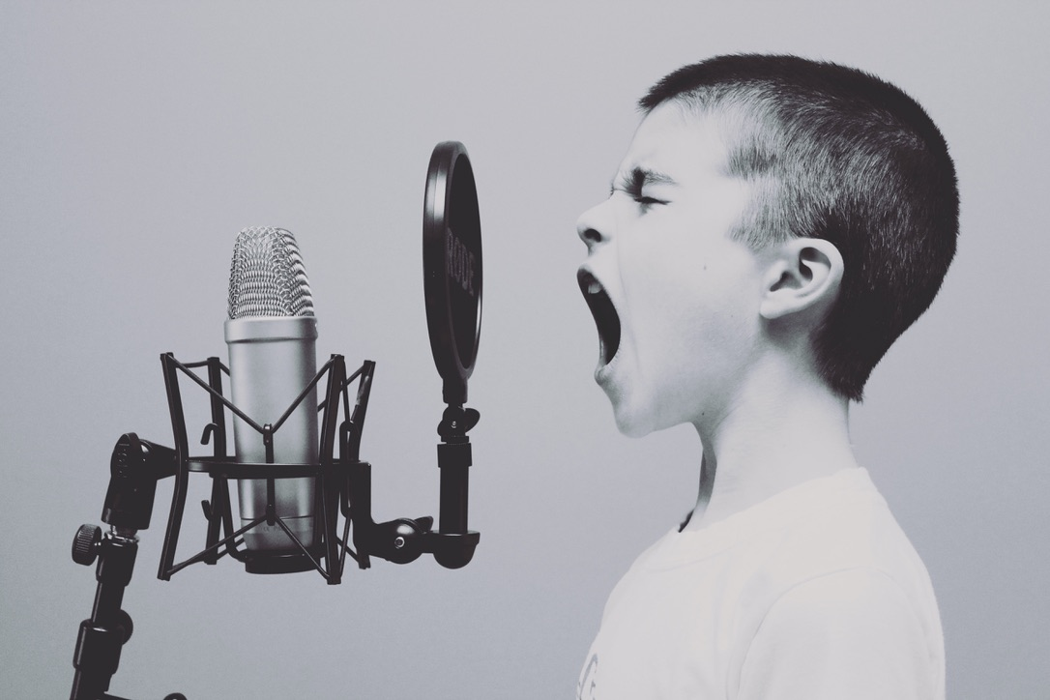
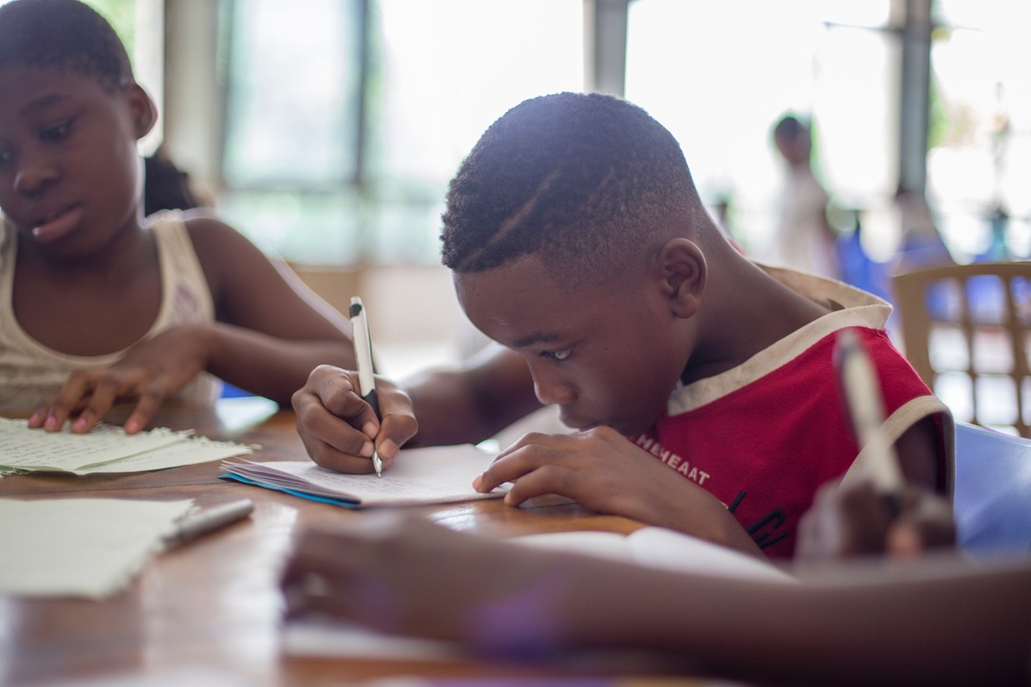
So…
get writing and get recording!!
We look forward to reading and listening to your entries.
Winners of the 2021 Blog Competiton can be found here:
https://www.reonline.org.uk/blog

