Slide 1
Lessons that make a difference
Pupil Competition 2022

Slide 2
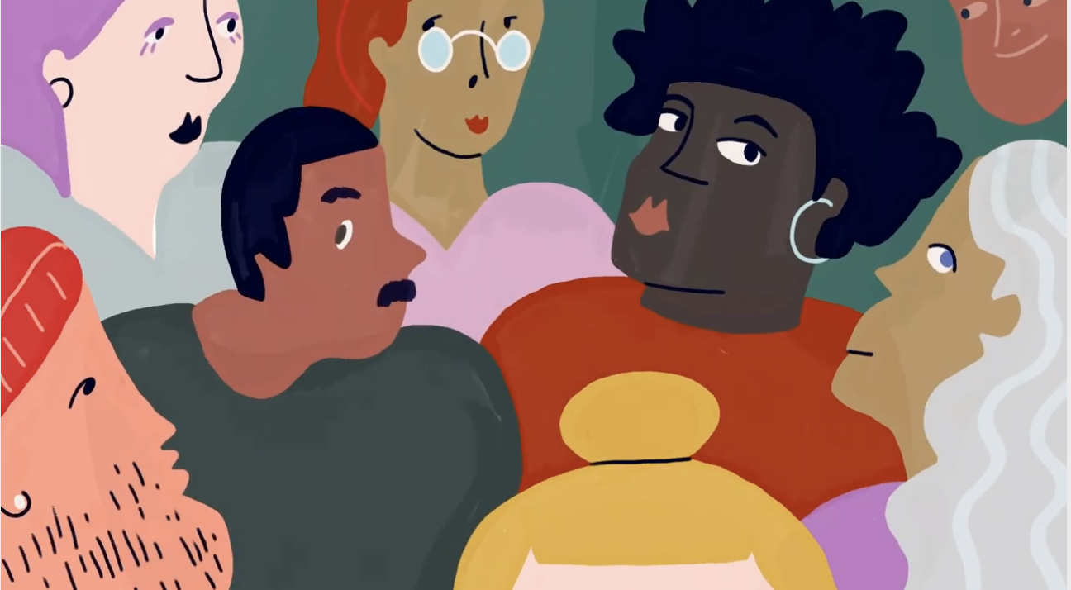
Do RE lessons make you question or think deeply?
Is there an RE lesson that really challenged you?
Which RE lesson has changed your mind about something or caused you to take action?
Is there an RE lesson that stands out as being the best learning experience ever?
We want to hear from you!

Slide 3
We are looking for your stories!
Stories of RE/Religion and Worldviews lessons that have made a difference to you!
Could you write a 500-word blog?
Or
Record a short 2-minute video or audio file?

Slide 4
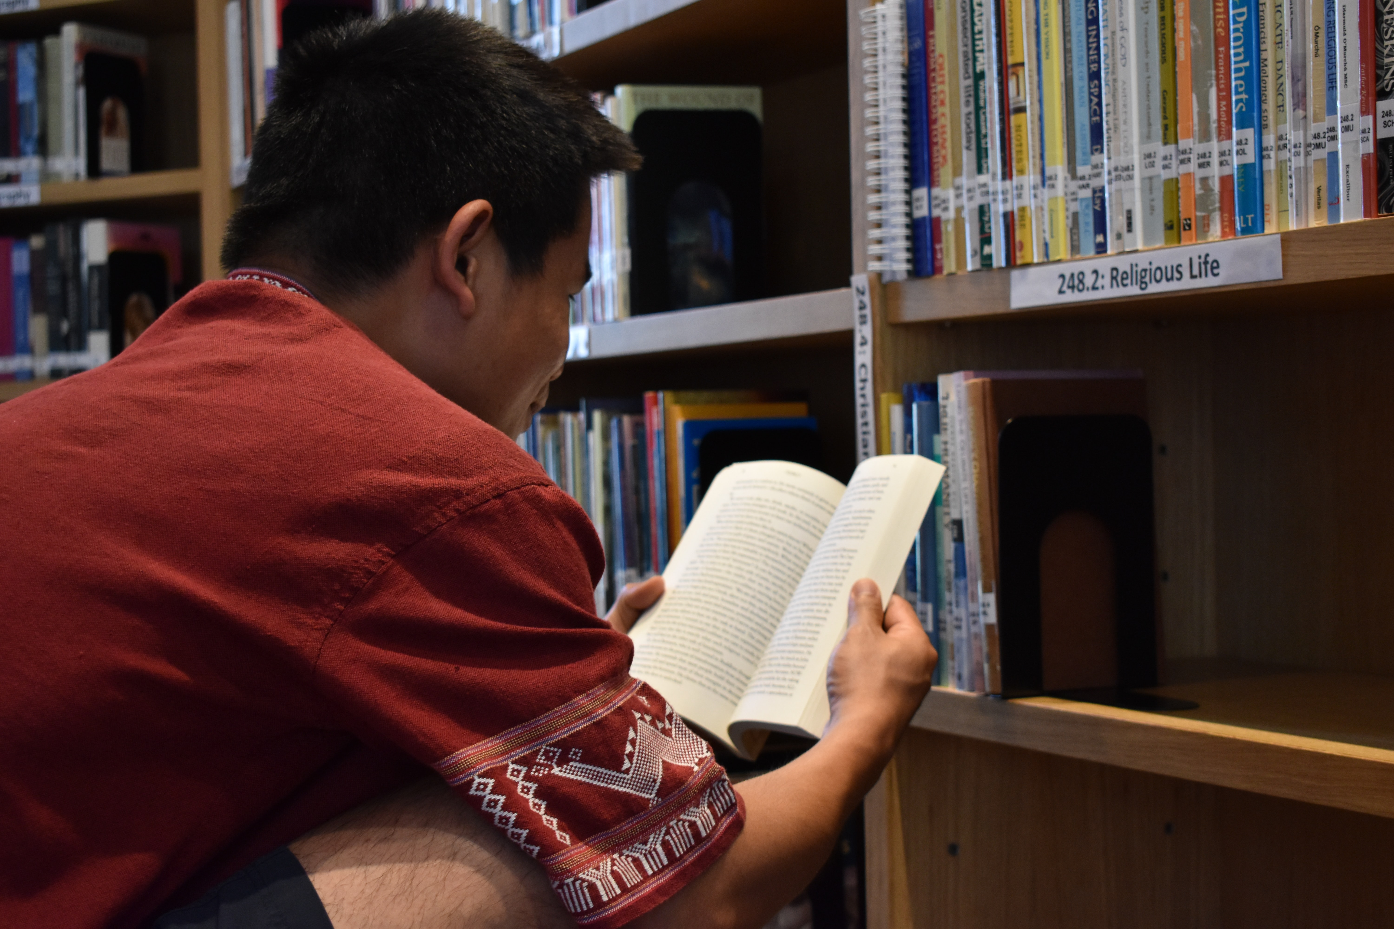
What are judges looking for?
A clear sense of how the lesson had an impact on or made a difference to your learning
An original or fresh learning experience
A unique, creative writing or speaking style
Supporting arguments with examples
The ability to keep the reader or listener excited and engaged

Slide 5
Are there any prizes if I win?
Yes- £30 Book Token if you enter as an individual, or £15 Book Token each if you enter in a pair.
Your school will also receive a voucher to spend on RE Resources.

Slide 6
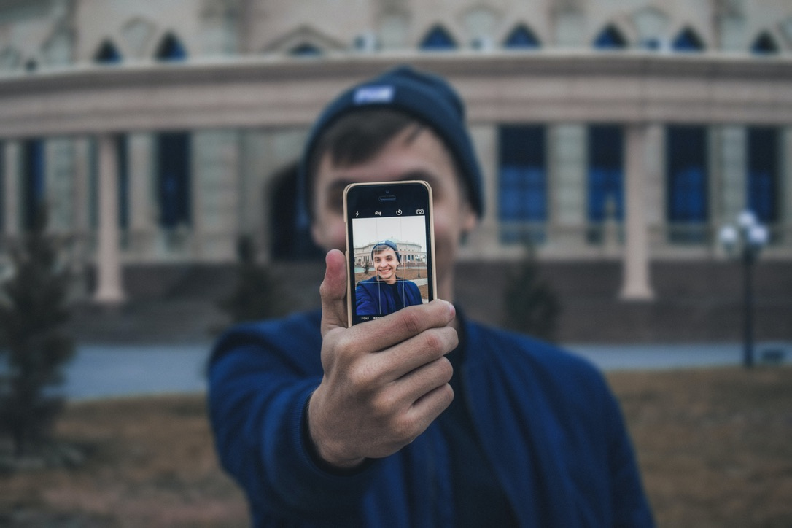
So…
get writing and get recording!!
We look forward to reading and listening to your entries.
Winners of the 2021 Blog Competiton can be found here:
https://www.reonline.org.uk/blog

