Slide 1
Hermeneutics for RE
Knowledge as Interpretation
Jennifer Jenkins, RE Facilitator for Coventry & Warwickshire

Slide 2
Classroom Practice
Hermeneutics Part 2

Slide 3
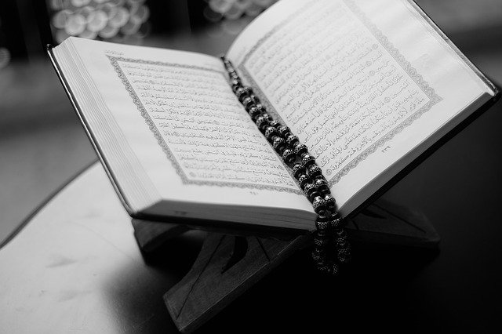
Using Text in RE
Text often used only as artefact (e.g. showing how the Qur’an is approached with washed hands, place on a stand, stored higher than all other books)
Often fragments used simply for argumentation (to ‘prove’ a stance taken or belief held by religious adherents)
Extracts culture common
Texts themselves rarely studied on their own terms but with another goal
Notes:
https://pixabay.com/photos/book-quran-open-pages-open-book-1283468/

Slide 4
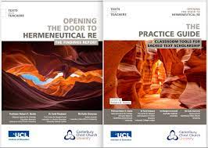
The Role of Hermeneutics in RE & Worldviews- Robert Bowie et al
Key Features of the Study:
Hermeneutics = The art or skill of interpretation
Applies to sacred texts, art and literature
Based on the work of Hans Georg Gadamer, who named something called ‘Pre-understanding’; what we bring to a text before understanding. This is about lenses again.
No-one is a blank slate and no text is read identically by any two readers as each person views it through their own lens, bringing their own worldview, beliefs and life experiences to the text.
Hermeneutics is a concept applicable across the curriculum, not just in RE.
Texts & Teachers: Opening the Door to Hermeneutical RE Findings Report & Practice Guide

Slide 5
The Role of Hermeneutics in RE & Worldviews- Robert Bowie et al
Assumptions influence our interpretation of new content. Our personal worldview predisposes us to understand and interpret events and experiences in particular ways, and this is the same for how we interpret texts.
Hermeneutics is part of a theological approach to worldviews and the texts which are sacred to those aligning their personal worldview with an organised/institutional one.
Text use in RE classrooms is often poor, with sacred texts being used as artefacts rather than to study.
When texts are studied these are often reduced to memorised quotes to act as ‘proof’ texts for answering exam-style questions focused on certain ideas and issues. There is a growing concern this could make pupils think religion is full of arguments.

Slide 6
The Role of Hermeneutics in RE & Worldviews- Robert Bowie et al
At best, pupils may engage with short extracts but have no concept of how faith adherents engage with their sacred texts or how different meaning is found within e.g. for prayer, meditation, study, worship, personal reflection, for solo use or reading aloud/recitation or through group discussion.
Pupils are often unaware that individuals with a personal worldview located within an organised/institutional worldview can interpret sacred texts differently, for instance literal, moral, spiritual and symbolic interpretations, so that members of the same faith community can express what sacred texts say and mean differently.
Umberto Eco said that the skill of a good reader is to be proficient in handling texts in ways first handled by its author, hearers and audience. In other words, you must look at it through a worldview lens other than your own.

Slide 7
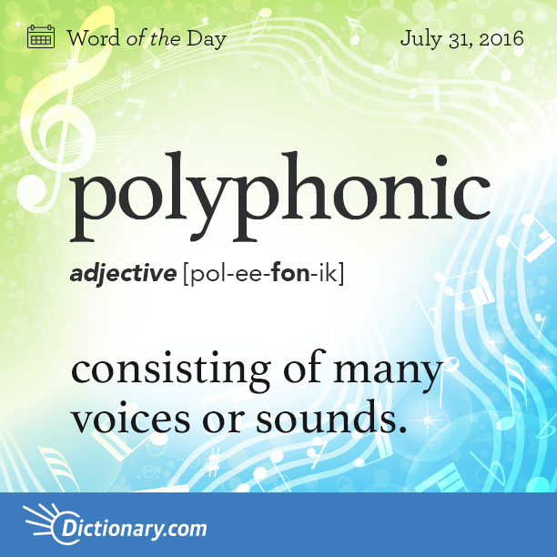
Types of Hermeneutical Enquiry for Teachers to Use in the Classroom
Intention of authors at point of writing
How audiences first heard and responded to sacred texts
The significance of the settings (context) in which texts emerged
Different genres within texts and how this can effect reading
Norms that developed in the reading of sacred texts, such as how the books within the Bible reference each other and how the Bible is traditionally read as a whole text in Christian life rather than fragments
Introduction to key hermeneutical ideas such as the polyphonic nature of texts and where layers of meaning (e.g. literal, symbolic, spiritual) exist within texts
Hermeneutics has a role to play in de-colonising the curriculum & approaching sacred texts critically on issues like race

Slide 8
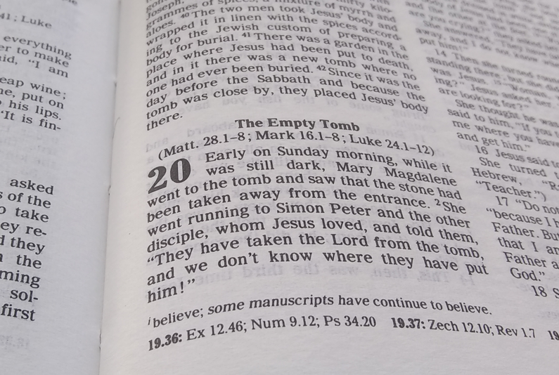
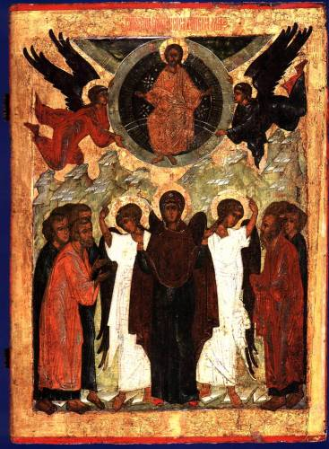
Present
Key hermeneutical question: What is being said, how is it being said and why?
Past
Notes:
https://commons.wikimedia.org/wiki/File:Icons_of_Ascension_of_Christ_(Russia,_16_c.).jpg
https://pixabay.com/photos/glasses-spectacles-style-fashion-789885/

Slide 9
Linking Belief and Practice Through Hermeneutics
Human and Social Sciences
Theology

Slide 10
Types of Text-Based Enquiry for Teachers to Use in the Classroom
Where meaning resides- the author’s mind, audience’s hearing, community of faith’s understanding, particular reader’s conscience
Exploration of historical context
Interpretations made by visitors and pupils of different faith perspectives- how do these differ?
The specific guidance and advice on techniques around exploring texts (using much longer extracts)
Exploring the language and key terms relevant to sacred study and scholarship

Slide 11
Key Terms for Classroom Use
Audience
Author
Chain of meaning
Context
Death of the author
Hermeneutics
Historical Critical
Interpretation
Literal
Literary Form
Meaning
Multi-dimensional
Polyphonic
Pretext
Reader
Reading
Re-reader
Re-reading
Sense
Setting
Significance
Spiritual
Symbolic
Text
This is about helping pupils to become good readers and responsible interpreters in RE

Slide 12
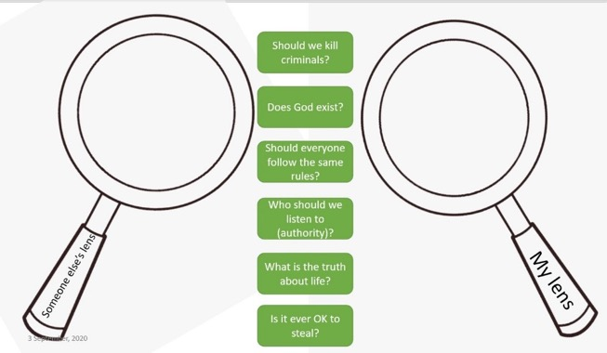
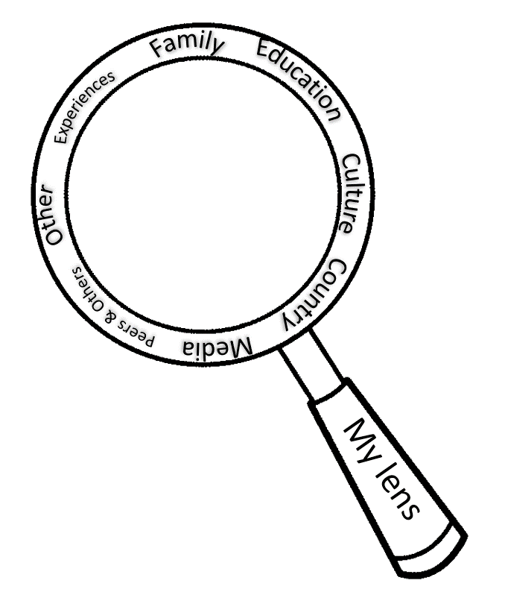
Hermeneutical Lenses
Hermeneutics is a methodology of interpretation with regards to texts, specifically the Bible and other sacred and literary texts.
A simple way to explain this to pupils is through the concept of lenses- the way we see the world because of our own experiences.
Lenses courtesy of Dawn Cox
It is possible to use the lenses of theology, philosophy and human and social sciences to approach different texts.

Slide 13
Hermeneutical Lenses
For example, when studying a Bible story you can approach it through different lenses: Different Christian interpretations (e.g. literal, metaphorical, spiritual), pupils’ own lenses, Muslim perspectives, etc. Pupils see that truth and meaning are not objective concepts when approaching texts.
Lenses courtesy of Dawn Cox

Slide 14
Task: Story of Noah
Biblical scholar John Walton puts it like this: the Bible was written for us all, but it was not written to us. Thus, for us to understand what Genesis means, we first need to understand what it meant to those who wrote and received it.
Work your way through the two resource sheets- reading the biblical account from Genesis 7 and Sura 11 from the Qur’an
Think about your own pre-understanding for this story- how has your life experience impacted the way you read it?
Think about how a Christian might read it (would they all read it in the same way?), how a Muslim would read it, how someone of no religious worldview would read it, how a scientist might read it. Share your ideas on the resource sheet.
Now read the ‘Biblical scholarship’ article about context, authorship, readership, authority, interpretations. Does this knowledge impact upon the way you interpret this story?

Slide 15
Translations

Slide 16
Modes of Interpreting
Literal- the Bible is read as entirely factual. For some Christians it is ‘inerrant’- without error, incapable of being wrong, the literal word of God in written form
Allegorical- considers the foreshadowing of future people and future events in the Bible
Moral- considers what can be learned in terms of virtue from what is read
Spiritual/Symbolic- poetic meaning rather literal meaning sitting behind the events of a text

Slide 17
Types of Criticism
Socio-Historical Criticism- understanding the historical context of the author and the recipient community of a text
Form Criticism- understanding the type of writing
Narrative Criticism- understanding the elements of a story
The Understanding Christianity resource builds on narrative criticism and the big frieze helps pupils old elements together

Slide 18
The Role of Hermeneutics in RE & Worldviews: A Summary
Hermeneutics is part of approaching the study of religions and worldviews through a theological lens (more on disciplinary lenses in the next section).
At best, pupils may engage with short extracts but have no concept of how faith adherents engage with their sacred texts or how different meaning is found within e.g. for prayer, meditation, study, worship, personal reflection, for solo use or reading aloud/recitation or through group discussion.
Pupils are often unaware that individuals with a personal worldview located within an organised/institutional worldview can interpret sacred texts differently, for instance literal, moral, spiritual and symbolic interpretations, so that members of the same faith community can express what sacred texts say and mean differently.
Umberto Eco said that the skill of a good reader is to be proficient in handling texts in ways first handled by its author, hearers and audience. In other words, you must look at it through a worldview lens other than your own. This involves connecting with history and the ancient ongoing conversation about meaning as recorded through language.

