Slide 1
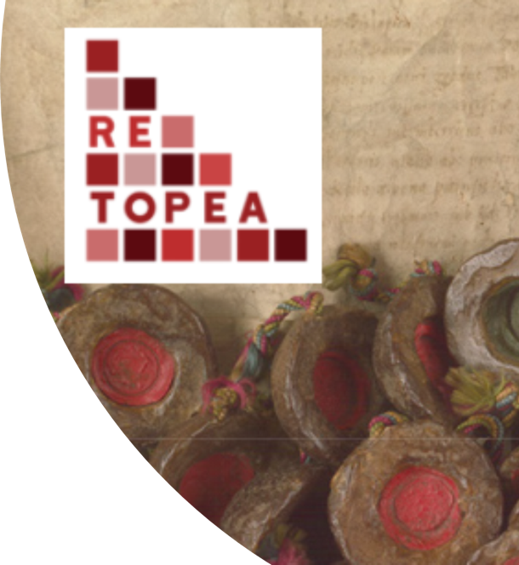
Research of the Month: The RETOPEA project
https://www.open.edu/openlearn/pluginfile.php/3350228/mod_oucontent/oucontent/110491/1562ee14/synej1t5/nc_retopea_2019_vid001_compressed.mp4
Notes:
I am John Wolffe, the Open University lead for the Religious Toleration and Peace project. First I would like you to look at a short film introducing the project, so please click on the link below the right hand image in this slide.

Slide 2
RELIGIOUS TOLERATION AND PEACE
Four year project 2018-22
Linking past and present
Partners in Belgium, Estonia, Finland, Germany, North Macedonia, Poland, Spain
Open University UK lead
Notes:
The original RETOPEA project was funded by the European Commission and ran for four years finishing late last year. It linked together partners from eight European countries. We were responding to a brief from the European Commission to produce materials engaging with the history of religion and developing innovative methodologies for getting young people to think constructively about religious diversity.

Slide 3
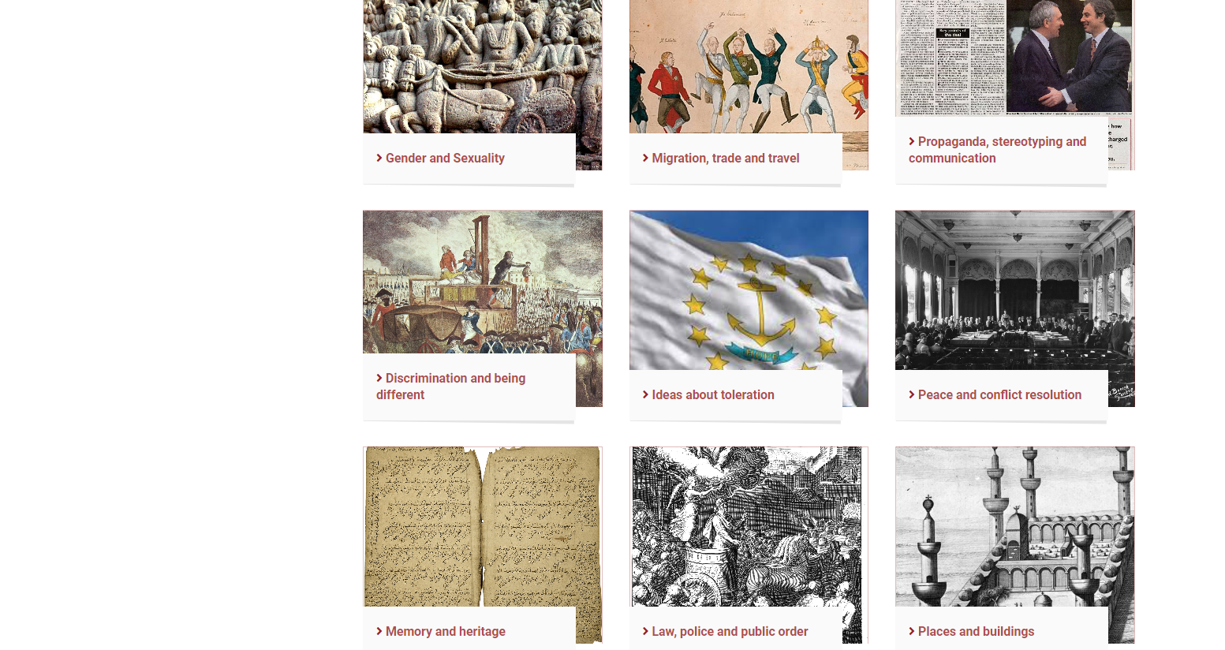
RETOPEA ‘Clippings’ Collection
https://retopea.eu/s/en/page/clippings
Notes:
A key outcome from the project is our collection of ‘clippings’, images and short extracts from historical and contemporary documents that are intended to stimulate ‘out of the box’ reflection and discussion among young people. On the website these are grouped under a number of different themes. To browse the collection for yourself click on the link.

Slide 4
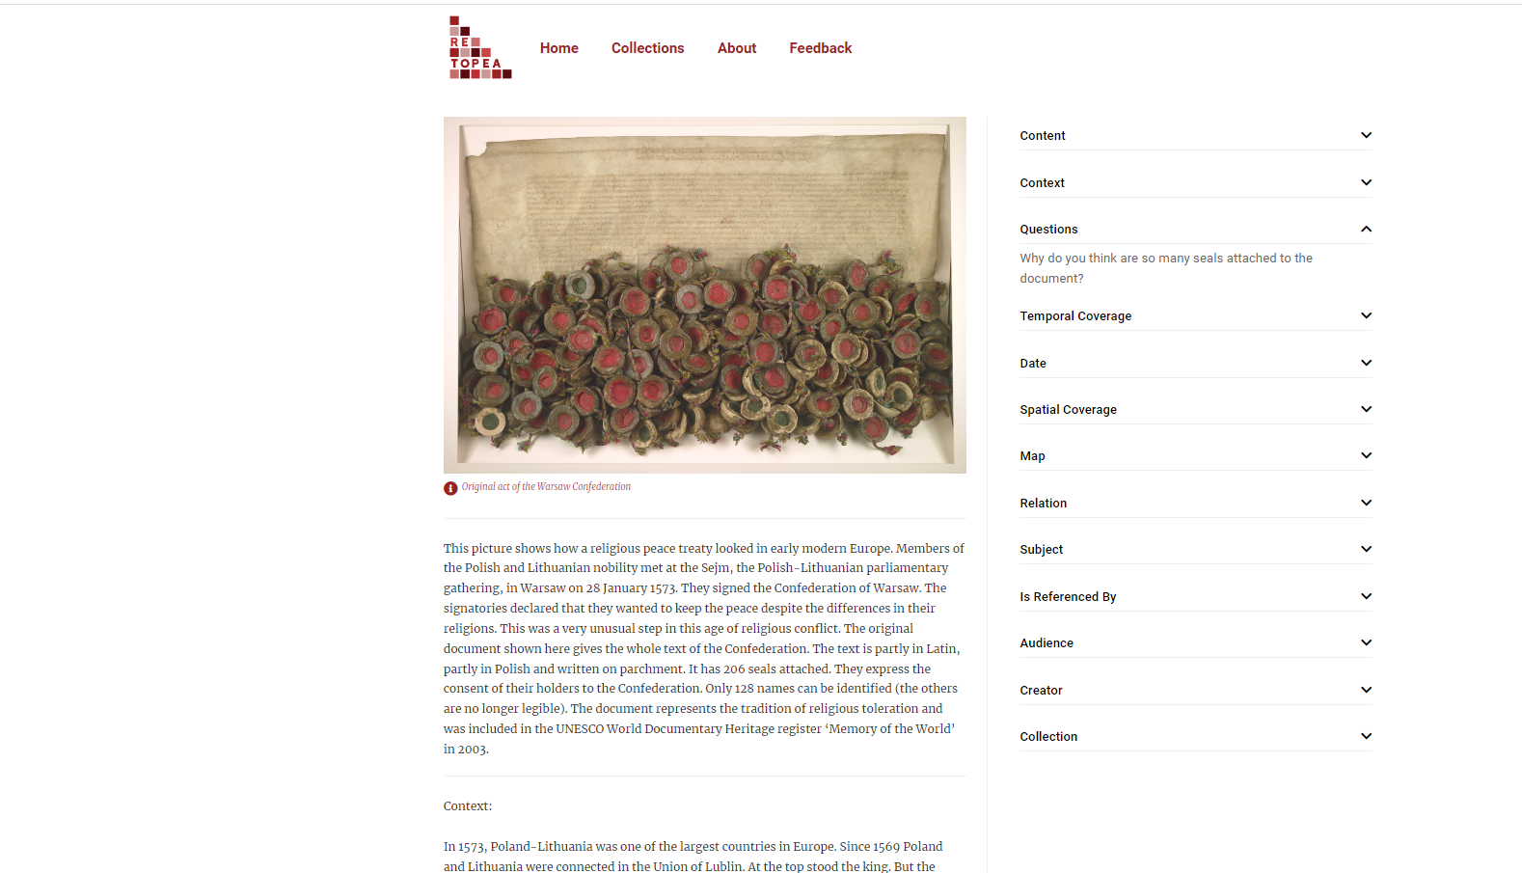
Confederation of Warsaw 1573
Notes:
Here’s just one example from the clippings collection, the 1573 Confederation of Warsaw which was an agreement between the Polish-Lithuanian nobility to keep the peace despite religious differences. Taking place just a year after the St Bartholomew’s Massacre in Paris it suggests a significant counter-narrative to the more familiar emphasis on religious violence in later sixteenth-century Europe. We include a visually engaging image of the document itself, some brief explanation of context, a question for discussion and a variety of links to enable users to explore related items in the collection.

Slide 5
Notes:
Using selections from the clippings as our starting point we then ran 11 pilot workshops, largely with young people between the ages of 13 and 18 in eight different European countries. The aim of the workshops was for them to make short films drawing on ideas from the clippings and relating them to their own context and experience.

Slide 6
Notes:
The workshops took place over two or three days intensively, or in a couple of cases ran in shorter sessions spread over a few weeks. The participants used Go-Pro cameras that we provided, but the project could equally well be done with iPads or with mobile phones. There were four phases – First a classroom discussion in which young people were prompted to reflect on their prior experience of religious diversity and to ENGAGE with a few selected clippings; second, with the young people in groups of three or four they were asked to PLAN their film and the pitch their ideas to those leading the workshop; third they CREATED their films in a variety of different ways. Some groups went on location to museums or religious sites; some interviewed passers by or members of the staff at their own institution; others produced their own graphics. Once filming was completed participants then edited their work to produce films normally lasting three minutes or so. Finally and crucially they were prompted to reflect on their experience, in both a short survey and in a group discussion. It is important to emphasise that the object was not to produce a perfect movie, but rather to learn through the process of discussion, teamwork and developing a narrative in the medium of film.

Slide 7
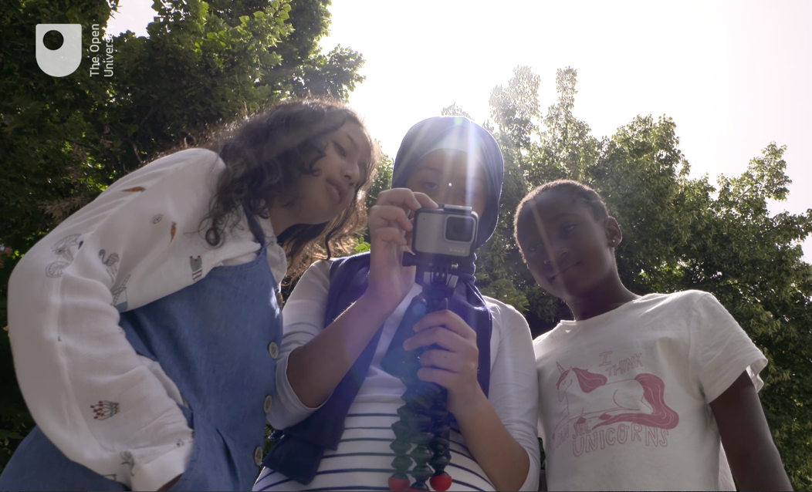
Docutubes
Religious Tolerance in School https://retopea.eu/s/en/item/14655
https://retopea.eu/s/en/page/docutubes
Notes:
Now I’d like you to look at one example of a film produced during a two day workshop at a school in East London, so please click on the first link in this slide. If you would like to explore the whole collection of films made so far by young people across Europe then click on the second link which will take you to the home page for our collection of these films which we have termed ‘docutubes’.

Slide 8
Total of 97 young people (aged 12-18) took part in Docutube pilot workshops in 2020-22 Evaluation through small group interviews as well as teachers’/ researchers’ observation reports A total of 65 students who took part in Docutube pilot workshops in Tampere, Warsaw, Tartu, Urswick (London), Mainz and Skopje completed anonymous evaluation questionnaires
Evaluation
Notes:
We evaluated these workshops in a variety of ways. Not all the participants completed questionnaires but from those who did we were able to gather some useful quantitative data.

Slide 9
Notes:
Their responses suggest that participants very much recognized the value of an historical perspective on present-day religious diversity and toleration. This is an especially significant outcome as our pre-workshop discussions with participants suggested that they initially thought that there was little or no potential to learn from history.

Slide 10
Notes:
This was another very positive outcome. While the participants also very much enjoyed making their films they also recognized that the exercise gave them a significant opportunity to learn about the underlying issues.

Slide 11
Notes:
Here are some examples of the comments participants made in the open section of the form. They convey the participants’ sense of a very positive and enjoyable learning experience. As one German student put it ‘Everyone should take part in this. A new good method to learn something’.

Slide 12
Conclusions:
Effectiveness of creative approach to learning with history and critical thinking about the past and present
Multisensory, ‘hands on’ approach can support deep learning
Value of respectful, ‘open minded approach’ to discussions with young people about religious toleration and peace, facilitation of a ‘safe space to speak out’, express their own opinions and share experiences
Room for exploration and creative freedom
Young people expressed desire to learn more about different religious traditions and religious history in their local environment
Process of making docutube is more important than the end result
Importance of team work, collaboration, learning with/from others
Development of a wide range of skills (incl. critical thinking, cultural/ historical/ religious literacy, team working, presenting/ public speaking, filmmaking/ editing skills etc.)
Notes:
Here our conclusions from the feedback and from our own observations. I’d like to highlight three things in particular.
First, the concept of learning WITH history, not learning ABOUT history, or learning FROM history. In other words history becomes a resource to explore different possibilities, to think ‘outside the box’ about the present. This is not learning about the past as an end in itself, much less offering historical examples as models to be followed, but a process of creative engagement between past and present.
Second, while we provide initial materials and guidance, the films are very much the creation of the young people themselves. We had to field initial concern from ethics committees that that the results could be problematic – for example in promoting religious prejudice rather than toleration – but in face we have found participants to be entirely responsible in what they say.
Finally, the process is more important than the end result. The planning and discussion among themselves enabled young people to explore sometimes sensitive issues in ways with which they would probably have felt uncomfortable in a more formal structured classroom setting.

Slide 13
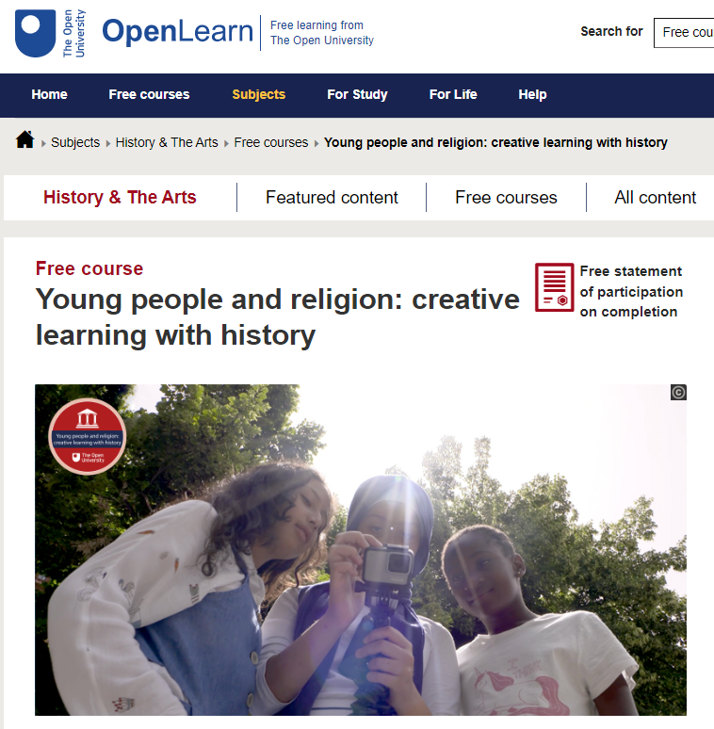
Badged Open Course (BOC) for educators Young people and religion: creative learning with history
Notes:
If you want to learn more about the methodology and to explore trying it out for yourself we have produced a short online course. The link is on this page. It is entirely free thanks to the funding we received from the European Commission, but you will need to register on the site.

Slide 14
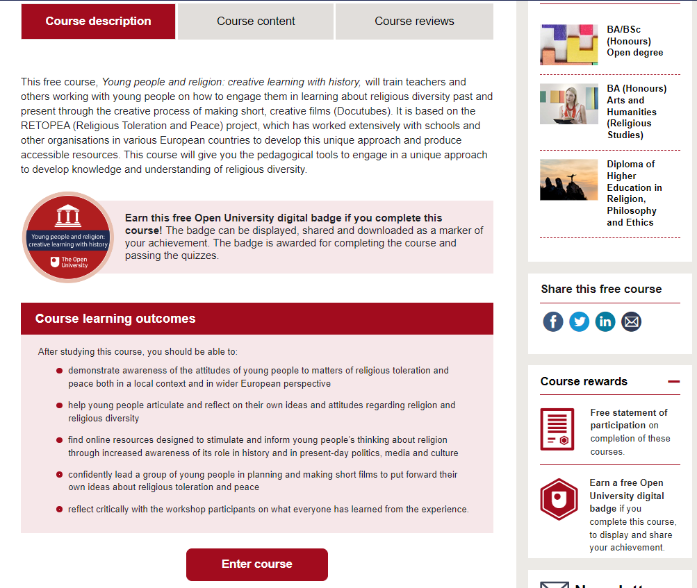
Badged Open Course (BOC) for educators Young people and religion: creative learning with history
Notes:
Here is the course description and learning outcomes. You can earn a digital badge for successful completion.

Slide 15
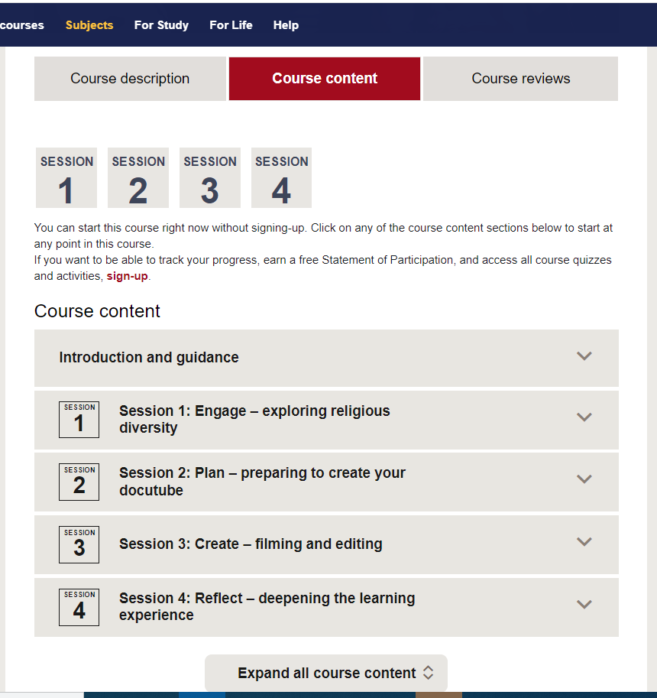
Badged Open Course (BOC) for educators Young people and religion: creative learning with history
Notes:
It follows the fourfold structure I outline earlier – Engage, Plan, Create, Reflect.

Slide 16
Future Plans UK
New funding of £26k from Culham St Gabriels Trust for UK-based activity; £23k from Open University for international activity
2023: Workshops in UK, including Bishop Douglass Catholic School (East Finchley, north London) and Rose Castle Foundation Youth Programme.
Discussions with further school and other partners ongoing: offers and recommendations still very welcome
Dissemination/impact event in London and Belfast late 2023/early 2024 – engagement with UK parliament and Northern Ireland Assembly + written policy briefing
Opportunity for additional systematic evaluation without Covid constraints, leading to academic publication
Notes:
How then will we be taking the project forward? The European Commission funding has now come to an end, but we are very grateful to Culham St Gabriels Trust who are supporting further work in the UK, and to the Open University Open Societal Challenges programme who have given us support for related international activity. We are currently organizing a programme of further workshops which will allow us to test the methodology in a variety of different contexts. Some plans have already firmed up and others are under discussion, but we would delighted to hear from any school or youth organization that would like to participate. I’ll give you contact emails at the end of the presentation.
We hope this further round of pilot workshops will us the further evidence we need to achieve a rigorous academic evaluation of the methodology and to promote it among policy makers, to school leaders and to other stakeholders.

Slide 17
Future Plans: International
Workshops EuroClio – History teachers (Vilnius - April 2023) EFTRE – Religious Studies teachers (Rome – August 2023)
Planning for workshops in Albania, Jordan, Oman – three contrasting majority Muslim countries
Ongoing development of existing RETOPEA network and contacts
Notes:
Meanwhile we are also maintaining and further developing our international engagement. In particular we hope later this year to run workshops in three majority Muslim countries, Albania, Jordan and Oman. We will also be presenting reports on our work so far to conferences of European teachers – History teachers in April and Religious Studies ones in August.

Slide 18
Further Information and Contacts
RETOPEA home page: https://retopea.eu/s/start/page/home
Open Learn Course: Young people and religion: creative learning with history
The Open University RETOPEA Team: John Maiden, Stefanie Sinclair, Katelin Teller, John Wolffe retopea@open.ac.uk and/or Katelin.Teller1@open.ac.uk
Notes:
Finally here is reminder of two essential links, to the RETOPEA home page and to our online course ‘Young People and religion: creative learning with history’. I’ve also included our generic email address and email address for Katelin Teller, who is employed with the money generously granted by Culham St Gabriels and is the best person to contact in the first instance. Do get in touch, especially if you are interested in working with us in a workshop and we would also be very pleased to answer any questions you might have. Thank you for listening.

