Slide 1
Finsbury Park Mosque
Date

Slide 2
Finsbury Park Mosque
Also called the North London Central Mosque
A city mosque for London’s Muslims.
Accommodates 2,000 people.
A community centre for the local Muslim community.
Heavily involved in nearby charities
Image search: Finsbury Park Mosque

Slide 3
Mosques in the UK
Around 50% of all Muslims attend a mosque once a week and most mosques act as a community centre.
According to a YOUGOV poll 70% of Britain have never been inside a non Christian place of worship and almost 90% of Britons have never visited a mosque.
The most recent figures from the office of national statistics (2018) say that 5.1% of the population Muslim, that’s 3, 372, 966
5% of Swiss people are Muslim. Nearly 9% of French people are Muslim and 4.5% of Germans are Muslim.

Slide 4
Image search: Finsbury Park mosque attach
This article from the BBC shows a photo of the aftermath of the attack that a cartoonist echoed to make a point about the Islamophobic messages in British newspapers
https://www.bbc.co.uk/news/uk-40323769

Slide 5
Image search:
Cartoon by Martin Rowson in the Guardian: https://www.theguardian.com/commentisfree/picture/2017/jun/19/martin-rowson-on-the-finsbury-park-attack-cartoon

Slide 6
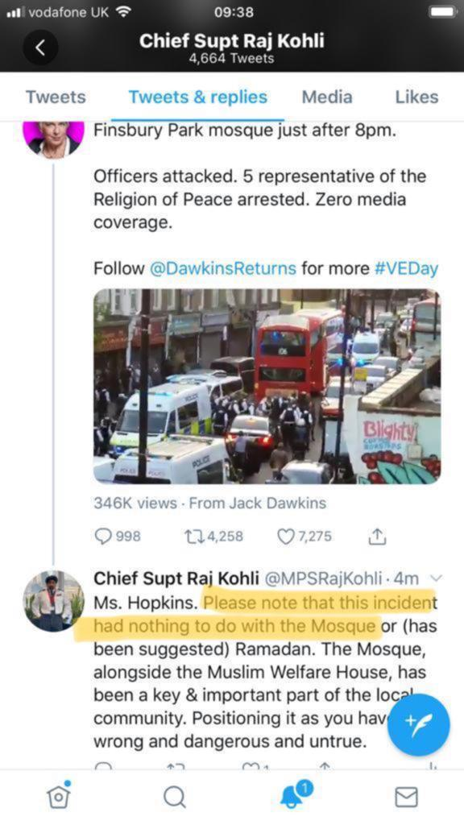

Slide 7
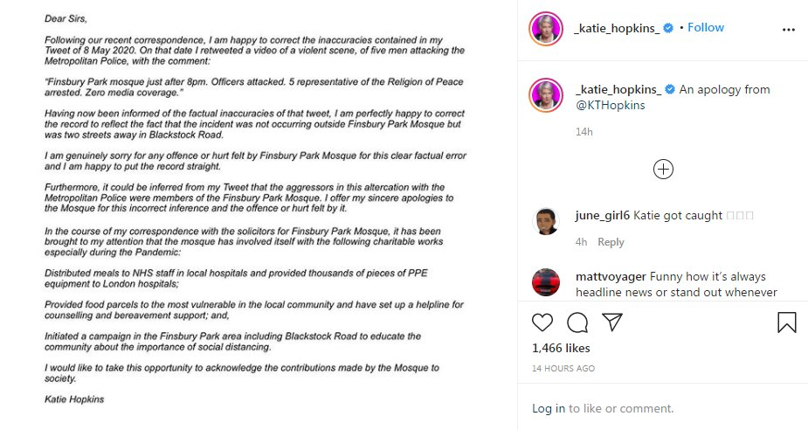

Slide 8
