Slide 1

Hermeneutics for RE
Knowledge as Interpretation
Jennifer Jenkins, RE Facilitator for Coventry & Warwickshire

Slide 2
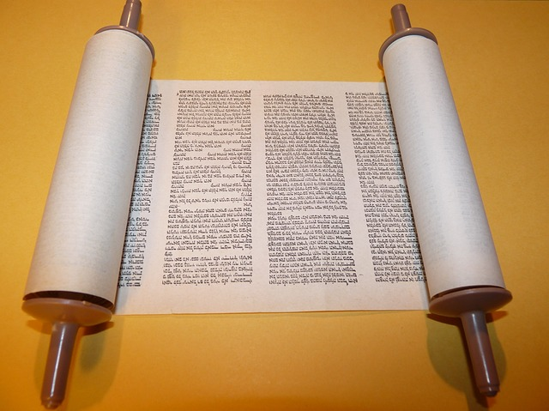

Text-Based Approaches for RE
Hermeneutics Part 3
Notes:
https://pixabay.com/photos/bible-torah-writing-scroll-read-3524065/

Slide 3
Practical Ways to Include Hermeneutics
Questions adapted from Texts and Teachers: Opening the Door to Hermeneutical RE
Questions to ask when modelling good reading with pupils:
What do I need to know to decode the meaning of these words?
Who wrote this and why?
Who did they write it for?
What is the historical-social setting (era, geographical location, politics, society) for this text?
How was this text regarded in the early Christian world?
What literary form does this text take (e.g. letter, poem, history, etc)?
How can this text be read alongside other texts? Do other texts help us to understand this one?
What it teaches about God, humanity, the world, both then and today
Story text
5 Key Quotes
Story text

Slide 4
Practical Ways to Include Hermeneutics
Questions adapted from Texts and Teachers: Opening the Door to Hermeneutical RE
Lead discussions and set up debates around
Texts and key concepts like authorship, ownership, context and readership
Engaging with Texts:
How is this text engaged with by people of faith?
For whom does this text have authority?
How does this text make connections with a person’s faith or worldview?
How is this text engaged with in the following scenarios:
  Liturgy and acts of collective worship
  Prayer and spiritual life
  Theological contexts
  Moral aspects of life
Encouraging Re-Reading:
What connections can you make between what you have read and your own life?
How do your own circumstances bring you new insights to the texts?
How do you read texts- can you identify biases you might have?
How is your reading of the text related to that of a faith community?
Investigate how texts are read/recited in different faith traditions.
Invite faith visitors in to talk about how sacred texts are approached by individuals and religious communities
Re-reading is an important skill for pupils to develop

Slide 5
Practical Ways to Include Hermeneutics
Questions adapted from Texts and Teachers: Opening the Door to Hermeneutical RE
Discussion Questions:
Where is meaning found? The text itself, the author’s mind, the situation/circumstance which shaped and informed the text, the community that receives, reads, engages with and interacts with the text, the mind of the reader who encounters it for themselves?
How can we be a good, responsible reader?
Is the meaning of a text stable and enduring?
Do meanings of texts change over time and can new meanings appear? Is there a hierarchy of authentic meanings?
Can things be revealed through a text that the author had no concept? If so, are there criteria for this?
“In community a shared endeavour for reading the text is important. Sacred text scholarship commonly takes place in a disciplinary community, a group of scholars with a shared commitment to disciplinary study with common approaches that are practised. It can happen in interfaith settings. It also takes place in wider public life. This can be thought of as a learning community, a school class. “What the text says to me” is a legitimate question for group discussion and this can be entirely inclusive.”
From Texts and Teachers Practice Guide
Lead discussions and set up debates around texts and key concepts like authorship, ownership, context and readership

Slide 6
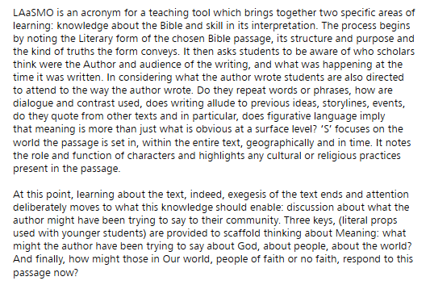
Practical Ways to Include Hermeneutics
LAASMO Technique
Literary form
Author
Audience
Setting
Meaning (what the author might be trying to say)
Our world (how the world, including people of different faiths or no faith, might interpret this passage).
Hermeneutical technique developed by Dr Margaret Carswell
https://www.canterbury.ac.uk/education/our-work/research-enterprise/national-institute-christian-education-research/docs/teachers-and-texts-the-practice-guide.pdf

Slide 7
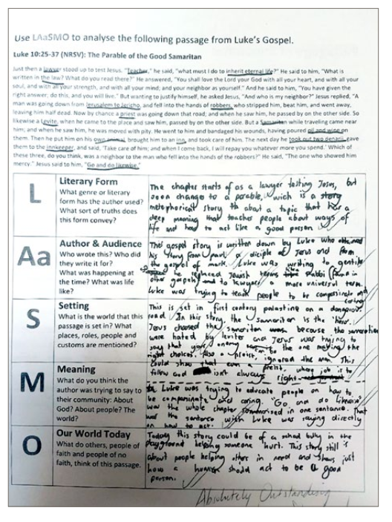
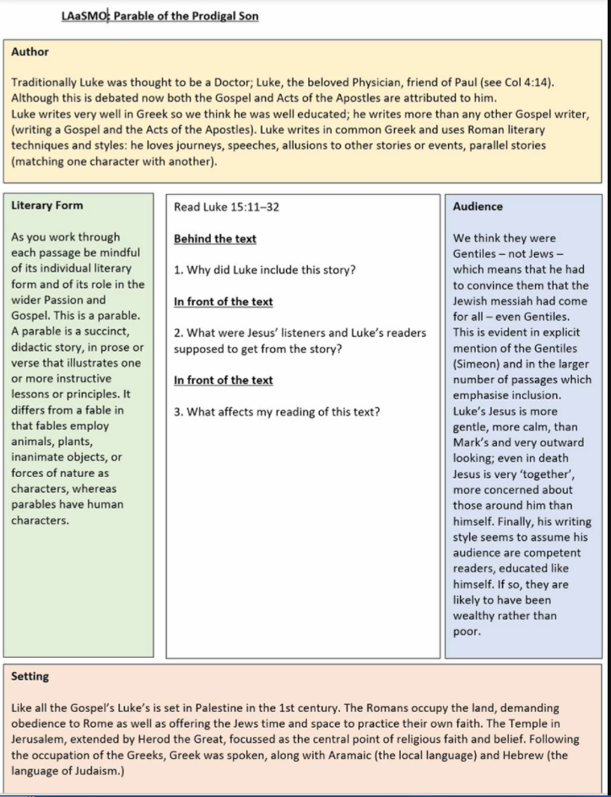

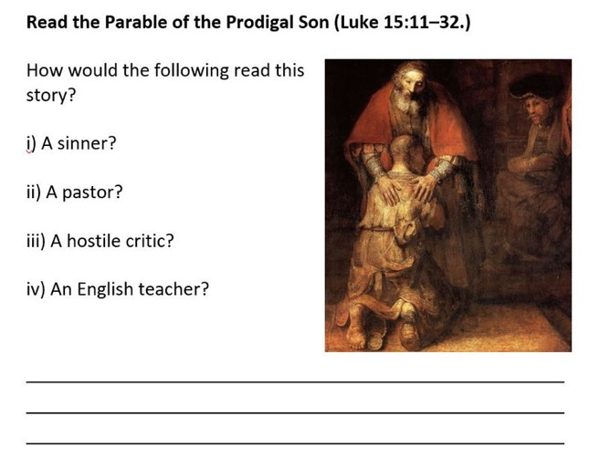
Have a go at LAaSMO!
Taken from: https://www.philosophycat.org/post/hermeneutics-in-the-classroom

Slide 8
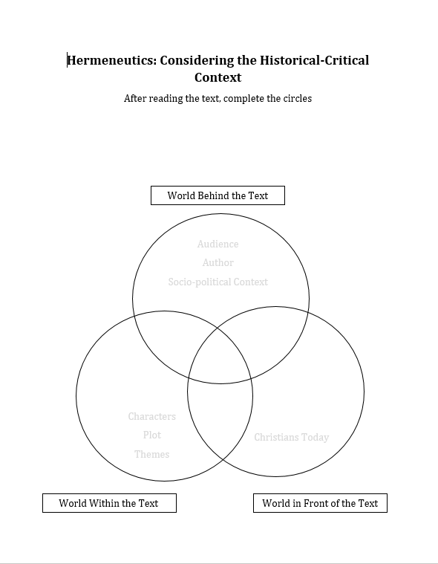


Practical Ways to Include Hermeneutics
Use videos from The Bible Project to support your own subject knowledge and pupils understanding about text
Use online translations like Quran Explorer
https://bibleproject.com/explore/

Slide 9
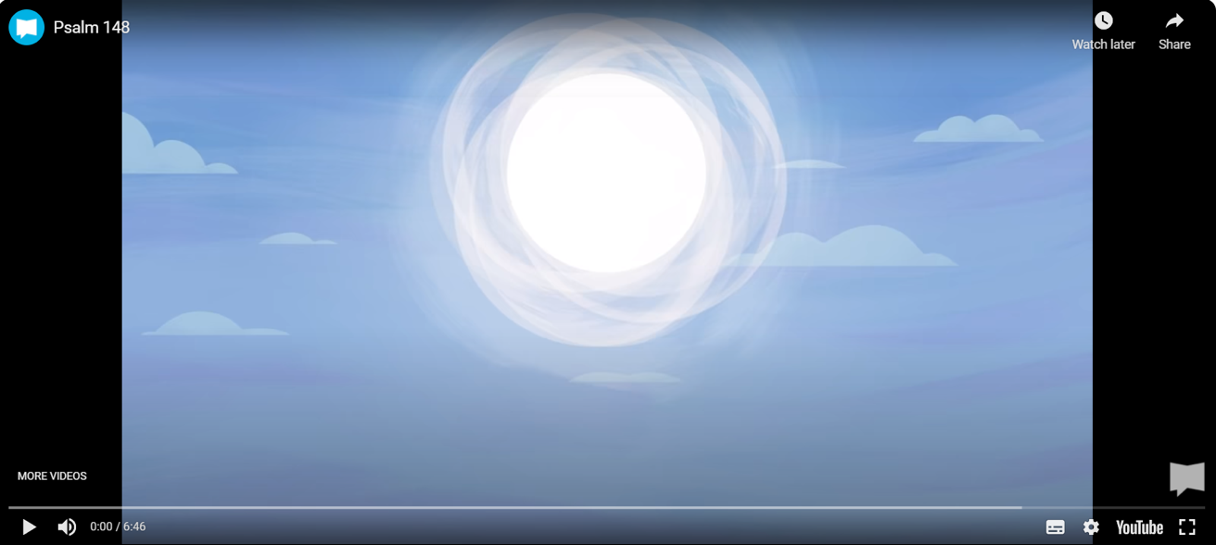
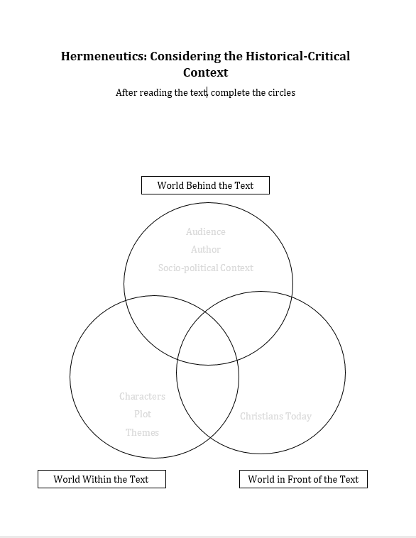
Have a go!
https://bibleproject.com/explore/video/psalm-148/

Slide 10
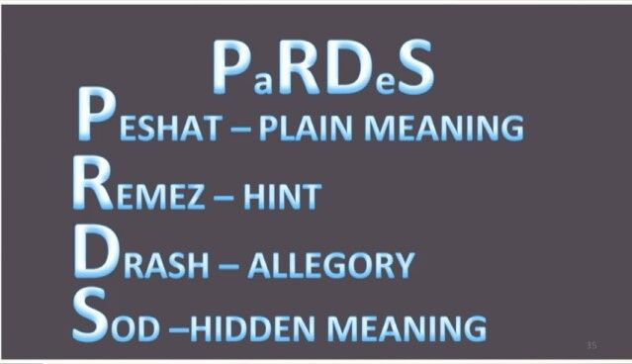
Practical Ways to Include Hermeneutics
Peshat (" — )פְּ שָׁ טplain" ("simple") or the direct meaning.
Remez (" — )רֶ מֶ זhints" or the deep (allegoric: hidden or symbolic) meaning beyond just the literal sense.
Derash ( — )דְּ רַ שfrom Hebrew darash: "inquire" ("seek") — the comparative (midrashic) meaning, as given through similar occurrences.
Sod (( )סוֹדpronounced with a long O as in 'bone') — "secret“ ("mystery") or the esoteric/mystical meaning, as given through inspiration or revelation.
Jewish Torah exegesis focusing on multiple interpretations
Discuss: Can anyone access a sacred text in this way? How would a Jewish faith community approach the Torah compared to a Christian or a Muslim?
See Jacob & Esau resource from Coventry Cathedral

Slide 11
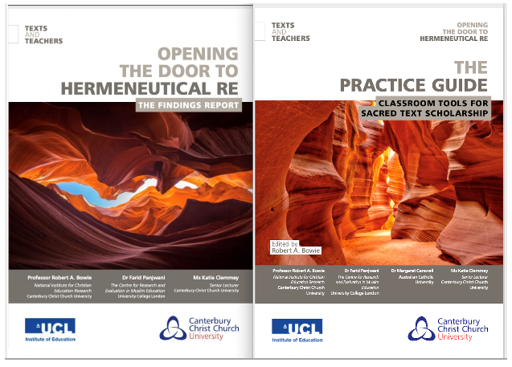
Top Resources: https://blogs.canterbury.ac.uk/nicer/teachers-and-texts-report/ https://bibleproject.com/ https://www.philosophycat.org/post/hermeneutics-in-the-classroom https://www.biblegateway.com/resources/commentaries/?source=1 https://www.biblestudytools.com/commentaries/ http://www.quranexplorer.com/ http://www.rec.bne.catholic.edu.au/Pages/Theological-Background-Search.aspx https://www.bl.uk/sacred-texts/themes/sacred-texts https://www.hisour.com/hermeneutics-49362/

