Slide 1

Hermeneutics for RE
Knowledge as Interpretation
Jennifer Jenkins, RE Facilitator for Coventry & Warwickshire

Slide 2
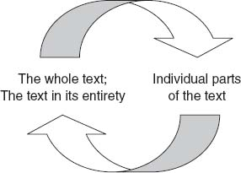

Art-Based Approaches for RE
image
The image
image
Hermeneutics Part 4:

Slide 3
Text is not the only thing subject to interpretation within your RE classroom.
Religious art offers another opportunity to engage with hermeneutics and consider interpretation.
Understanding the mesh of interpretation & what lies behind, beneath and in front of religious art

Slide 4
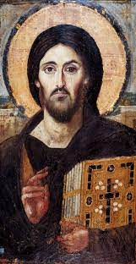
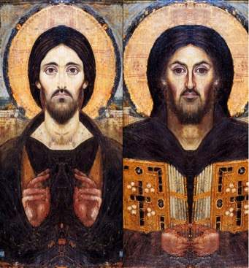
An artist shares a particular worldview with us in the same way an author does.
They have interpreted the world in front of them in a certain way, shaped by specific influences and made specific choices about media, colour and texture to convey that interpretation to us.
At the same time, we interpret religious art through our own worldview, bringing our own experiences of art, religion, faith, to what we see in their work. Nobody sees the exact same painting as the next person in the same way nobody reads the exact same text. We are unique, individual ‘interpretive animals’.
Providing/making small viewfinders can aid ‘really looking’
Creating paper glasses for younger children to wear when looking can really help pupils understand themselves as interpreter when viewing religious art
Notes:
https://commons.wikimedia.org/wiki/File:Spas_vsederzhitel_sinay.jpg
https://commons.wikimedia.org/wiki/File:Composite_christ_pantocrator.png

Slide 5
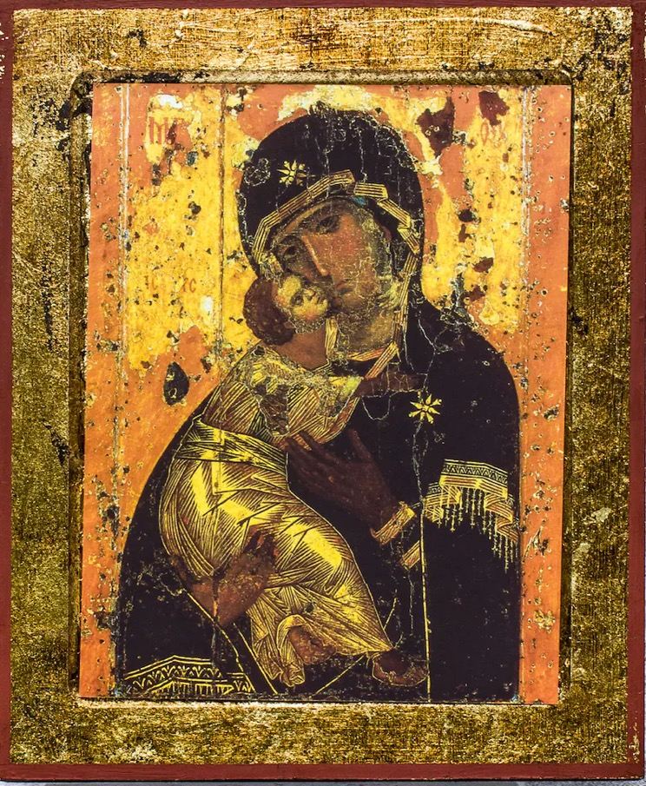
Modelling Engaged Viewing:
What do I need to know in order for me to understand this religious art?
Who painted this?
Who did they paint it for and why?
What is the historical-social setting (era, geographical location, politics, society) for this text?
How was this artwork regarded by the faith community of the time? What about now? Is there agreement about its merits and what it represents?
What style is this painted/sculpted in?
What do I need to know about art history to better understand this piece of religious art?
How can this artwork be interpreted alongside other pieces of art? Do other pieces help me to understand this one?
Notes:
https://commons.wikimedia.org/wiki/File:Virgin_of_Vladimir.jpg

Slide 6
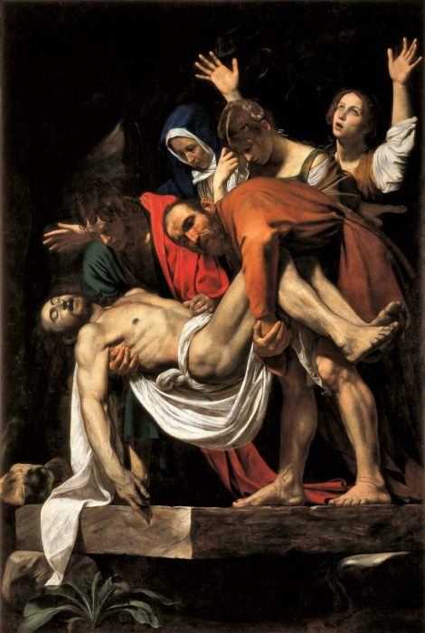
Encouraging Looking and Re-Looking:
What connections can you make between this piece of art and your own life and circumstances?
How does your own life circumstances and worldview bring you new insights into this piece?
Can you any tinted lenses (biases) through which you are looking at this piece?
How is your view and understanding of this piece related to that of a faith community?
The picture to the right is by Caravaggio.
A modern image by Ukrainian Jesuit Vyacheslav Okun echoes Caravaggio’s scene. In Okun’s piece, the figures are health workers in familiar PPE. We can’t reproduce Okun’s image for copywrite reasons, but you can see it here (entitled ‘Good Friday 2020’): https://twitter.com/jesuitsbritain/status/1261251249330098178
Unpicking Interpretation:
How is the artist’s worldview shown through this artwork?
How is this piece of art understood by people of faith?
How does this piece make connections with the viewer’s faith or worldview?
How might it be used by a person of faith/a person with no faith/different faith?
Notes:
https://commons.wikimedia.org/wiki/File:The_Deposition_of_Christ_(Caravaggio).jpg

Slide 7
Discussion Questions for Religious Art:
Where is meaning found? The artwork itself, the artist’s mind, the situation/circumstance which shaped and informed the art, the community that receives, views, engages with and interacts with the artwork, the mind of the viewer who encounters it for themselves?
How can we be responsible, conscious viewers of art?
Is the meaning of a piece of art fixed and enduring or can it change over time, with new interpretations emerging?
Can things be revealed through art work that the artist had no intention of conveying?
Can religious art be interpreted incorrectly and is this the case for all art?
What are the rules that govern the creation of religious art and why do these exist?
Would it be okay for a person to produce religious art that deviated from that accepted by religious communities? Where would such pieces have authority?
Choose a painting that has a modern resonance, maybe because it explores current questions and concerns, or relates to a current event.
A good example could be Nikola Saric’s ‘Martyrs of Libya’. This haunting piece recalls the 21 Christians murdered by IS in 2015. They have been declared martyrs in the Coptic Church.
We can’t reproduce the piece but you can find it here: https://www.nikolasaric.de/portfolio/martyrs-of-libya/?lang=en

Slide 8
Sources of Religious Art
https://www.50treasures.divinity.cam.ac.uk/
https://thevcs.org/
http://www.museumwnf.org/
https://www.metmuseum.org/toah/keywords/religious-art/
https://www.nationalgallery.org.uk/research/about-research/art-and-religion/art-and-religion
https://www.thrivent.com/art-collection/
http://www.methodist.org.uk/artcollection
https://fineartamerica.com/art/religion

Slide 9

What Next?
How can you bring hermeneutics into your RE classroom?
What adaptations can you make to the way text is used and studied in your RE lessons?
Where can you bring more religious art into your RE lessons?
How can you share today’s learning with other staff?
What do you still need some support/help with in order to make the leap from CPD to classroom practice?
Feedback in chat
Longer piece for blog posts on how used
Examples of pupils’ work

