Slide 1
Theologies of Reading
Christian approaches to the Bible
RESOURCES
What is Lectio Divina?
Using Lectio Divina in the classroom

Slide 2
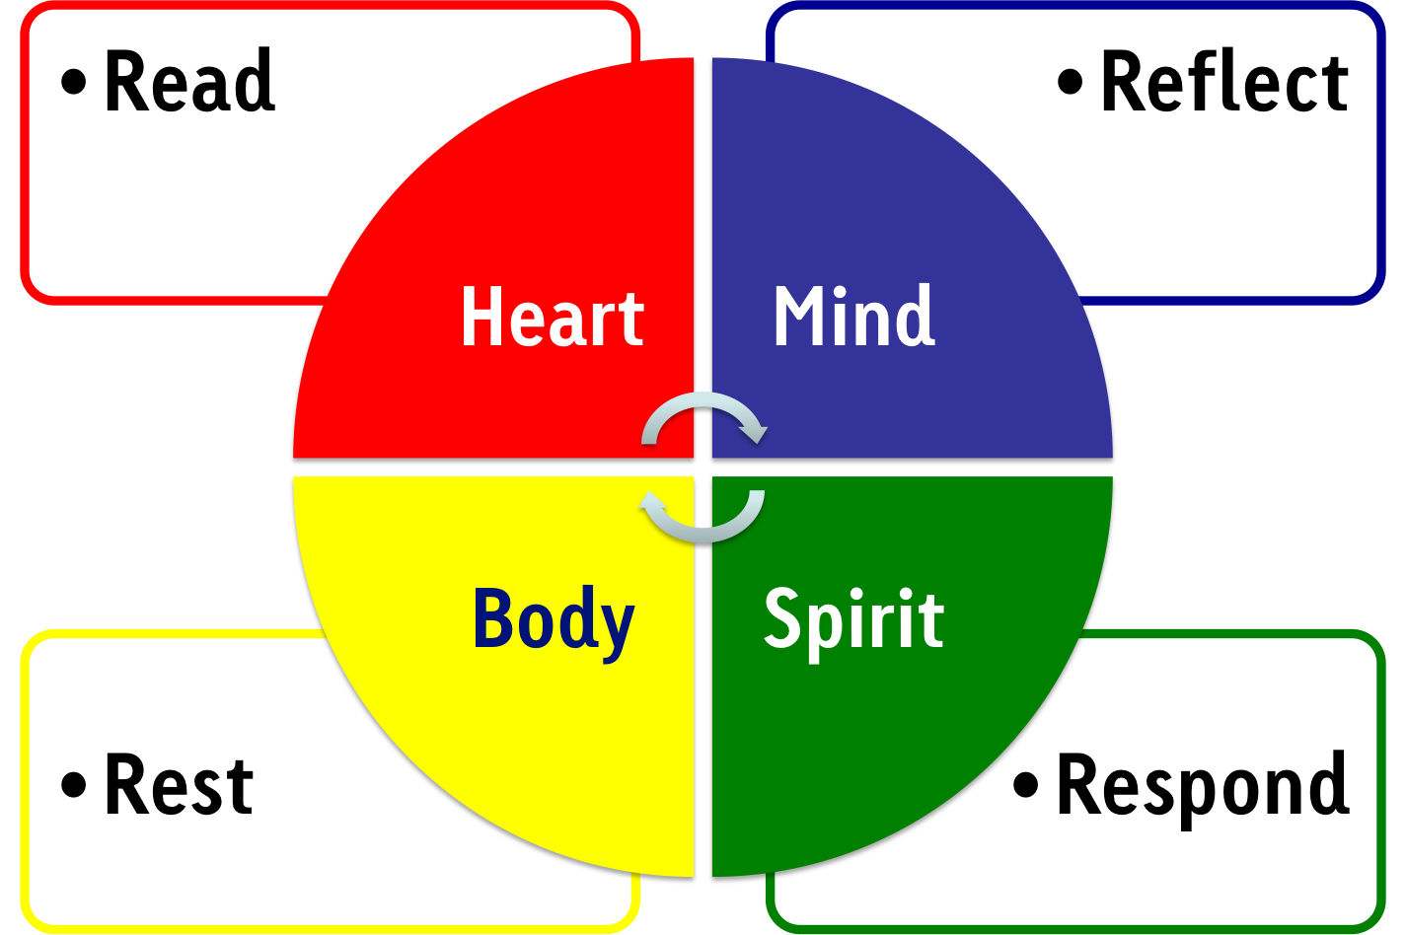
Lectio Divina (divine reading)
‘Lectio Divina is a contemplative way of reading the Bible. It dates back to the early centuries of the Christian Church and was established as a monastic practice by Benedict in the 6th century. It is a way of praying the scriptures that leads us deeper into God’s word. We slow down. We read a short passage more than once. We chew it over slowly and carefully. We savour it. Scripture begins to speak to us in a new way. It speaks to us personally, and aids that union we have with God through Christ who is himself the Living Word.’
Extract from ‘What is Lectio Divina?’ information sheet
Notes:
Resource: what is Lectio Divina?

Slide 3
Working with Lectio Divina
Rev Lindsay Yates, Chaplin at Westcott House, Cambridge, uses Lectio Divina in a group setting. She stresses the following before attempting group lectio:
It is an ancient method of Praying with Scripture.
It is based on the belief that Christ is truly present in Scripture and that the reading of Scripture allows God to speak
It is a receptive way of praying.
Biblical interpretation can be useful but engaging in lectio is not concerned primarily with ascertaining theological or doctrinal truths but listening to what God is saying through the text.
It is not a discussion and no one comments on what another person shares.
Group lectio involves an invitation to share but sharing is not compulsory.
Groups listen to what is shared in the belief that God communicates with through other members of the group
The quote on the previous slide is from a longer document; ‘What is Lectio Divina? Read more to find out
Try ‘Lectio Divina in the classroom’ guidance sheet…
Notes:
Resource: Lectio Divina in the classroom

Slide 4
Ambient Reading
This is a theory that focuses on the importance of the surroundings and context with which we read and how reading in different circumstances can really affect the way we interact with the text as readers. Readers are viewed as ‘makers’.
IN THE CLASSROOM:
Give pupils sections of sacred text and ask them to read it in different locations e.g. in the classroom, in the library with other books, outside, at home in their bedroom. Invite them to record how the text changes for them when read in different locations. Do different things seem more important or take on new meaning when the context for reading changes?

Slide 5
Practical Criticism
6 main assumptions of Practical Criticism:
Don’t be too concerned about authorship
History, context, etc come after the free personal judgement
Poetic language is not like ordinary language
Multiple valid responses are expected
Text offers a verbal analogue to experience and does not simply refer to experience
Reading necessarily involves appreciation
“Practical Criticism encourages reflective and close reading of individual texts, a kind of reading which dwells upon the artistry of particular passages and that artistry’s implications, or which examines those works’ arguments and rhetoric…Where practical criticism is understood tomean the exercise of close attention to writing, informed by historical understanding and imaginative response, the conclusions of which are then organised rationally in the service of a coherent argument. Inevitably, close reading of this sort invites students to articulate their own individual responses to texts, but these interpretations must then be presented under the light of reasoned and shareable day- i.e. by weighing up evidence and arguing the case for one’s particular judgements…”
L. M. Kilbride, University of Cambridge

Slide 6
Practical Criticism
Allow pupils to approach a sacred text in a non-threatening way…
Read through the text in your head or under your breath for and make note of any difficulties, moments of tensions, lines/words/phrases which really appeal or don’t appeal at all.
Write a few lines about it. Any favourite lines? Any parts you feel require further thinking? Any aspects of form which seem particularly striking, important or worth mentioning?
Share responses with the group.
‘Fill in’- providing historical information, important subject knowledge related to the text (substantive knowledge) or how it was formed (disciplinary knowledge)
Work in pairs: any further thoughts/comments based on what you now know?

Slide 7
Infographics
Infographic bibles are a great resource…
www.theinfographicbible.com/
www.harpercollins.co.uk/9780310520436/visual-theology
Choose a popular or well-known Biblical passage, book or story.
Compare to its presentation in an infographic bible.
What essential information is retained/lost?
Does it matter?
Can pupils create their own infographics based on given text?
Can they match infographics to different passages of text?

Slide 8
Read and
Respond
Providing a piece of text and asking pupils to read and then respond in some way could provide some interesting interpretations
For example, providing each group with one of The Beatitudes and then asking them to represent it through drama or tableaux would produce varied representation.
Equally, providing text and asking pupils to produce art or music in response could yield diverse and creative understandings of text.

Slide 9
Book of Hours
A ‘Book of Hours’ is a book of prayers appointed for particular canonical hours or times of day, used by Roman Catholics for private devotions and popular especially in the Middle Ages, when they were often richly illuminated.
Search on the internet for images of Books of Hours from Medieval Europe.
These are interesting when looking at devotional practices linked to texts as artefacts and how ownership is shown through annotation.
Get creative…
Invite pupils to create their own ‘Book of Hours’, selecting texts that mean something to them personally or texts along a given theme across traditions e.g. peace.
They could illuminate letters and add their own annotation.
Presenting texts in the centre of paper with plenty of room around it for annotation or silent debate is in keeping with this tradition of personal devotion.

Slide 10
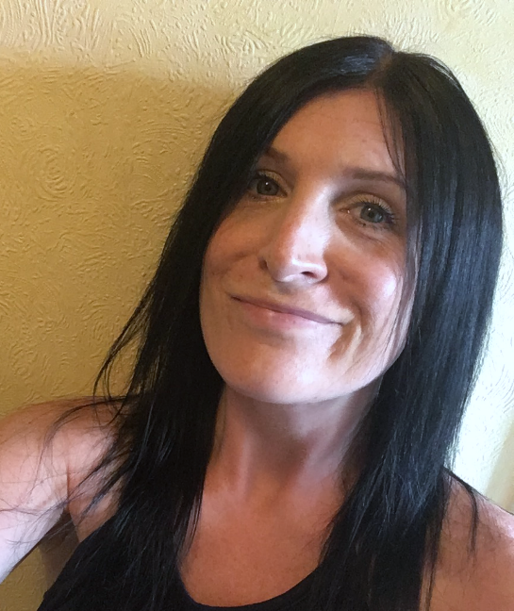

Jennifer Jenkins
RE Facilitator for Coventry and Warwick
Former assistant head teacher at a large primary school in Nuneaton. Former English subject leader (13 years) and Lead Teacher for Royal Shakespeare Company (2 years), as well as RE subject leader for 15 years.
Currently working one day a week as RE Facilitator for Coventry and Warwickshire on behalf of both SACREs working jointly and some work for Coventry Diocesan Board of Education. ICON School Project Manager for Coventry Cathedral. ICONS are schools awarded a Cross of Nails (a symbol of peace and reconciliation following the Coventry Blitz in November 1940) for their commitment to teaching children and young people how to be peace-makers and reconcilers.
Lover of all things literary and text-based and super fan of lifelong learning.

