Slide 1
Theologies of Reading
Jewish approaches to the Tanakh
RESOURCES
Fill in the gaps task
‘Kiss or bite?’ info sheet
YouTube lecture (slide 4)

Slide 2
Imagine you found this message on the pavement. The vowels are missing. What could this message say…?
PL_S L_T M_ L_V_
Notes:
Resource: fill in the gaps task

Slide 3
The Jewish scriptures, the Tanakh, was written without vowels.
This means there can be multiple interpretations of scripture.
Classical textual interpretations are made by rabbis and are called the Midrash.
The word Midrash means ‘textual interpretation’ or ‘study’, from the Hebrew ‘darash’ meaning ‘to seek’.
TORAH
Teachings
NEVI’IM
Prophets
KETUVIM
Writings
The lack of vowels matches Jewish belief that G-d’s speech produces multiple interpretations and that limiting scripture to one meaning, as in human texts, undermines God’s vastness. Human speech is narrow but G-d’s speech, through scripture, is wide. It gives rise to creative interpretations and the full expression of the human spirit.
TaNaKh
Jewish Bible
Torah + Nevi’im + Ketuvim

Slide 4
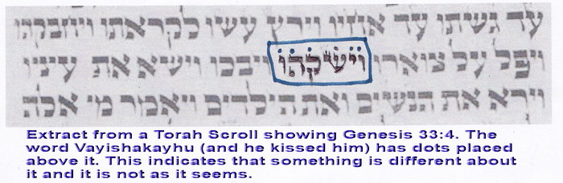
Midrash Interpretations
There are no limits to the number of Midrash interpretations, but they must stay true to the theological and ethical norms of the belief community. We find contrasting, often very different and creative, interpretations, all of which are considered valid.
In the Torah, there are 10 instances of puncta extraordinarie. They affect interpretation.
Puncta Extraordinaria (extraordinary points)
Extract from Torah scroll showing Genesis 33:4. the phrase ‘and he kissed him’ carries puncta extraordinarie, indicating that something is different about the word.
This word can mean ‘kiss’ or ‘bite’!
Notes:
Resource: Kiss or Bite? Information sheet
Lecture om this topic: https://www.youtube.com/watch?v=zIdnlOngxqE&feature=youtu.be

Slide 5
Midrash in the Classroom
This freedom and creativity is an opportunity to break out from grammar and allow pupils to interpret texts. Begin with the activity with missing letters and explain how Jewish scriptures were written and the openness to interpretation this provides, leading to the Midrash.
Give pupils a passage of scripture from the Tanakh (what Christians call the Old Testament) and invite them to interpret it. Moses with the Burning Bush or The Israelites Crossing the River Jordan would be interesting texts to use, but you could choose other texts.
Allow pupils to generate their own interpretations individually or in pairs. Then bring individuals/pairs together in groups to compare and contrast their interpretations. How similar/different are they?
Pupils must ensure their interpretations don’t break from Jewish theological or ethical norms, so an interpretation that resulted in 4 Gods or a God that is not omnipresent, omniscient, omnipotent would not be a valid interpretation.
Can pupils identify where their interpretations came from? Do they have experiences and existing ideas that have contributed to their interpretation? (Think schema and hermeneutics here!)

Slide 6
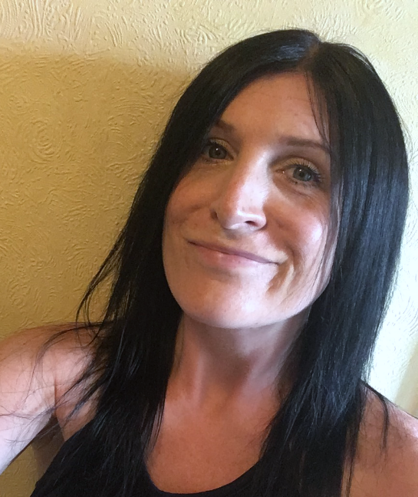
Jennifer Jenkins
RE Facilitator for Coventry and Warwick
Former assistant head teacher at a large primary school in Nuneaton. Former English subject leader (13 years) and Lead Teacher for Royal Shakespeare Company (2 years), as well as RE subject leader for 15 years.
Currently working one day a week as RE Facilitator for Coventry and Warwickshire on behalf of both SACREs working jointly and some work for Coventry Diocesan Board of Education. ICON School Project Manager for Coventry Cathedral. ICONS are schools awarded a Cross of Nails (a symbol of peace and reconciliation following the Coventry Blitz in November 1940) for their commitment to teaching children and young people how to be peace-makers and reconcilers.
Lover of all things literary and text-based and super fan of lifelong learning.

