Slide 1
Theologies of Reading
Approaches to Sacred Texts
in the RE Classroom
Jennifer Jenkins

Slide 2
INTRODUCTION
  How do you use text in RE lessons?
  Should text in RE be treated differently to text in other subjects?
  What is the purpose of engaging with texts?
  This introduction to ‘Theologies of Reading’ both offers improved subject knowledge as well as ways to handle text in the RE classroom.
  We will consider:
  the basic idea: the Theologies of Reading
  the idea of making meaning as we read, or ‘hermeneutics’
  how this can fit into the new Ofsted (May 2019) Framework.
  How these ideas can offer different ways of thinking in RE, in other words, a multidisciplinary approach
RESOURCES
RE Double Entry Journal
Schema Matrix
Reading glasses template
Notes:
Welcome to this presentation on Theologies of Reading. You can present to a group such as for a staff or department meeting, or work through in your own time. You can pause at any point although we suggest points at which a discussion makes sense.
Theologies of Reading describes the idea of meaning and interpretation in texts in RE. it also raises wider questions about meaning, understanding and reading more generally. This is a general presentation, three separate presentations exist focusing on Judaism, Christianity and islam specifically.
This presentation will take around 40 minutes to work through, allowing time to read, think and discuss.

Slide 3
1) Reading reflectively
Starter question: why do we read?
To gather information
To see from the author’s point of view
To gain an understanding of a particular time and place
To enrich our sense of the world
In this section we will look at techniques to allow slow, reflective reading and open up conversations about interpretation and meaning
Notes:
Firstly we will think about techniques to focus the attention on reading itself. This enables pupils to enter into discussions about understanding and meaning.
Pause this slide here. Discuss the starter q if you are in a group, or jot down your answer if alone: why do we read?

Slide 4
Bringing Reading into the RE Classroom
Make space for oracy and reading aloud, and time to discuss the reader’s positioning and pupils’ interpretations
Slow down the reading. Take time. Emphasise different words. Talk about their meaning and different interpretations. How does a different emphasis impact upon the meaning? What roles do our experiences play in influencing our emphasis?
Read in groups to develop a ‘community of inquiry’ within the classroom. Describe this as a place for shared wisdom. Consider what texts say to individuals and to the whole as a group.
Create class commentaries on texts; introduce commentaries made by others. Begin to see text along side commentaries. Evaluate interpretations of texts and discuss which ones are most convincing and why.
Compare different translations of the same text. Use first language texts for EAL pupils to support their access. View texts in their original languages: Arabic, Hebrew, Greek, Sanskrit, etc.
Discuss concepts of ‘truth’ and ‘meaning’ with pupils in relation to sacred texts. Invite them to write their own paraphrases of passages.
Consider the theology of fictional texts such as An Inspector Calls or The Lion, the Witch and the Wardrobe. Work together with the English department or co-ordinate RE and English planning to support pupils in greater access to these texts.
Based on findings of Dr Kathryn Wright
Notes:
The next three slides offer practical techniques for focusing the attention on reading itself.
These allow you to introduce conversations to the class about why we read, how we make meaning from text, and whether we all arrive at different meanings.
Pause and have a look at these techniques. Has your answer to the starter question changed?

Slide 5
Using a Double Entry Journal
Groups complete these as they read and discuss to yield a rich picture of the text and its meaning
From the Text | From Your Mind
What is the passage about? | What is your reaction?
List some interesting language | What is your theory or idea about this passage? What does it make you think about?
An important quote | What other stories or events does this passage remind you of?
What is the key moment or event in the passage? | What explanation can you give for why this passage/story is still read or retold today?
What is the main idea, theme or concept? | How important do you think this passage is to believers?
Is there a problem or conflict? If so, what is it? | What do other people in your group think about this passage?
Notes:
Resource: RE double entry journal

Slide 6
More Text-Based Classroom Ideas…
Text Hunt- match up two texts and might be linked together. How? (also match with images)
Oracy- The Bible is typically read alone when not read aloud to an assembled group. The Guru Granth Sahib is usually read together and treated as a person. How does it feel to read separately and as a group?
Strip back clues they are dealing with a religious text and set a reading task for homework.
Reading in pairs- two different colours. Pupils make their own highlights and annotation. What is similar and what is different?
Conduct a silent debate around a passage of text and a question. Pupils can write comments in one colour and question other comments in another.
Look at 4 translations of one text. What is retained in all? How do they differ in emphasis?
Emojji translation to represent a line of text.
Paraphrasing lines/passages into their own words. How are these similar/different across the class? What seemed to be the essential ideas to convey?
Explode a text: pull out key words and phrases, add images and own ideas/interpretations about meaning.

Slide 7
Looking at Original Manuscripts
Bring ancient texts to life
Check out these sites where you can explore texts in original (or ancient) versions:
https://www.divinity.cam.ac.uk/news/50-religious-treasures-of-cambridge
Religious Treasures of Cambridge: to support learning at KS3
https://thevcs.org/
The visual Commentary on Scripture explores biblical teachings through works of art.
https://www.bl.uk/sacred-texts
Sacred texts at the British Library; large annotated images.
Activity suggestions:
Find 3 images that could act as commentary or response to a given text/verse
Find one image to go with a specific text and explain your choice
Find two different types of text, such as a Bible in two languages, to show diversity
Notes:
When considering sacred texts in RE, it is always useful to give pupils as much context as possible. Show them images of ancient texts, the original languages they are written in or precious fragments that survive in museums. Give some historical context to these texts, such as the era they were created in, the place, the languages, who created them, and so on.
Pause at this point and have a look at these websites. Brief activities are suggested. How can you use these websites?

Slide 8
2) Working with meaning and interpretation
Starter question: how do we work out a text’s meaning?
The text communicates the meaning
Text communicates several meanings, which we can then consider
We need to know something of the author’s context to grasp a text’s meaning
The text interacts with each reader uniquely to yield countless meanings
In this section we will consider ideas about the relationship between reader and text and how a reader gains meaning from text.
Notes:
In this second section we come to questions about meaning and interpretation. How do we make meaning from text? How can we know what the author meant? Is there one meaning or several?
Pause at this point and discuss or jot down your answer to this starter question.

Slide 9
Schema
THE SCHEMA MATRIX
The brain makes connections in 4 ways:
WORLD: the brain connects the text to your understanding of the world and people
MEDIA: the brain connects the impressions you have gained form the media about the particular text and the people associated with it
TEXT: the brain connects with your prior encounters with this specific text, varying forms of this text or other similar texts
SELF: the brain connects the text to your own beliefs, opinions, ideas and anything of personal significance in the text.
‘Schema’ is a developmental psychological idea, originally from Piaget, describing the way humans file information in the brain.
New information or ideas interact with information that is already there.
The word ‘dog’ takes someone straight to their ‘dog’ schema, which might be very different depending on the person; covering memories, associations, emotions and experiences as well as a definition of ‘dog’.
A reader will encounter text in their own way due to schema related to words, meaning and text itself.
Notes:
This slide introduces the idea of schema, you might have read about schema in Piaget or developmental psychology.
Now pause this slide and conduct an activity. Read the 4 elements of the Schema matrix: choose a word or idea and jot down your associations or connections to the word, connections through the world, the media, the text itself and your self .
Suggested words: school, religion, freedom, happiness, suffering or belief.
Resource: Schema Matrix

Slide 10
What is Hermeneutics?
Do we create our own meaning and project it into the world?
Does the way we read religious texts reflect our assumptions about religious books, such as whether we believe them to be sacred or not?
Hermeneutics is the study of interpretation of texts, particularly biblical and philosophical texts. It is an investigation into how humans make sense of the world and how humans communicate their ideas to others.
The word ‘hermeneutics’ comes from the Greek ‘hermeneuo’, which means ‘to interpret’.
Hermeneutical study considers the ‘lenses’ we bring to our reading, which shape the way we read and the understanding and meaning we glean from each reading encounter.
SCHLEIERMACHER’S PRINCIPLES
Friedrich Schleiermacher (1768–1834)) is seen as the father of hermeneutics. He proposes there is no difference in interpreting sacred texts and secular texts because the meaning of both texts is affected by its history and the interpretation of the reader.
Notes:
You might have heard of ‘hermeneutics’, it is an idea that is gaining currency in RE.
The word might be alarming, but it refers to how humans make meaning. Schleiermacher was important in suggesting that sacred texts are just as open to interpretation as non-sacred texts. Sacred texts don’t necessarily impart one clear message from heaven.

Slide 11
Schleiermacher and Hermeneutics
Schleiermacher talks about ‘lenses’. Lenses can be formed by life experiences, a belief system, prior experience of sacred texts, knowledge of classical allusions, cultural experiences, etc.
The act of reading brings another lens into play; the reader’s attempt to understand the meaning as meant by the author of the text. The reader reads through her own lenses, but is also engaged in trying to work out the author’s lenses, or experiences, beliefs and culture.
Empathy and intuition are our tools as we approach the concept of an author behind a text.
Some discussion questions:
What is at stake when we read a sacred text? Truth? Theology? Beauty? Meaning? This may be different for all who read the same text.
Can anyone say with authority what ancient sacred texts truly mean? Are all interpretations valid? How are interpretations affected by the time period we live in and the lenses that gives us?
‘Canon’- why are some texts considered more worthwhile than others?
Is there one transcendent meaning behind a text or a plurality of possible meanings?
Is authorial intent accessible? Are reader interpretations equally as valid as authorial intent?
Notes:
Pause and discuss these questions around meaning and lenses.
How can these questions be raised in the classroom?

Slide 12
Lenses as Disciplines
THEOLOGY: how does this religion/ worldview see the world, the universe, humans, the earth and human destiny?
We can looking at sacred texts through lenses more formal than individual experience and beliefs; the disciplines
A discipline is a way of understanding the world, from History to Physics. To look through a disciplinary lens is to learn a particular way of seeing, as well as increasing understanding of the world, to think like a historian or physicist.
Disciplines relevant to reading sacred texts (as well as religion and worldviews generally) are Theology, Philosophy and the social sciences, such as History and Psychology
Wright, Georgiou, 2018
PHILOSOPHY: how can we know what information is true, or reliable?
ETHICS (a branch of Philosophy): how can we know what is right and wrong, fair and just?
HISTORY: what do we need to know about the past to understand religion and worldviews today?
PSYCHOLOGY: what can we learn about human belief and behaviour that helps us understand human action in the world?
Notes:
Another way of approaching text is to look at it through different ‘lenses’. This is also an idea gaining traction in the RE world.
Choose a piece of text and discuss or reflect on how it might change, looked at through these lenses.
Eg: Genesis 1, Genesis 2, Psalm 23.

Slide 13
Echo Chambers
“An environment in which a person encounters only beliefs or opinions that coincide with their own, so that their existing views are reinforced and alternative ideas are not considered.”
(https://www.lexico.com/en/definition/echo_chamber)
Can you suggest examples of ‘echo chambers’ in today’s media?
Is it possible that sacred texts are read and understood in ‘echo chambers’? Would this change the meaning of the text?
Could finding out about interpretations of a sacred text from another tradition or even another religion bring new understanding to people of faith?
Notes:
Pause and rad through the next 3 slides which suggest further ideas and questions about exploring meaning in the classroom

Slide 14

Grab Your Reading Glasses
Questions for approaching a text with pupils’ ‘Reading Glasses’ on:
What does it actually say?
What do I think it means?
What is clear about it?
What is questionable?
What does it remind me of?
How would…read this?
What lenses do I bring to the text that affect my reading?
Notes:
resource: Reading glasses template

Slide 15

Drama Techniques to aid Reading
These rehearsal room techniques used by RSC actors to ‘get inside’ the text:
Hot-seating (interview, use lines from the text in 1st person)
Conscience alley (unpacking the subconscious, exploring bias)
Select one word each from a text to present as a company of 3 to demonstrate key meaning
Tableaux (representing a line, phrase or single word in freeze frame)
Word carpet (phrases and text on paper on floor, can also add images, take partner on tour with their eyes closed, impact of text on individual, write own notes, comments, questions)
Re-read with emphasis (tap the page for important words, step forward at important words to show ‘power’ of text)
Elongating different vowels (try recital with consonants clipped and vowels more elongated)

Slide 16

Questions to
consider
IMPACT
What are the ‘desired endpoints’? For example:
Pupils understand different ways in which texts have been, and can be, interpreted
Pupils understand texts have multiple meanings
Pupils progress in sophistication of understanding about texts
Pupils are aware of how their own ‘reading lenses’ effects interpretation
Pupils show increased religious literacy
INTENT
First, ask yourself, what is the intent, or purpose, behind the whole curriculum, and the RE curriculum within your school?
How does engaging with texts support the purpose of the RE curriculum?
IMPLEMENTATION
How can Theologies of Reading be implemented across the RE curriculum?
How could a deeper engagement with texts, interpretation and lenses be implemented across the RE curriculum?
EXAMPLES ON NEXT SLIDE
Notes:
The next three slides connect this topic with Ofsted.
How can intent, implementation and impact support richer, more engaging reading techniques? These slides give some suggestions.

Slide 17
Examples of Implementation
Different ways to approach reading:
Lectio Divina (Christianity)- slow and reflective reading
Recitation (Islam)- approaching the Qur’an as recitations revealed from God
Midrash (Judaism)- reading commentaries/ interpretation with the original sacred text
Translations and original languages
Find cartoon or infographic versions
Read together- create a group meaning
Use drama techniques to explore meaning (see RSC slide)
Take one text (poem, sacred text, creed, prayer…) and:
    Before reading: hook and orientation
    During reading: explore, explain, expose
    After reading: review and reflect
    Reading strategies: which, why, when?
    Inspiring writing
    Exploiting wider learning opportunities
    Using journals and floor books Framework taken from http://justimagine.co.uk/course/take-one-book-book-based-planning/
Move deeper into layers of interpretation
Approach texts from different angles
Cultivate an appreciation of words: mystery and power
Use text as a springboard into a unit of work

Slide 18
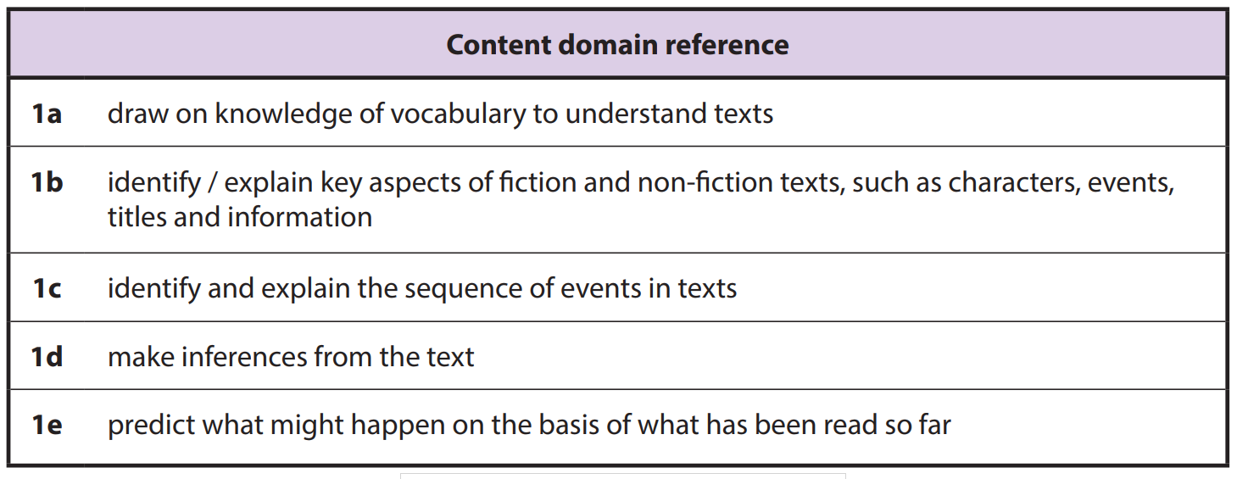
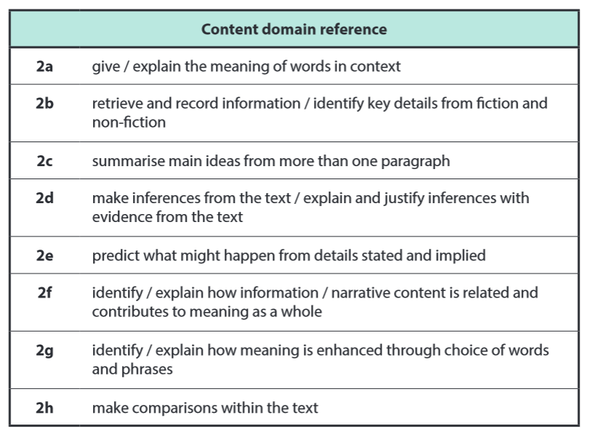
RE Reading and the Reading Content Domains for KS1 and KS2
Top Tip: Many of the techniques for approaching sacred texts support pupils in meeting content domains in the KS1 and KS2 reading curriculum. Having a text-rich RE curriculum contributes to developing learners as readers and brings academic rigour to RE.
Notes:
For Primary teachers, these last two slides show how Reading domains at KS1 and 2 can support reading in RE.

Slide 19
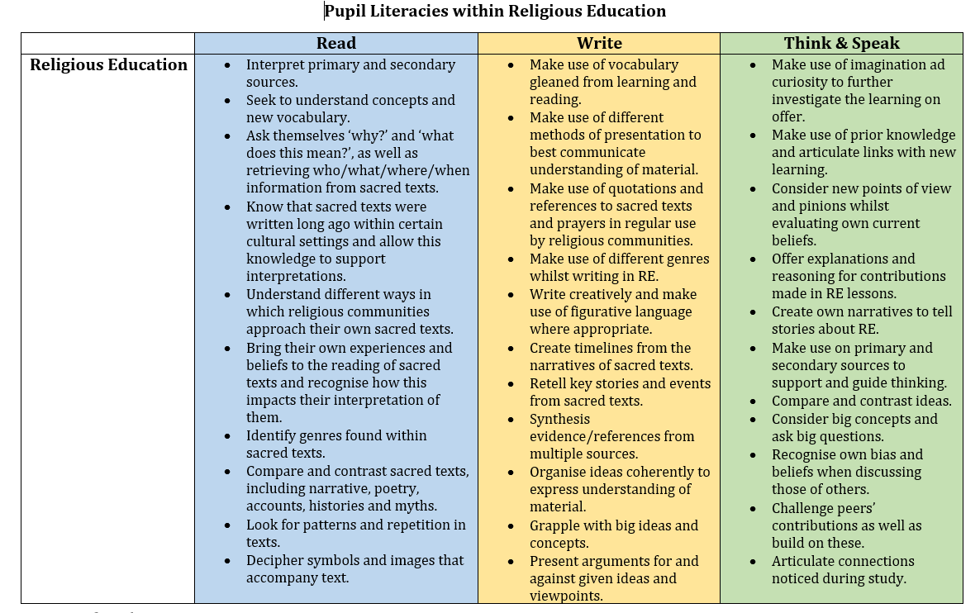
RE Students as Readers and Writers

Slide 20


Jennifer Jenkins
RE Facilitator for Coventry and Warwick
Former assistant head teacher at a large primary school in Nuneaton. Former English subject leader (13 years) and Lead Teacher for Royal Shakespeare Company (2 years), as well as RE subject leader for 15 years.
Currently working one day a week as RE Facilitator for Coventry and Warwickshire on behalf of both SACREs working jointly and some work for Coventry Diocesan Board of Education. ICON School Project Manager for Coventry Cathedral. ICONS are schools awarded a Cross of Nails (a symbol of peace and reconciliation following the Coventry Blitz in November 1940) for their commitment to teaching children and young people how to be peace-makers and reconcilers.
Lover of all things literary and text-based and super fan of lifelong learning.

