Slide 1
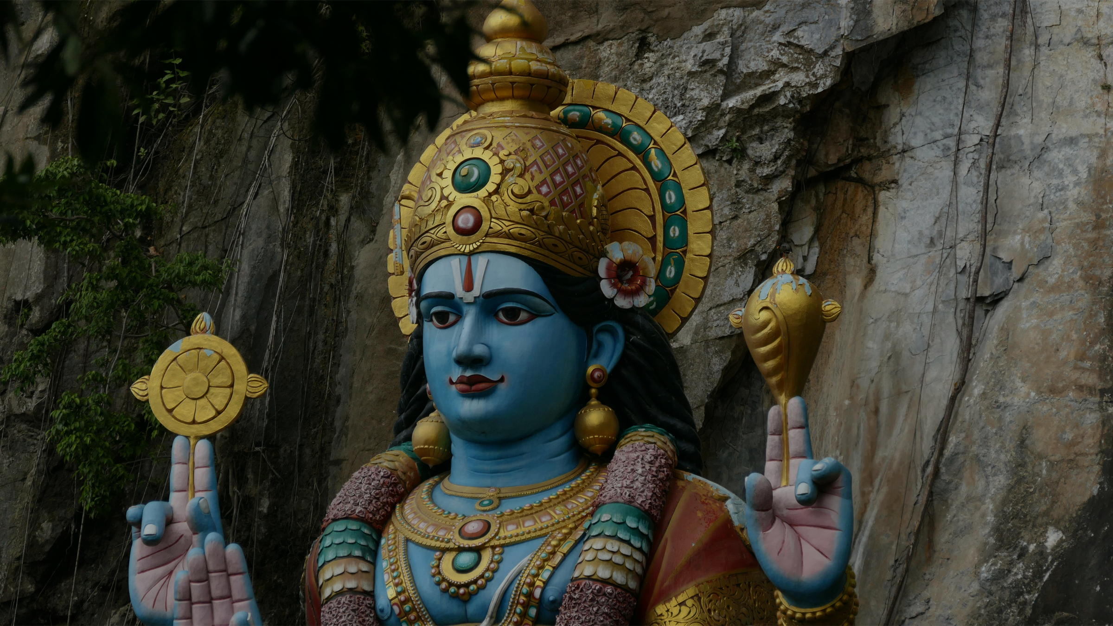
Rationale: What is RE? Why RE?
Rhiannon Love, University of Winchester & Lizzie Yeomans, Liverpool John Moores
Notes:
RE in this PowerPoint is used as an umbrella term for the name of the subject in all four nations of the UK, including RVE (Religion, Values and Ethics) in Wales and RME (Religion and Moral Education) in non-denominational settings in Scotland.

Slide 2




What is the first thing you see?
Notes:
Activity 1
Get trainees to consider what they first see and how this might have implications for RE?
Faces or vase?
Discuss on tables and then share with group.
Possible thoughts:
- Perception, interpretation, different ways of seeing the world, understanding different viewpoints etc
Discussion 6 or 9
– Just because you are right does not mean that I am wrong – you just haven’t seen life from my side.

Slide 3
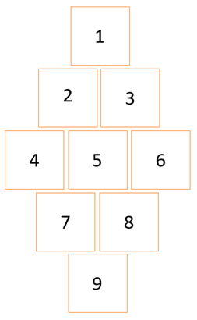
What is the purpose of RE?
To enable children/young people to hold balanced and well-informed conversations about religion and worldviews
To prevent extremism and radicalisation
To help children/young people work out how to live a good life
To inspire life-long
engagement with
and/or study of
religions and beliefs
To pass on the truth
and traditions of a
particular faith or
belief system
To enable
children/young
people to explore the meaning of their existence and their purpose in life
To promote spiritual,
moral, social and
cultural development
To enable
children/young
people to flourish as citizens in a
pluralistic and global community
To equip
children/young
people with
knowledge and
understanding of
religion and
worldviews
Once activity is completed, watch short video - https://youtu.be/-A9szVaN-wo
Notes:
Activity 2
In small groups the students discuss and create a Diamond 9 on the Purpose of RE (1 = most important purpose)
Statements to be printed on cards and sets given to each table.
Important considerations for each statement:
To be equipped with knowledge and understanding of a range of religions and world views – a key purpose of RE
To enable children to hold and informed conversation about religion and belief - a key purpose of RE
To enable children to flourish as citizens in a pluralistic and global community - a key purpose of RE
To enable children to explore the meaning of existence and their place in the world – a key purpose of RE – links with Ofsted ‘personal knowledge’
To promote spiritual, moral, social and cultural development (SMSC) – strong links, and good RE should develop this, but not key purpose
To inspire lifelong engagement with and/or study of religion and beliefs – possible outcome of RE
To help children work out how to live a good life - – possible outcome of RE, but careful not to infer that you need a religious worldview to have a good life
To prevent extremism and radicalisation – whilst RE might contribute to this, NOT key purpose
To pass on the truth and traditions of a particular faith or belief system – NOT the purpose of RE – the key issue here is the word truth – we do not hold one religion to have truth
Diamond Nine activity (adapted from RE Today (2016) Understanding Christianity, Birmingham: CEP)
Watch short video which starts to unpick a new vision for RE, that will be picked up in subsequent slides

Slide 4

Is the UK a Christian country today…?

Slide 5
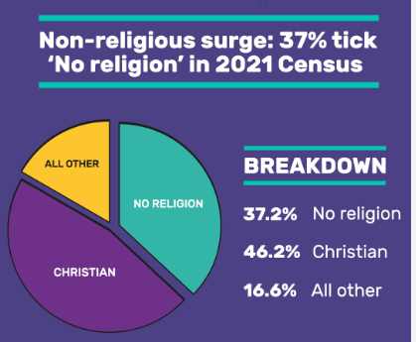
What does the 2021 census tell us about religion in England and Wales?
Notes:
Across England and Wales, 46% of people identified as being Christian, 37% said they had no religion, 6% identified as Muslim, and 2% identified as Hindu. Around 2% identified as being Buddhist, Sikh, Jewish or of another religion​
​
Key point – as the identification with organised religion is dropping, the growth in identification with non-religious worldviews is increasing – this has implications for the classroom.

Slide 6
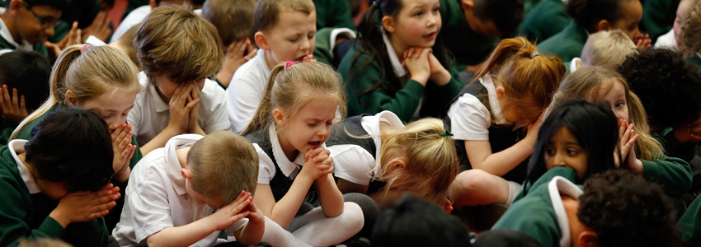
What are your experiences/memories of primary RE...?
…does it look like this?

Slide 7
True or false?

Slide 8
RE is part of the National Curriculum in England
RE is part of the Statutory Curriculum, which is:
The National Curriculum (5-16)
Religious Education (?-?)
Sex Education (11-18)
Notes:
This is the current situation (June 2026) in England.
Religion, values and ethics (RVE) is part of the stautory Curriculum for Wales, sitting within the Humanities Area of Learning and Experience (Area) .
In Scotland, within the Curriculum For Excellence, the religious and moral education (RME) curriculum area includes the two distinct areas of religious and moral education (non-denominational) and religious education in Roman Catholic schools.
The Curriculum and Assessment Review (2025) Has recommended that RE be brought into the National Curriculum in England, and this may be included in the Government's consultation during 2026
In England:
The LA has a responsibility to ensure that a SACRE oversees an Agreed Syllabus:
LA maintained schools without a religious character (community schools) must follow their locally agreed syllabus
Schools with a religious character are free to set their own syllabus
Non-denominational Free schools/Academies may choose to follow the Locally Agreed Syllabus
Special schools are free to adapt the curriculum to suit the needs of their pupils

Slide 9
RE is part of the Early Years curriculum
RE is not a named subject, but is covered under ‘Understanding the World’
Notes:
The Quality Framework for Early Childhood Play, Learning and Care in Wales focuses on the needs of the developing child (0-3) through five developmental pathways, which are not subject based.
From Age 3-16 the curriculum for Wales includes RVE as part of the Humanities Area of Learning and Experience (Area)
In Scotland RME is part of the curriculum from 3-18

Slide 10
RE must be provided by all schools
RE must be provided for children in all maintained schools.
Independent schools do not have to provide RE (although most do)

Slide 11
RE must be provided for Sixth Formers
Schools are obliged to provide a programme of Religious Education for all 11-18 year olds (…although many don’t bother in Sixth Forms!)
Notes:
In Scotland RME is a compulsory part of the curriculum from 3-18.
Post-16 RVE is optional in Wales

Slide 12
Parents can withdraw their children from RE
Parents have the right to withdraw their children from RE
They don’t need to give a reason and schools must agree
Sixth Formers over the age of 18 can withdraw themselves
Notes:
Again, this is the case in England.
In Wales there is no longer a right to withdrawal.
In Scotland Parents no longer have the right to withdraw a child from religious education since the Children (Withdrawal from Religious Education and Amendment of UNCRC Compatibility Duty) (Scotland) Bill became law on 2nd April 2026.

Slide 13
Collective worship is part of RE
Collective Worship is a legal requirement.
It is separate from curriculum RE.
Notes:
In Scotland it is called Religious Observance.

Slide 14
Teachers have to teach RE
It is reasonable for a teacher to be expected to teach RE in a denominational school.
In other schools, they can refuse on grounds of conscience.

Slide 15
Teachers can express their own religious beliefs
Teachers are free to express their own religious beliefs.
They must be careful not to unduly influence their pupils, however.

Slide 16

Where do your ideas and beliefs come from?
Special texts or stories?
Positionality
Friends/ social media?
Faith?
Life Experience?
Parents/ Carers?
Media?

Slide 17
Positionality
Who do you turn to when you are scared or anxious?
Why do you think we exist?
What cultural traditions are important to you?
Where do you get your sense of right and wrong from?
What do you believe happens when you die?
Notes:
Allow time for the students to draw a stick person representing themselves in the middle of a page and to answer the questions listening to the music (E.g ‘Change’ by Big Thief). They may choose to just focus on one or may want to answer all. Some students find this an uncomfortable activity so its worth exploring that feeling with them. Allow this to be a private activity so they do not feel they have to share the answers.

Slide 18
Safe space activity
Who do you turn to when you are scared or anxious?
Now that you have thought of your responses, work in pairs.
Partner A. choose a question to ask partner B. Listen to their response. Say "Thank you for sharing with me. I found what you said about... really interesting." The partner B asks Partner A a question. Repeat.
Why do you think we exist?
What cultural traditions are important to you?
Where do you get your sense of right and wrong from?
What do you believe happens when you die?
Notes:
Allow time for the students to draw a stick person representing themselves in the middle of a page and to answer the questions listening to the music (E.g ‘Change’ by Big Thief). They may choose to just focus on one or may want to answer all. Some students find this an uncomfortable activity so its worth exploring that feeling with them. Allow this to be a private activity so they do not feel they have to share the answers.

Slide 19
What did this activity tell us about knowledge in RE?
assumptions
feelings
upbringing
facts
opinions
experiences
beliefs
Notes:
Knowledge is more than fact-finding in RE. It’s about understanding each other. Rejecting a dehumanising approach to people who are different from me. Understanding that I have a position and a culture – and I am not ‘just normal’. See Decolonising RE for more on this.

Slide 20

And finally...
‘To teach in a manner that respects and cares for the souls of our students is essential if we are to provide the necessary conditions where learning can most deeply and intimately begin. Throughout my years as student and professor, I have been most inspired by those teachers who have had the courage to transgress those boundaries that would confine each pupil to a rote, assembly-line approach to learning. Such teachers approach students with the will and desire to respond to our unique beings’ (hooks, 1994, p. 13).

Slide 21
This document has been produced by a group focusing on supporting Primary Initial Teacher Education convened by Culham St Gabriel’s. The group is made up of Helen Sheehan from Sheffield Hallam University, Rhiannon Love form the University of Winchester, Imran Mogra from Birmingham City University, Ruth Flanagan from the University of Exeter, Lizzie Yeomans from Liverpool John Moores and Fiona Moss /Paul Smalley from Culham St. Gabriel’s.
Rhiannon Love and Lizzie Yeomans led on this PowerPoint. ​

