Slide 1

Understanding our worldviews
Understanding our worldviews
Ruth Flanagan, University of Exeter & Rhiannon Love, University of Winchester
Ruth Flanagan
Rhiannon Love
Notes:
This is a very basic introduction to worldviews. For further information, do read: ‘Elton Chalcraft (Ed). (2024) ‘Teaching Religious Education and Worldviews creatively’. Routledge

Slide 2



Worldviews: What do you think they are?

Slide 3

Worldviews: What are they?
‘A big picture’
Ultimate stories
A map of the mind
Weltanschauung
Lenses or filters
Frameworks
Notes:
Here are some key definitions.
Weltanschauung is the German for worldview which was the first use of the term in Kant’s ‘Critique of reason’ (1790)

Slide 4

How worldviews “make sense” of our world
A range of metaphors are suggested for worldviews each with its own challenges.
Smart tech eye wear provides an example of glasses which are given information from a central data base to interpret and inform the wearer. Yet these can easily be removed, whilst worldviews cannot.
An internal database, such as in this Terminator clip, provides an example of an embodied experience of worldviews. The data base is from within informed by life experience (formal and informal education), ‘colouring’ the world that they encounter. This is harder to identify and cannot be removed.
Notes:
Smart tech eyewear, popularised in fictional books and films, such as the “Mission Impossible” franchise, which employ Smart Wear glasses with their augmented reality experience. These resemble sunglasses but contain the capability to perform real time cross-referencing against central databases to provide information on individuals, corporations or situations that the wearer finds themselves in. In a similar way worldviews provide individuals with information about the situations they are in – people they meet, places they go, norms of practice, value of events/interactions/individuals etc... Information is provided from a data base – what the individual has read, or been taught through informal (community, family norms, media) or formal means (through schooling) or has experienced themselves. These databases are constantly updated with new information received through education or life experience. These experiences or information can then alter the individual’s worldview to a greater or lesser degree.
This metaphor provides an effective picture of the interconnectedness of worldviews and their constantly evolving dynamic. The limitation of this metaphor lies in the fact that while these glasses may be removed, individuals cannot so easily detach their worldviews. Even so, they can be made aware of the influences that are constantly impacting their lives and, therefore, their worldview.
An internal database such as the robot in the Terminator films. In parts of the first film, the audience glimpses the world through the robot’s red eyes with all the information appearing from its database as and when he needs it.
This central database for us is populated by our life – we learn throughout our life: informally through friends, family, communities, social media, and formally through school, employment, government, laws etc…

Slide 5

Nobody stands nowhere
What is your view of the world?
What makes you who you are?
Nobody stands nowhere
(Emily Downe)
Notes:
https://www.youtube.com/watch?reload=9&v=AFRxKF-Jdos&feature=youtu.be
This animated film by Emily Downe unpacks the idea of worldviews and invites the viewer to consider how their own unique view of the world might co–exist with other, sometimes quite different, vantage points held by those around them.

Slide 6

How do we see below the surface?
“A worldview is a commitment, a fundamental orientation of the heart, that can be expressed as a story or a set of presuppositions (assumptions which may be true, partially true or entirely false) that we hold (consciously or subconsciously, consistently or inconsistently) about the basic construction of reality, and that provides the foundation on which we live and move and have our being.”
Sire (2004:20)

Slide 7
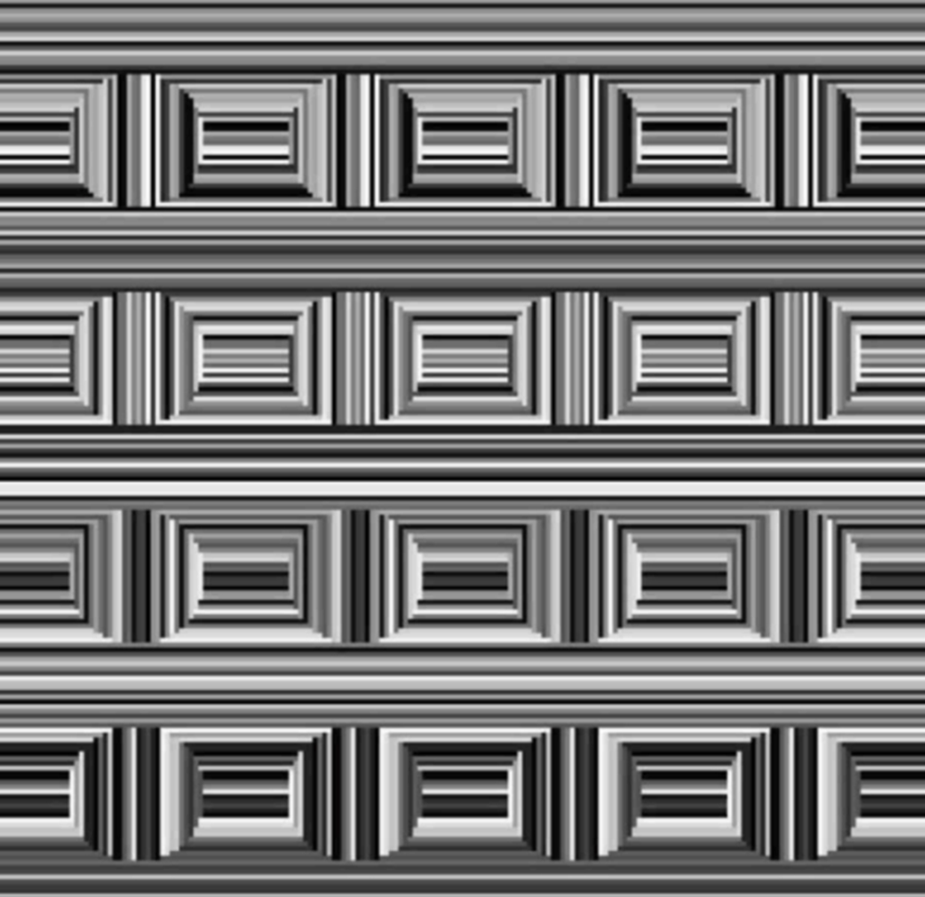
What do you see?
Culture literally changes how we see the world | Science | AAAS
Notes:
Circles or rectangles?

Slide 8
What do you see?
What do you see when you stare at this grid of line segments: a series of rectangles, or a series of circles? The way you perceive this optical illusion, known as the Coffer illusion, may tie back to the visual environment that surrounds you.
Anthony Norcia/Smith-Kettlewell Eye Research Institute
Culture literally changes how we see the world | Science | AAAS
Notes:
Circles or rectangles? For example, when presented with a grid of line segments that can be seen as either rectangles or circles—an optical illusion known as the Coffer illusion—people from the U.S. and U.K. almost always see rectangles first, and they often struggle to see circles. The researchers suspect this is because they are surrounded by rectangular architecture, an idea known as the carpentered world hypothesis. In contrast, the traditional villages of Himba people are composed of round huts surrounding a circular livestock corral. People from these villages almost always see circles first, and about half don’t see rectangles even when prompted.

Slide 9
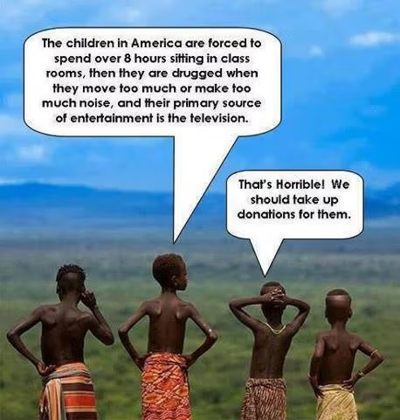
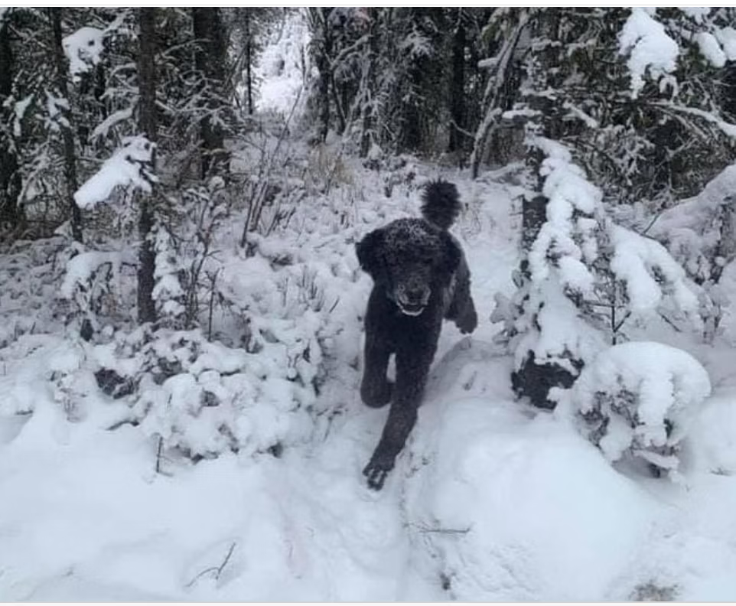
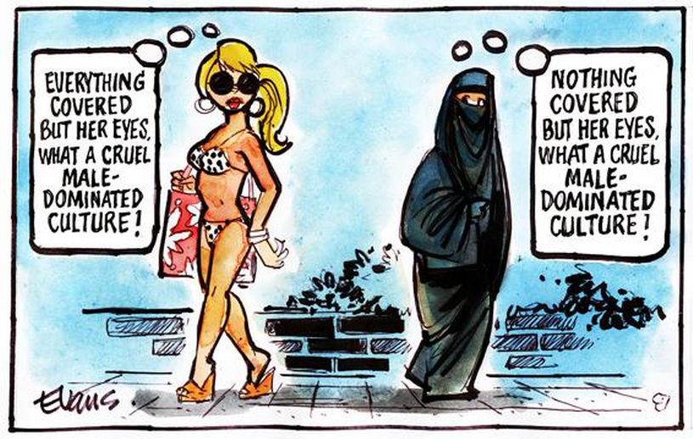
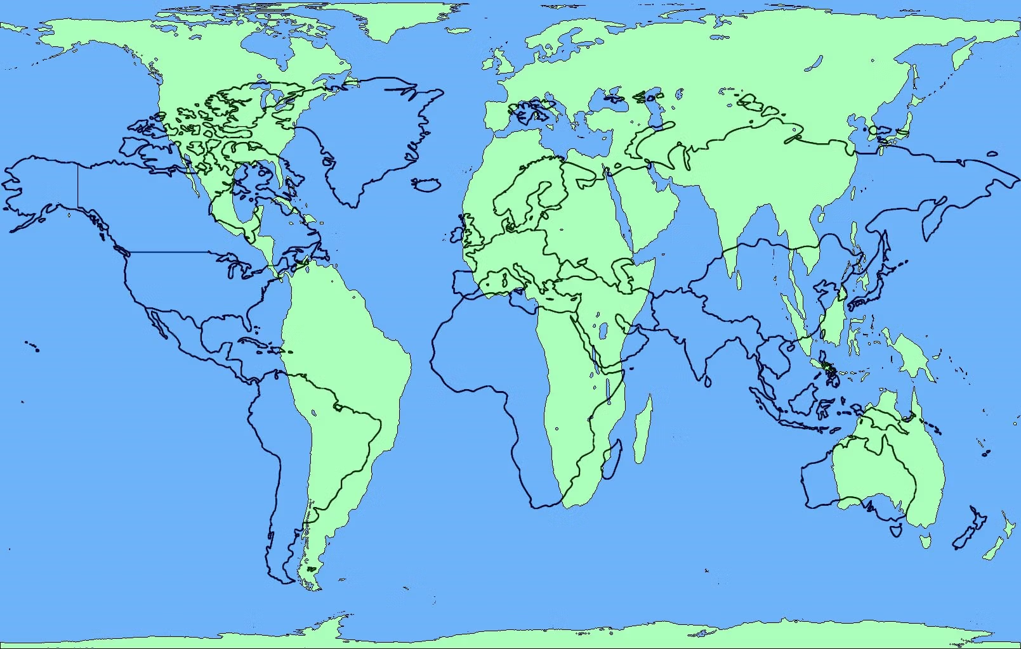
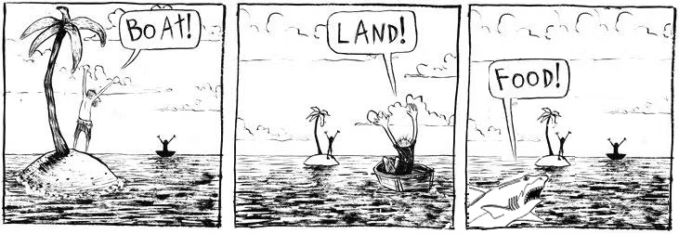
Activity: How do we identify worldviews
Examine this selection of pictures.
Can you see different perspective in each one?

Slide 10

Why focus on worldviews?
Enable teachers and students to understand:
people do not see the world the same;
no one is neutral;
everyone interprets the world.

Slide 11
Digging deeper
behaviour
belief
values
Notes:
When we look at, or encounter, an individual, we see only the external behaviour but not the values and beliefs beneath that behaviour.

Slide 12
Digging deeper
behaviour
Students should look at the teacher to show that they are listening
belief
Students should respect their teachers.
values
What a teacher says is important.
Notes:
We can sometimes have two individuals with the same beliefs, but they express that in different behaviours. This can lead to miscommunications. For example, a teacher reprimanding a student and the student refuses to look at them in the eye. The teacher sees that as insolence. However, the student believes it is important to respect the teacher but shows respect by bowing their head and not looking at the teacher, as that would be insolent.

Slide 13
Values/beliefs
What’s the difference?
They are interrelated but differences exist.
Beliefs: something that an individual holds to be true.
Values: something that an individual holds to be important.
(This may well connect to a belief.)
Notes:
V; integrity, respect, honesty,
B: all born equal,

Slide 14
Activity 1: Identifying elements of our personal worldviews
Why did you want to become a teacher?
What would make you vote for a war? Is there ever a just war?
What would make you want to remove a student from school?
Is it acceptable to lie?
Do you make any conscious decisions about shopping i.e. organic, fair trade, UK produce, local produce?
Notes:
Discuss this with a colleague or friend – are your answers the same or different? These questions can elicit elements of your worldview.

Slide 15
Activity 2
Try and map
out the beliefs
and values
beneath
your
behaviour.
behaviour
belief
values
Notes:
Pick one of your answers to the questions on the previous slide and place it on the 'behaviour' circle of this image.
Now consider what belief and value underpins this behaviour and write these in the respective places - see slide 13 for a simple distinction between values and beliefs and slide 12 for an example

Slide 16
Worldviews: Development and influence

Slide 17
How are worldviews formed?
Interaction
Life experience
Starting point
Change
Notes:
V; integrity, respect, honesty,
B: all born equal,

Slide 18

How are worldviews formed?
change
interaction
Time
experience
Start
Notes:
This is not a one-off process but a continual evolving process as the individual interacts with more texts/life experiences.

Slide 19
Can you identify how aspects of your worldview formed?
Can you identify any key moments of change for you?
Can you identify any key interactions that led to that change?
change
interaction
Time
experience
Start

Slide 20
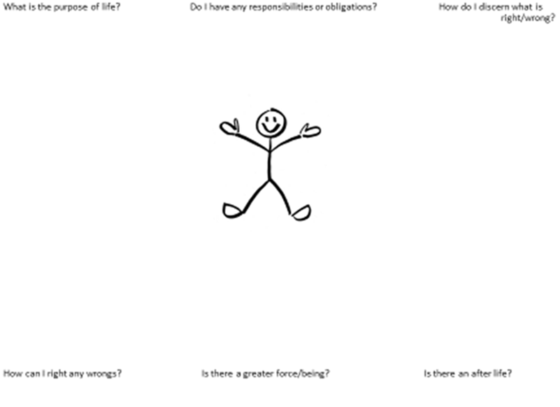
Identifying worldviews through ultimate questions
Notes:
Try and answer these questions – you may not have ever answered these before and you may have no answer for them. This is fine and is merely to help you reflect on ultimate questions which are seen as part of personal worldviews (Valk, 2009). When you come to investigate religious or non-religious worldviews you can see if they ask or answer any of these. This provides a simple framework to see similarities and differences.

Slide 21
Thank you for working through this PowerPoint!
This is a very basic introduction to worldviews. For further information, do read:
Elton Chalcraft, S. (Ed) (2024). ‘Teaching Religious Education and Worldviews creatively’. Routledge.
Flanagan, R. (2020). Worldviews: overarching concept, discrete body of knowledge or paradigmatic tool? Journal of Religious Education, 68(3), 331-344.
Valk, J. (2009) Knowing self and others: Worldview study at Renaissance college. Journal of Adult Theological Education, 6 (1), 69 -80.

Slide 22
This PowerPoint has been produced by a group focusing on supporting Primary Initial Teacher Education convened by Culham St Gabriel’s. The group is made up of Helen Sheehan from Sheffield Hallam University, Rhiannon Love from the University of Winchester, Imran Mogra from Birmingham City University, Ruth Flanagan from the University of Exeter, Lizzie Yeomans from Liverpool John Moores and Fiona Moss /Paul Smalley from Culham St. Gabriel’s.
Ruth Flanagan led on this PowerPoint.

